Slide 1
BE A VIBRANT CLUB
OUR CLUB LEADERSHIP PLAN
Notes:
Presenter’s Notes
Use the notes on these slides to help you give your presentation. In addition to providing background information, we’ve also included optional activities and questions you can ask members to get them involved in your presentation. Together with the Be a Vibrant Club publication, this presentation can help you get your members thinking about their club and what they can do to revitalize it.
Tailor the text to your audience’s needs.
Activity
Ask participants:
What is our club like? Is it lively and fun? Is it diverse and open to new ideas? Are our members actively involved?
How can our club become more vibrant?

Slide 2
WHAT IS A VIBRANT CLUB?
Engages its members
Conducts meaningful projects
Tries new ideas

Slide 3
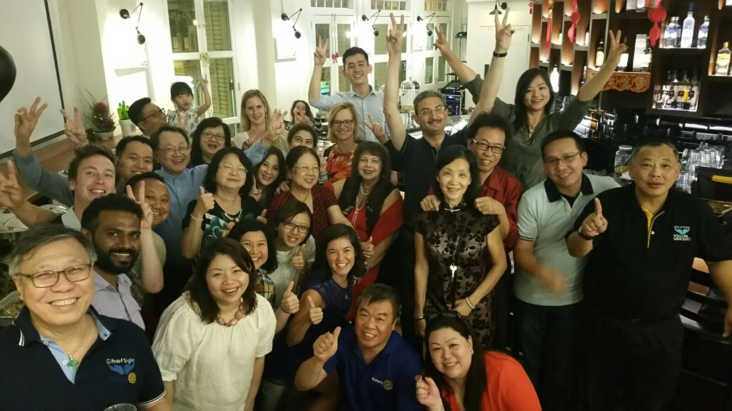
WHY IS THIS GOOD FOR OUR CLUB?
Notes:
What’s in it for us? Vibrant clubs are open to new ideas. They look for ways to stay relevant to their communities while meeting their members’ needs.
The flexibility that Rotary clubs now have makes it easier than ever to make changes that will enhance the club experience, attract new members, and keep current members involved.
On the following slides, we’ll look at some recommended best practices for vibrant clubs. As we go through them, I want us to think about how we might use them in our club.

Slide 4
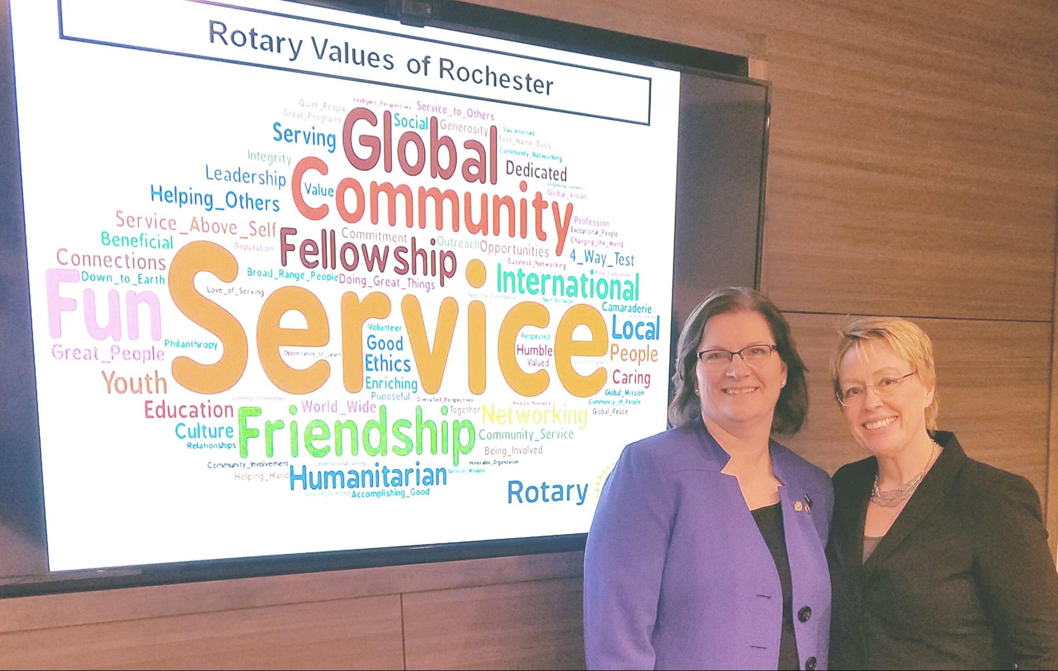
BEST PRACTICE:
MAKE LONG-RANGE PLANS
Notes:
What do we want our club to be like in 3-5 years? Do we want a more diverse membership? Are we interested in getting our community more involved in club activities? Or are we looking for ways to conduct more meaningful projects? Making a plan and setting goals that can be achieved in three to five years can help us achieve these objectives and more.
A strategic plan can help us capture our members’ priorities regarding the activities and ideas we want to keep, change, or implement to achieve our goals. An annual visioning session can help us assess our club and decide what needs to change.
Activities
Ask participants:
What’s your vision for our club?
What changes do we want to make?
What long-term goals do we want to accomplish in the next three to five years?
Give participants copies of Rotary Club Health Check and Strategic Planning Guide. Use the health check to identify your club’s strengths and the areas that need improvement. The Strategic Planning Guide can help you create a long-term strategy.

Slide 5
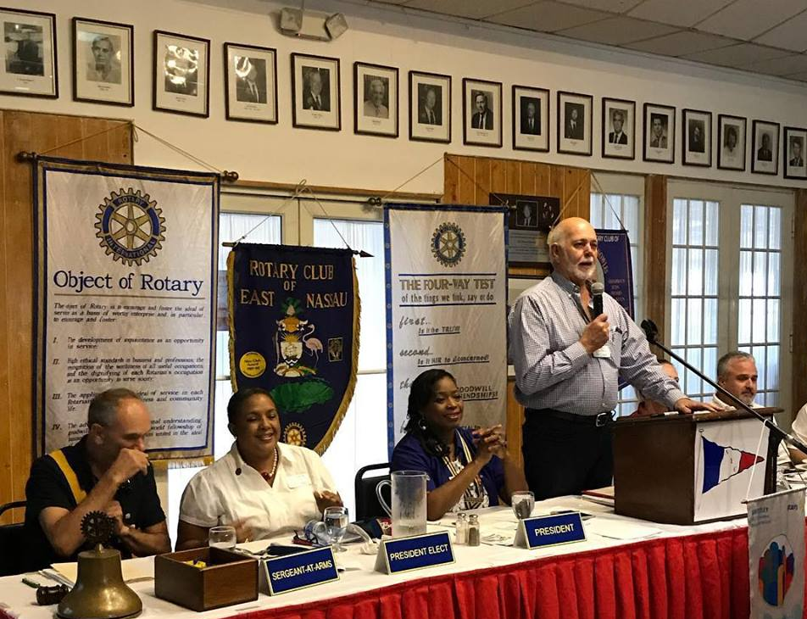
BEST PRACTICE:
DEVELOP ANNUAL GOALS
Notes:
It’s easier to achieve long-range goals when they’re broken into smaller annual goals. Rotary Club Central can help us transform our club’s vision into mini goals that we can achieve in less time.
Club leaders can also track our club’s progress toward our goals in Rotary Club Central and update our committees and members regularly.
Activity
Ask participants:
What are the club’s annual goals?
How were these goals set?
How can we use Rotary Club Central to set milestones toward achieving our long-range goals?

Slide 6
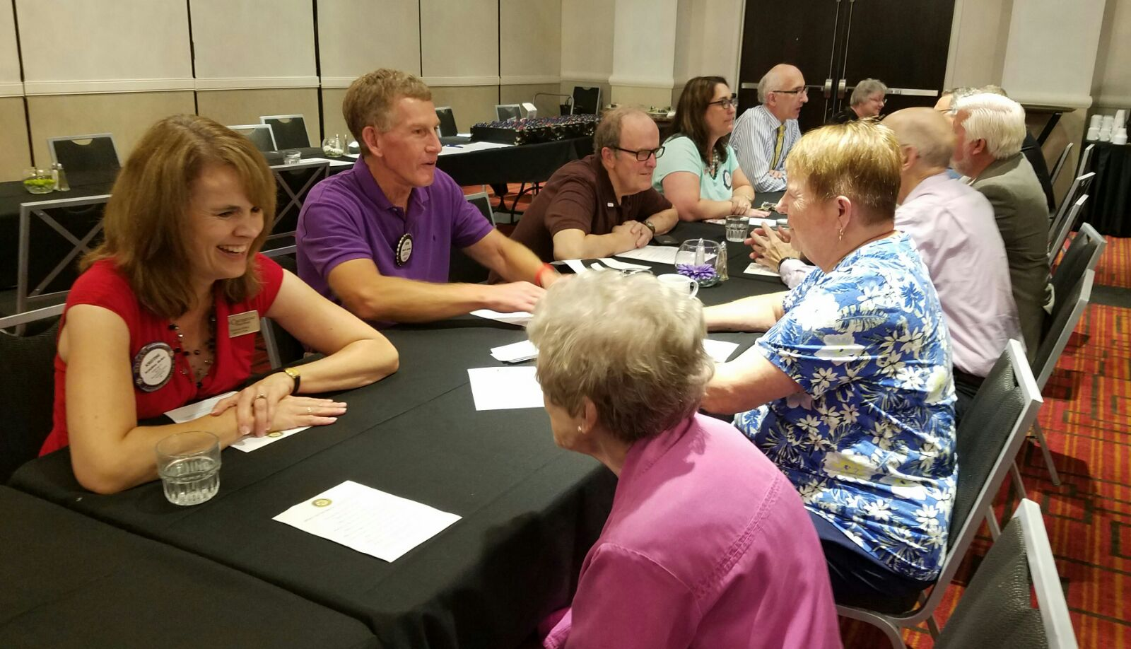
BEST PRACTICE:
HOLD ENGAGING MEETINGS
Notes:
Lively, informative meetings can get members excited about our club and keep them coming back.
We can make sure our meetings are engaging by using the Member Satisfaction Survey. The survey results can tell us what members like and don’t like about meetings and give us ideas for improving them.
One way to boost meeting attendance is to vary meeting formats. We could hold some meetings online or mix meetings with service projects or social gatherings.
Activity
Ask participants:
What makes a meeting engaging?
What do our members like about our club meetings, assemblies, and board meetings?
What could we improve?
What kind of meeting format could help our club engage or re-engage members?
Encourage club leaders to use these resources:
Member Satisfaction Survey
Understanding Why Members Leave: Exit Survey
Rotary Club Health Check: Is Your Club Healthy? (online course)

Slide 7
BEST PRACTICE:
HAVE A COMMUNICATION PLAN
Notes:
Every great strategic plan includes a good communication plan. Vibrant clubs are open to using creative methods to inform members and the community about the club and its activities.
Today’s digital world makes it easy to keep members informed. Skype, WhatsApp, and Facebook Live can all be used to communicate with members who can’t attend a meeting in person.
Social media can help us promote our club and its activities to our friends, family, and community members. It’s also a great way to show prospective members how we contribute to the community. It’s important to keep our club website and social media sites, like Facebook and Instagram, current.
Activity
Ask participants:
What do we do now that’s effective in keeping members informed and engaged? How can we improve it?
How often do we update our website?
How are we using the templates and resources in Rotary’s Brand Center to promote our activities to our community?

Slide 8
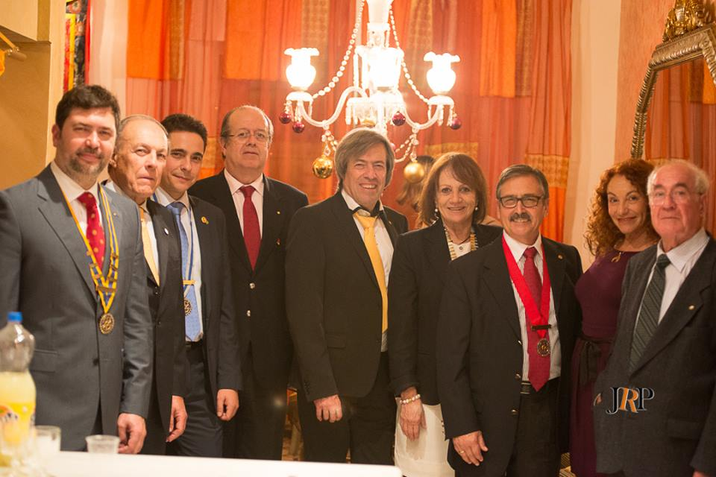
BEST PRACTICE:
PLAN TO MAINTAIN CONTINUITY OF LEADERSHIP
Notes:
To make sure our club achieves its long-range plan, we need leaders who’ve been involved, from the beginning, in setting goals and making decisions. Continuity in leadership can help. That means selecting club officers several years in advance and reporting them in My Rotary, so they can be involved in planning, get on-the-job training, and see reports in Rotary Club Central.
Activities
Ask participants:
Who will be our club leaders in the next Rotary year?
Current leaders: What helped you prepare for your term? What would have prepared you better?
Does our club have a leadership track — a way to identify potential leaders and develop their skills? If so, does it work? If we don’t have one, would it help?
Have small groups make a list of projects or processes that would benefit from having continuity in club leadership.

Slide 9
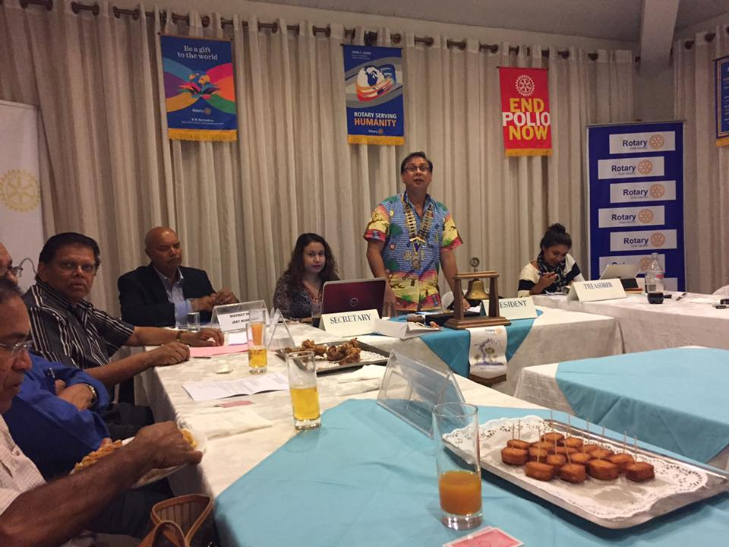
BEST PRACTICE:
ADAPT THE BYLAWS THAT SUIT OUR CLUB
Notes:
The recommended Rotary Club Bylaws are meant to be adapted by clubs. As our club evolves, our bylaws should reflect our current practices. Club members are encouraged to get involved in our annual review of club bylaws.
Activity
Have each member write one practice they’d like the club to stop and one they’d like the club to adopt.

Slide 10
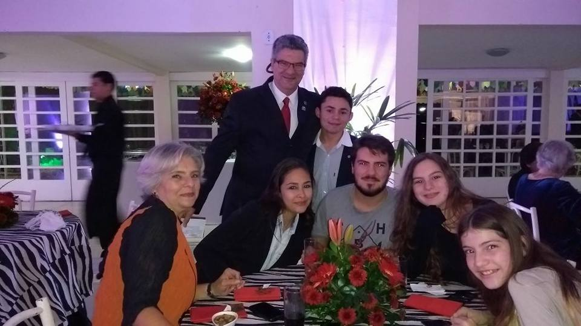
BEST PRACTICE:
DEVELOP RELATIONSHIPS WITHIN THE CLUB
Notes:
People who enjoy their clubs are more likely to be active members. One way to keep members connected to the club is to organize social and networking events that give us a chance to get to know each other better.
Activities
Ask members how they can create opportunities to get to know each other or develop professional connections. Record their responses on a flip chart.
Have each participant talk with another member they don’t know very well. Ask them to tell each other about something good that happened this week or something about themselves that people would be surprised to know.

Slide 11
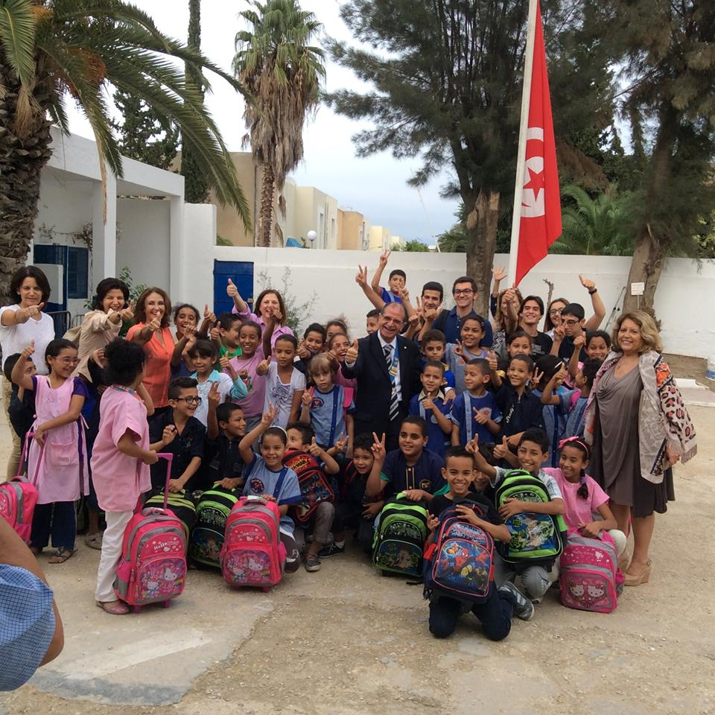
BEST PRACTICE:
MATCH MEMBERS ACTIVITIES TO THEIR INTERESTS
Notes:
Are members participating in activities that they genuinely care about? Members who are involved in activities they enjoy are often more committed to the club.
By surveying members regularly, we can find out what their interests are and plan activities that they enjoy. We can also encourage new members to get involved early by asking them to develop club programs and activities based on their interests.
Activity
Ask each participant to name a project they would like to participate in, and write their responses on a flip chart. Then choose one of the ideas and ask all participants to think of a skill they could bring to the project.

Slide 12
BEST PRACTICE:
COACH MEMBERS TO LEAD
Notes:
District meetings, new member orientation, online learning, and leadership development programs are all parts of a comprehensive training plan.
Appointing a club trainer (or, if the club is large, a training committee) can help make certain that new and current members receive the training they need. Members are encouraged to visit the Learning Center regularly to see what courses are available.
We can also use a survey to see which skills our members would like to develop. The Leadership in Action Leader’s Guide can help us design an effective training program.
Activity
Ask participants:
What training would you like our club to offer or participate in?
What training could be abandoned, combined, or radically changed?

Slide 13
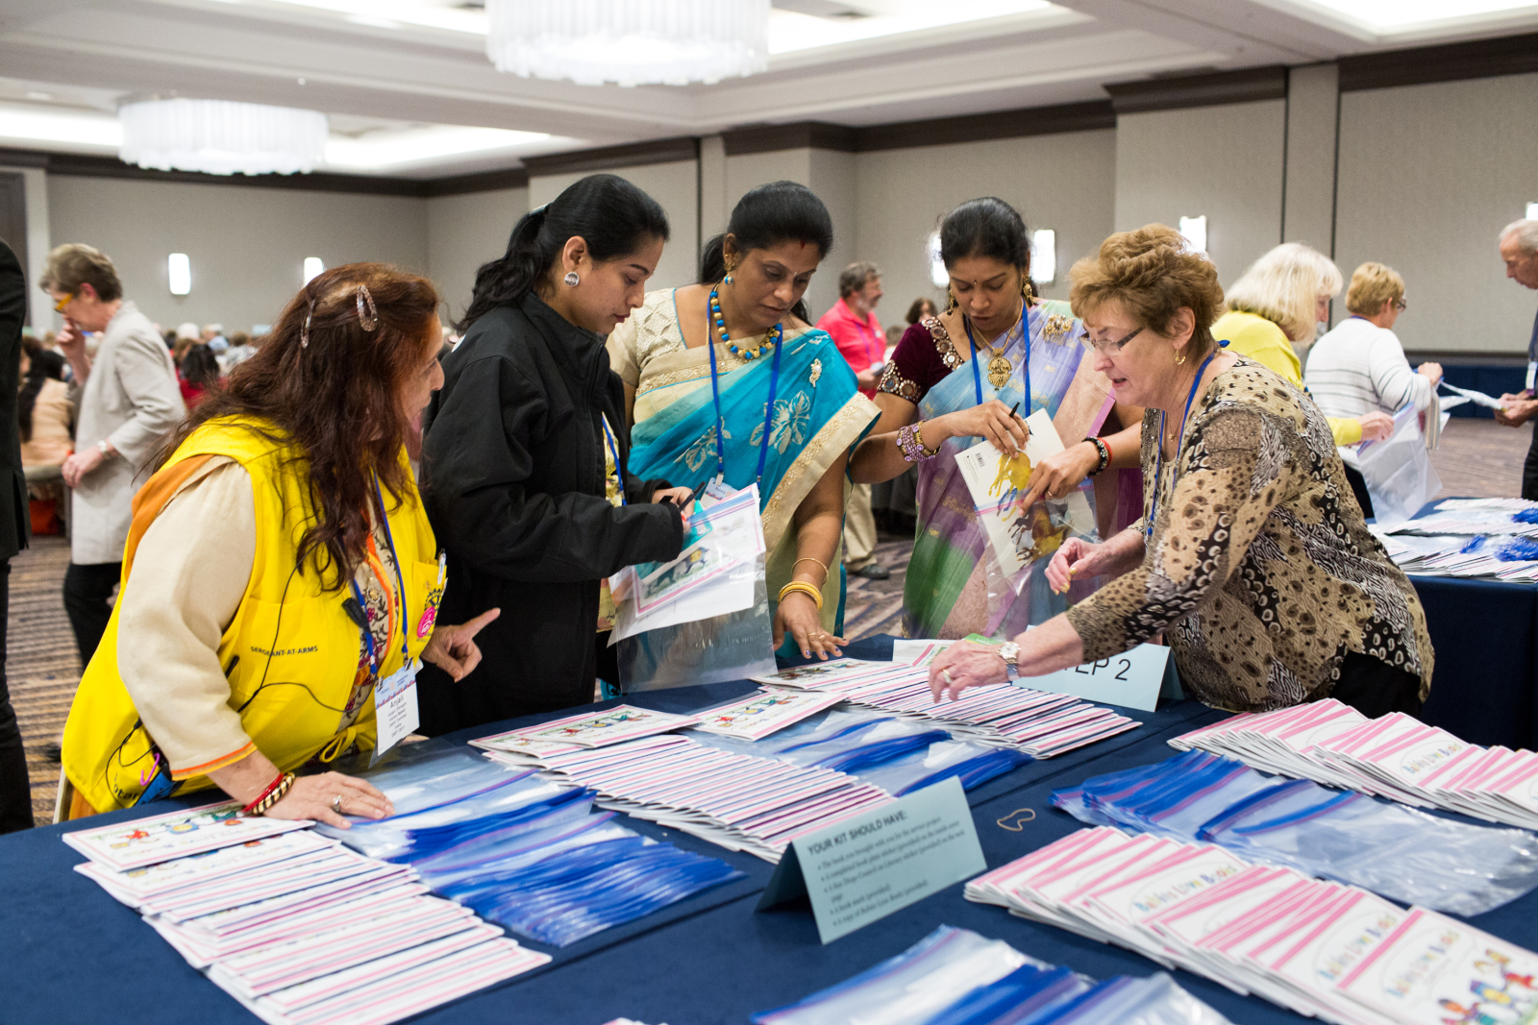
BEST PRACTICE:
CREATE EFFECTIVE COMMITTEES
Create committees that are useful to the club:
Administration
Membership
Public relations
Rotary Foundation
Service
Notes:
Vibrant clubs use committees to achieve their goals and provide members with opportunities to be involved.
Larger clubs might consider establishing additional committees or subcommittees to accomplish more. Smaller clubs might want to combine their committees to avoid having members serving in too many roles and becoming overwhelmed.
Regardless of our club’s committee structure, it’s a good idea to review our committees annually to make sure they’re helping us accomplish our goals.
Activity
Ask participants:
Is anything about our club’s structure not working well?
Could we add any committees to help the club run better?
Do we have any committees that aren’t needed?

Slide 14
EXAMPLES OF VIBRANT CLUBS
Clubs around the world have turned challenges into successes to become vibrant
Notes:
You can find the story of how one club in our region overcame its challenges by using some of the best practices in Be a Vibrant Club: Your Club Leadership Plan.
Activity
Have participants form groups of three. Distribute your region’s version of Be a Vibrant Club: Your Club Leadership Plan to each group. Have participants read the story and discuss it.
Discussion questions:
What challenges did the club face?
How did the club overcome its challenges?
How did its transformation affect membership and member engagement?
What recommended best practices can we use in our club?

Slide 15
RESOURCES
Sign in to My Rotary to find resources that can help us make our club more vibrant:
Rotary Club Health Check
Strategic Planning Guide
Rotary Club Central
Member Satisfaction Survey
Online membership courses in the Learning Center
The Brand Center
Introducing New Members to Rotary
Leadership in Action: Your Guide to Starting a Program

Slide 16
OUR CLUB, OUR STORY
What steps can we take to make our club vibrant?
Notes:
Work together to compare our club’s current practices with each of the best practices listed in the guide.
For areas that need improvement, think of new ideas and decide how to implement them. Change takes time, but it is worth the effort.
Activity
Ask participants:
What other best practices should our club consider?
What questions or comments do you have?

