Slide 1
เรียนรู้ให้กระจ่างเกี่ยวกับใบสมัครและการรายงานทุนสนับสนุนระดับโลก
Notes:
Greetings! In this session we are going to look closely at each step required to complete the Global Grant Applicaiton

Slide 2
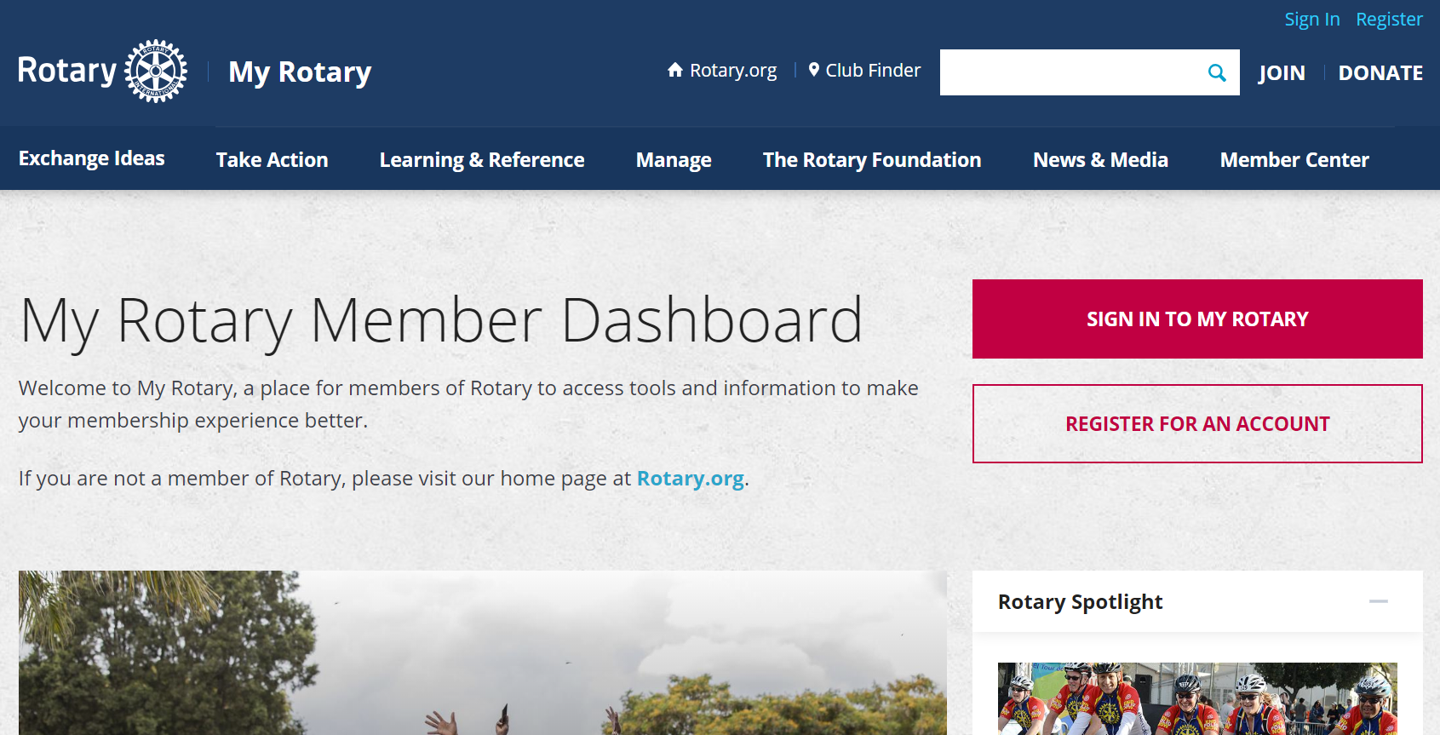
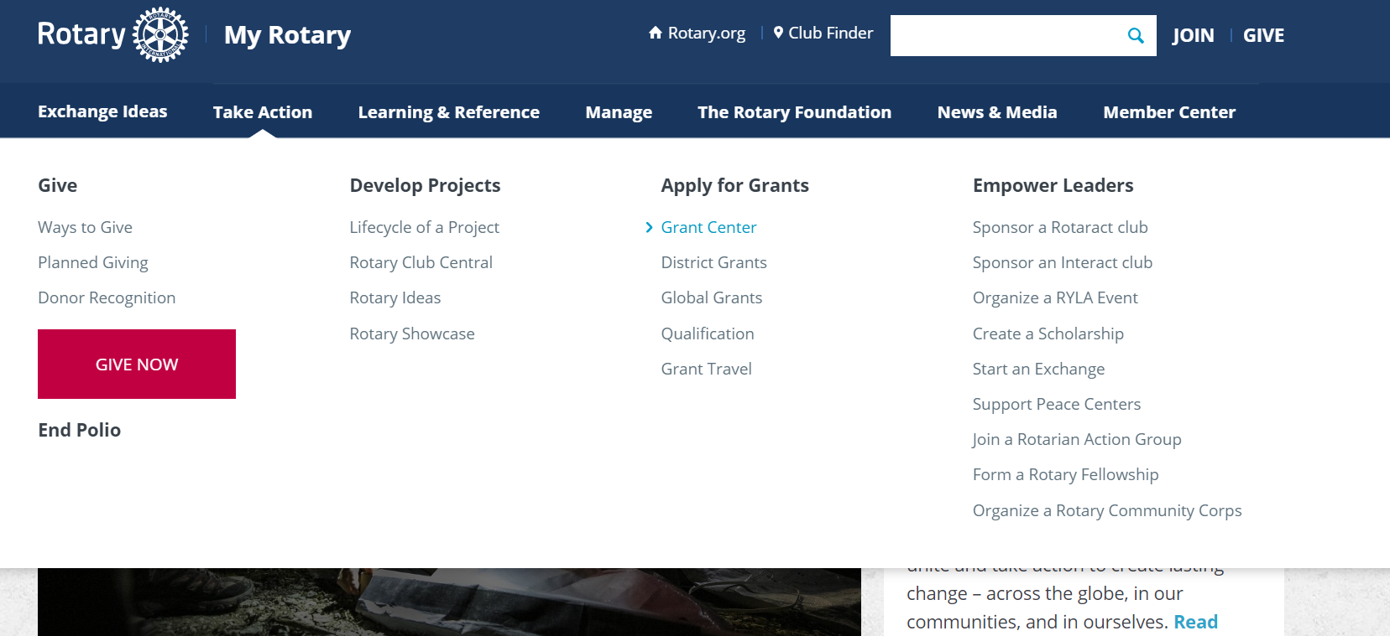
ค้นหา GRANT CENTER
ลงชื่อเข้าใช้ My Rotary
ไปที่ Take Action เลือก Grant Center
Notes:
The whole process starts with finding the Grant Center online.
Sign into My Rotary and then navigating to the Grant Center.

Slide 3
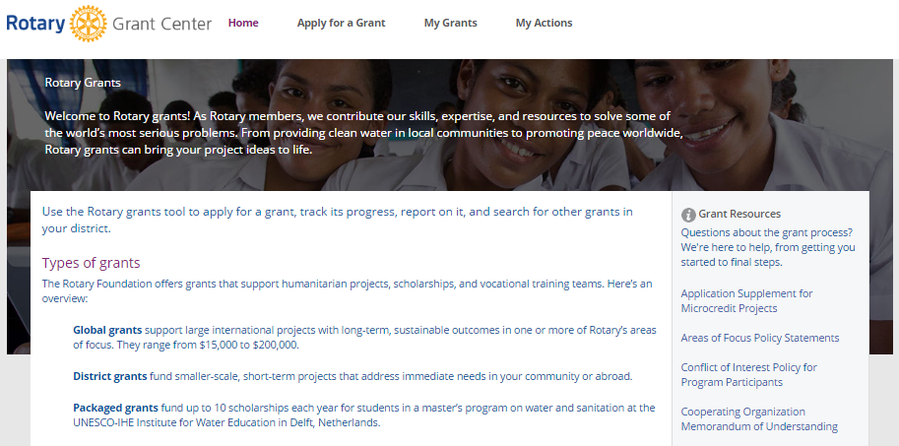
แนวทางการใช้ GRANT CENTER
หน้าเพจ Grant Center ให้ภาพรวมของทุนสนับสนุนของโรตารีและลิ้งค์ไปสู่ทรัพยากรที่มีประโยชน์
Notes:
That will get you to the Grant Center’s landing page where you will see an overview of Rotary grants and links to helpful resources.

Slide 4
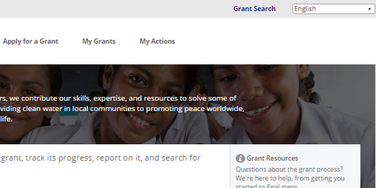
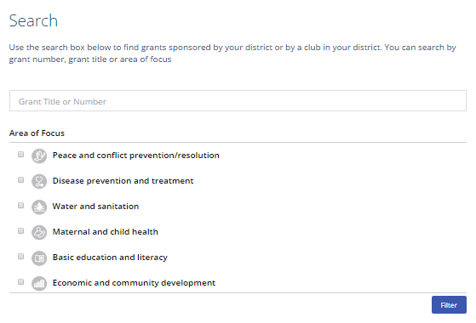
แนวทางการใช้ GRANT CENTER
ใช้ Grant Search เพื่อค้นหาทุนสนับสนุนระดับโลกและระดับภาคที่ภาคของท่านอุปถัมภ์ ไม่ว่าสโมสรของท่านจะเกี่ยวข้องหรือไม่
ท่านสามารถค้นหาทุนสนับสนุนโดยใช้หมายเลข ชื่อ หรือเรื่องที่เน้นความสำคัญ หลังจากใส่ข้อมูลตามหลักเกณฑ์ของการค้นหาแล้วให้ใช้ปุ่ม Filter
Notes:
Let’s talk about some of the features of the Grant Center landing page. Use the “Grant Search” function to find all of the global and district grants sponsored by your district, whether or not your club is involved.
You can search for grants by number, title, or area of focus. After entering search criteria, click the Filter button and a list of grants will pop up.

Slide 5
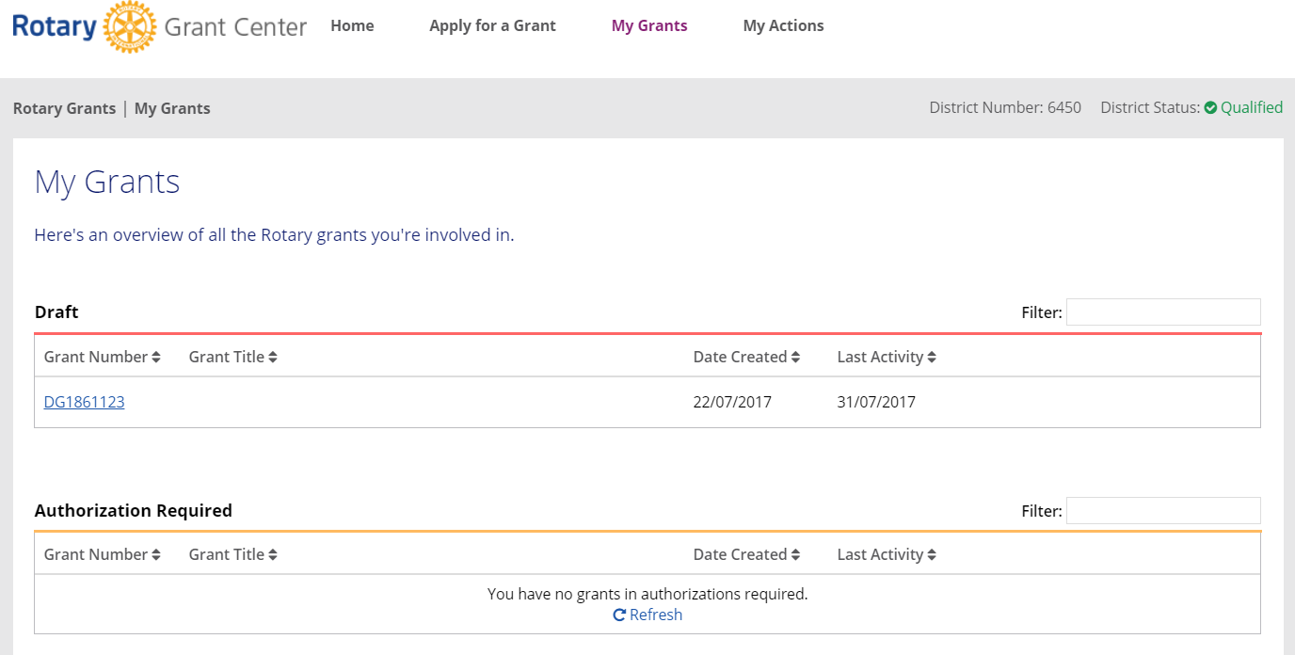
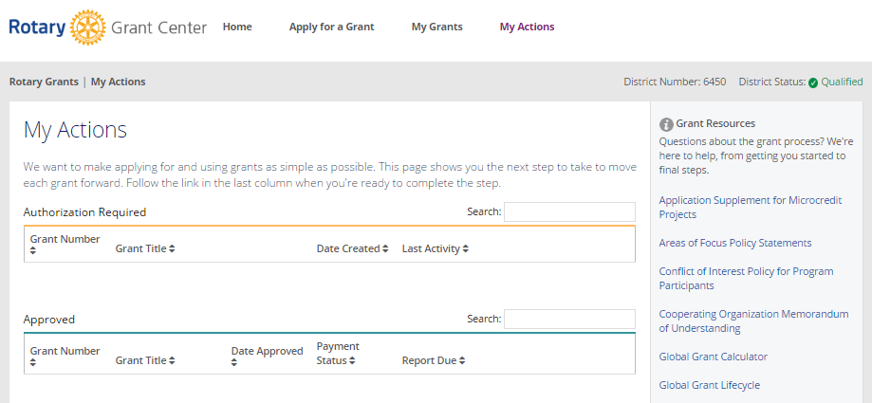
แนวทางการใช้ GRANT CENTER
ใช้เมนูด้านบนเพื่อ เป็นการนำทางใน Grant Center
เลือก My Grants เพื่อดูทุนสนับสนุนทั้งหมดที่ท่านมีส่วนเกี่ยวข้อง
ไปที่ My Actions เพื่อดูทุนสนับสนุนที่ท่านมีส่วนเกี่ยวข้องซึ่งกำหนดการปฏิบัติให้ท่าน
Notes:
You can use the menus at the top to navigate the Grant Center. Choose My Grants to see all of the grants you’re involved in.
Go to My Actions to see the grants you’re involved in that require action from you. For example, your authorization

Slide 6
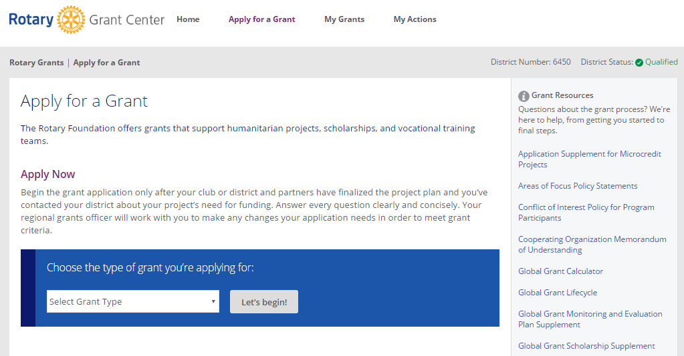
การสมัครทุนสนับสนุนระดับโลก
ในการเริ่มต้นสมัครทุนสนับสนุนระดับโลก ต้องไปที่ Apply for a Grant
เลือก Global Grant จากรายการและคลิ้กที่ Let’s begin!
Notes:
Finally we get to the exciting part, starting an application. To start a global grant application, go to Apply for a Grant. Choose Global Grant from the list and click Let’s begin!

Slide 7
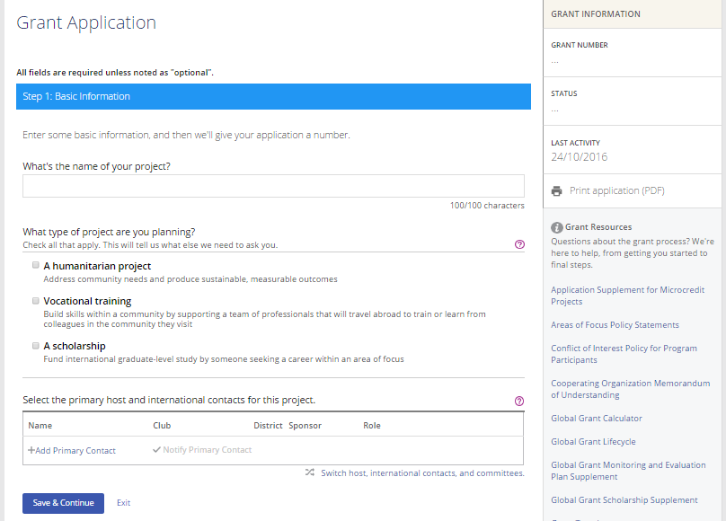
ขั้นตอนที่ 1 ข้อมูลพื้นฐาน
ในขั้นตอนที่ 1 Basic Information เริ่มต้นด้วยการแจ้งชื่อโครงการ เป็นโครงการประเภทใดและชื่อผู้ติดต่อหลักฝ่ายเจ้าภาพและต่างประเทศ
คลิกที่ไอคอนเครื่องหมายคำถาม (?) ได้ตลอดการสมัครเพื่อดูข้อมูลที่สำคัญ
ใช้ปุ่ม Save & Continue เพื่อไปสู่ขั้นตอนต่อไป
Notes:
That will bring you to step one! In step 1, Basic Information, start by telling us your project’s name, what type of project it is, by that I mean the activity type. Is it a humanitarian project, a vocational training team or a Scholarship. Most likely you are going to choosing Humanitarian project
You can Click on the question mark icons throughout the application for important information. Use the Save & Continue button to move to the next step.
But first, we are going to click on Add Primary Contact and see what happens

Slide 8
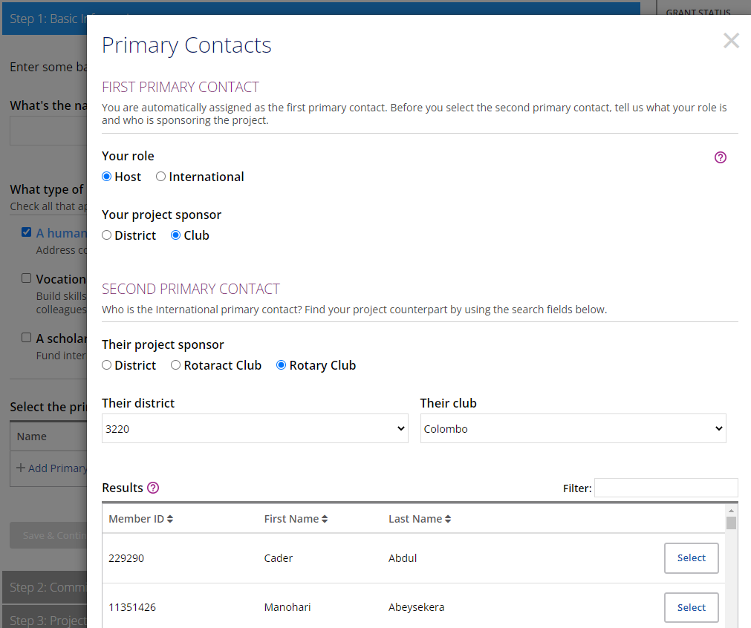
เพิ่มผู้ติดต่อหลัก
Notes:
That will bring you to this screen where you will make some important decisions.
The person that is starting the application will automatically be made a Primary Contact. Now it’s asking you to choose whether you are the host or the international partner. If the project activities are taking place in your country, then you are the host. If the grant activities are taking place outside of your country, then you are the international partner.
Now it is asking you if your project is District or Club sponsored. This question sometimes causes confusion. I think because we used the word “sponsor”. Here we are not talking about who is financially sponsoring the grant. Instead what we really mean is, who is directly implementing the grant? In most cases your project’s sponsor is going to be your Rotary club.
The reason the answer to this question is so important is that it determines who will be asked to be the legal authorizer of the grant and who will directly control the project bank account. Club sponsored grant means club controlled project bank account. District sponsored grant means district controlled project bank account.
Since you already told the system that you are the host, it is automatically identifying the other primary contact the international. But you still need to say if the grant is being sponsored by the district or the club. If everyone on the grant committee is in the same club, then most likely it is club sponsored too.

Slide 9
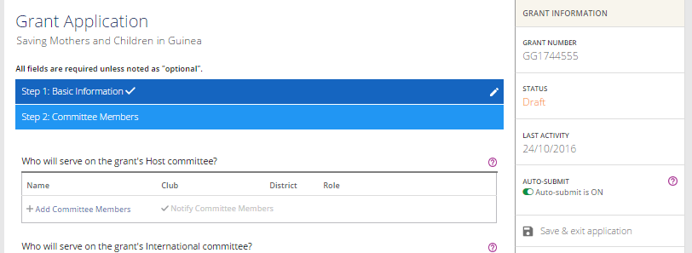
ขั้นตอนที่ 2 รายชื่อคณะกรรมการ
ในตอนนี้ Grant Center ได้ให้หมายเลขทุนสนับสนุนแก่โครงการของท่านแล้ว
ท่านสามารถคลิ้กที่ดินสอเพื่อแก้ไขขั้นตอนต่างๆ ที่ทำเสร็จสิ้นไปแล้ว
เมื่อทำขั้นตอนต่างๆ เสร็จสิ้น ท่านจะสังเกตเห็นเครื่องหมาย √ ปรากฏอยู่บนแถบสีของแต่ละขั้นตอน
Notes:
At this point you will notice, The Grant Center now assigns your project a grant number. As you complete the steps, you’ll notice that check marks appear next to their labels and completed sections will be highlighted in dark blue, incomplete sections will remain grey. You can click on the pencil to edit steps you’ve completed.
Lets talk briefly about Grant Committee Members. The requirement is for a grant committee of at least 3 members from each of the primary partners. The 3 members are, the primary contact plus 2 additional committee members. For Club sponsored grants all members of the grant committee must be from the same club. For District-sponsored grants, the grant committee can be anyone in your district. If you have more people you would like to include on the grant committee, if they are in your club, add as many as you want, but we also have another area to list additional partners.
In order to be able to add someone to the committee they will have to have logged into My Rotary at least once. So if you cannot find the person you are looking for on the list of options, chances are they have not yet logged into My Rotary.

Slide 10
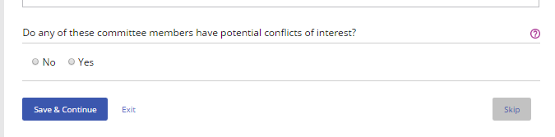
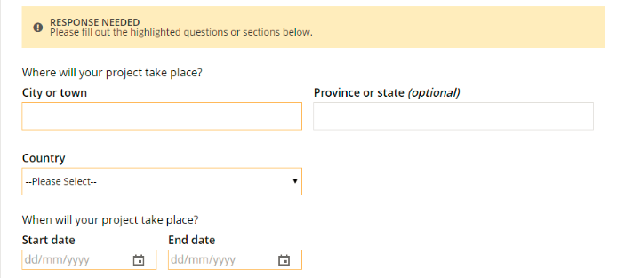
แนวทางการใช้ GRANT CENTER
ท่านยังสามารถใช้ Skip เพื่อข้ามขั้นตอนและกลับไปได้อีกในภายหลัง แต่การเปลี่ยนแปลงใดๆ ที่ทำในขั้นตอนนั้นจะไม่ถูกบันทึกไว้
หลังจากทำแต่ละขั้นตอนเสร็จสมบูรณ์แล้ว ใช้ปุ่ม Safe & Continue เพื่อไปสู่ขั้นตอนต่อไป
หากบันทึกขั้นตอนในขณะที่ยังไม่ได้ให้ข้อมูลที่จำเป็นครบถ้วน แบนเนอร์จะแจ้งว่าต้องการข้อมูลเพิ่มเติม ส่วนที่ยังไม่เสร็จสมบูรณ์จะถูกไฮไลท์ แบนเนอร์จะยังคงอยู่จนกระทั่งท่านได้ให้ข้อมูลครบทุกอย่างในขั้นตอนนั้น
Notes:
After each step, you’ll use the Save & Continue button to move to the next step.
You can also Skip a step and return to it later, but any changes you’ve made within that step will not be saved.
If you save a step when you haven’t supplied all of the necessary information, a banner will tell you that more information is needed. The incomplete sections will be highlighted in grey and the banner will remain until all information for the step has been provided

Slide 11
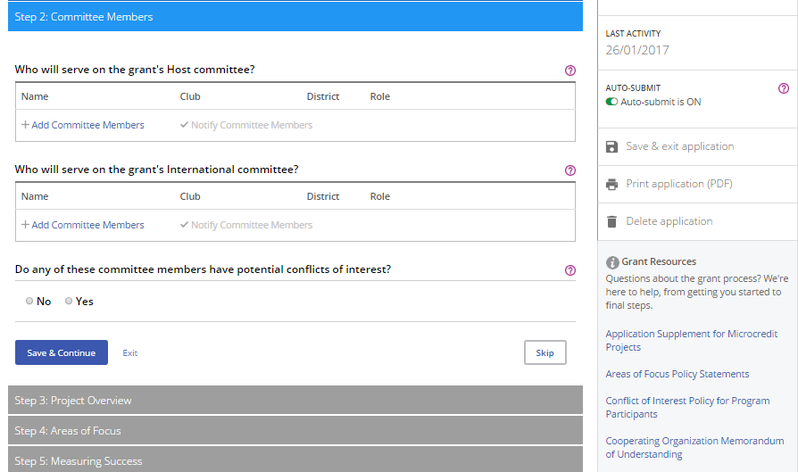
แนวทางการใช้ GRANT CENTER
ตลอดกระบวนการ ท่านสามารถคลิ้ก Save & exit application ได้
ท่านยังสามารถทำใบสมัครทุนสนับสนุนเป็นไฟล์ PDF เมื่อใดก็ได้ โดยการใช้ Print application (PDF) หรือสามารถลบการสมัครที่ยังอยู่ในสถานภาพ "Draft" (ร่าง) โดยการคลิ้กที่ Delete application
Grant Resources มีทรัพยากรทุนสนับสนุนที่เป็นประโยชน์อยู่ที่คอลัมน์ทางขวามือด้านล่าง
Notes:
A few other items to note. In each step you are going to want to hit the Save and Continue button to save your work on that step. But throughout the process, you can click Save & exit application. Then you can always return and start working again where you left off. Please do not ever exit the application by clicking on the X that closes out the screen. It will not save your work and it may keep the grant signed out to you for editing.
Now what do I mean by “signed out for editting”? Since the application is designed to be a collaborative tool, only one person can edit the contents of the application at a time. Clicking the save and exit will open the application to someone else to edit.

Slide 12
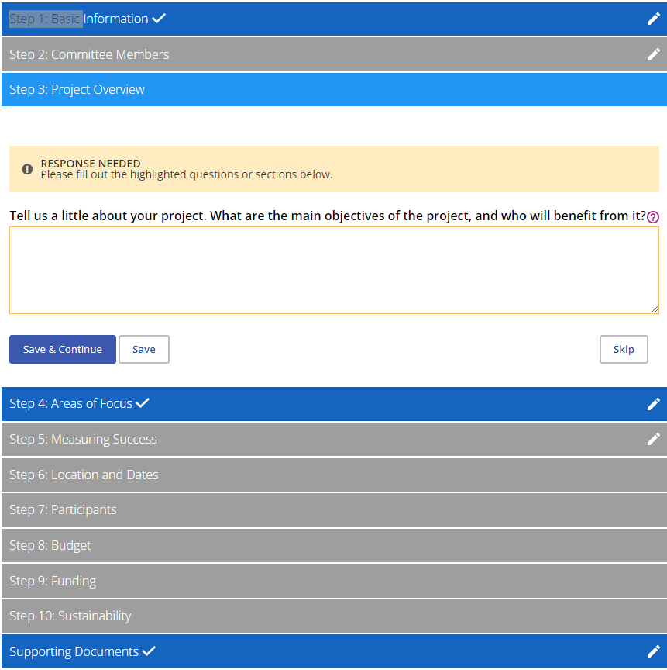
ขั้นตอนที่ 3 ภาพรวมของโครงการ
Notes:
So far we covered Step 1 “Basic Information” We covered Step 2 “Committee Members”.
There are 12 steps in all. You will notice that once you complete a step it changes from grey to dark blue. But you do not necessarily need to complete them in order. If you reach a step you are not ready to complete, you can click on skip and you will move to the next step.
Step #3 Project Overview, is just a summary description of what you will be doing for your project. We are going to ask you for more detail later, so this can really be a high level description.

Slide 13
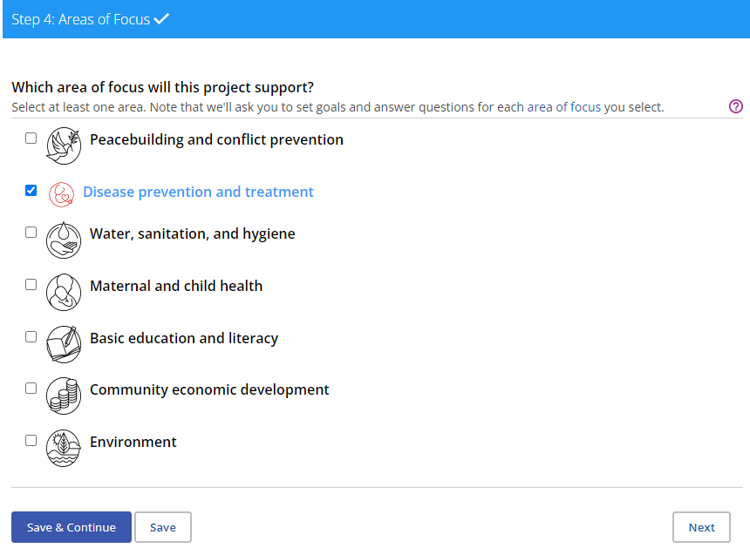
ขั้นตอนที่ 4 เรื่องที่เน้นความสำคัญ
Notes:
Step 4, choose the area of focus
Most projects could be seen as having some sort of impact on all the areas of focus. But you want to select a primary area of focus.

Slide 14
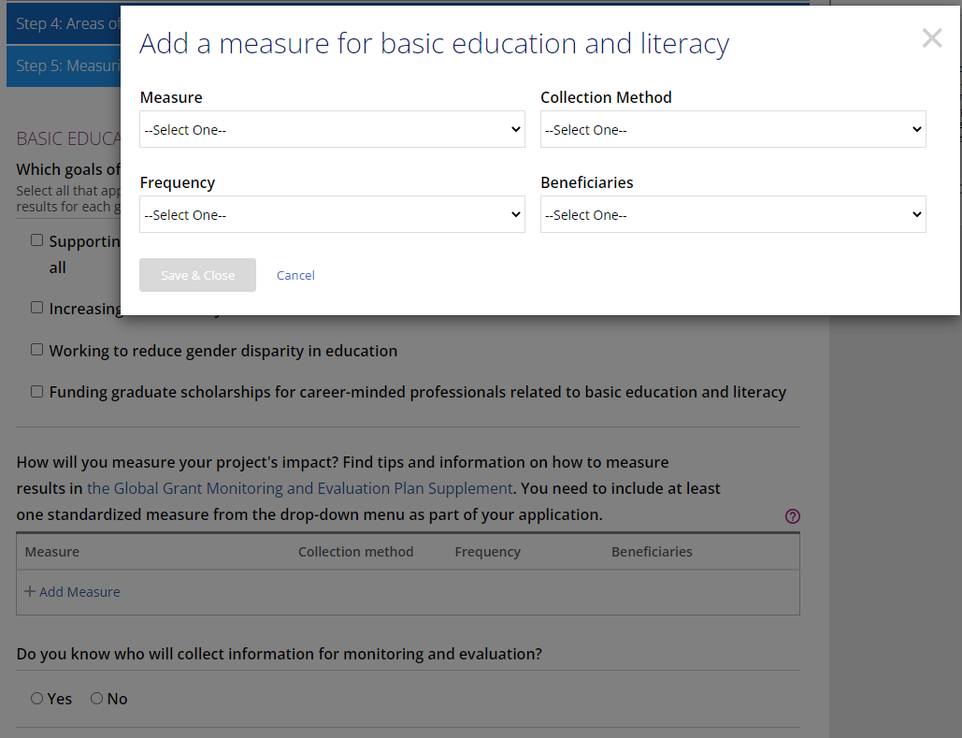
ขั้นตอนที่ 5 วัดผลความสำเร็จ
Notes:
You will not be able to fill this out until you have selected an Area of Focus. In this step, you will identify the goal under the area of focus that your project aligns with and select measures for your project.
You must select at least one of the provided measures, but you can also create your own. It is important to think about these now, because you may need to collect baseline data at the beginning of your project that will serve to show the change directly created by your project.

Slide 15
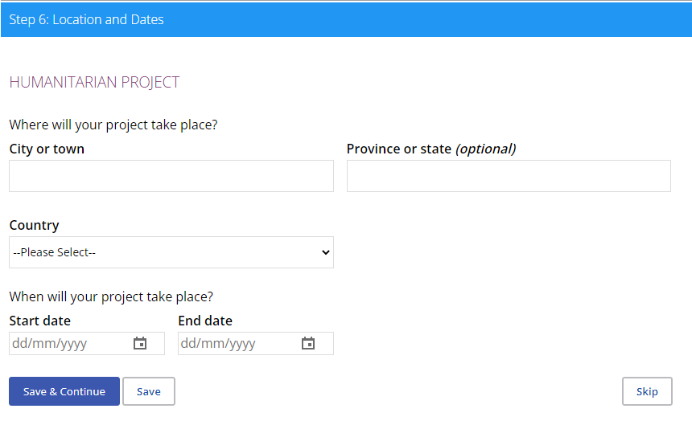
ขั้นตอนที่ 6 ที่ตั้งและวันที่
Notes:
Step 6: Location and Dates
This one is pretty straightforward, just remember, this is not the location of your club, it’s the location where the project will take place.

Slide 16
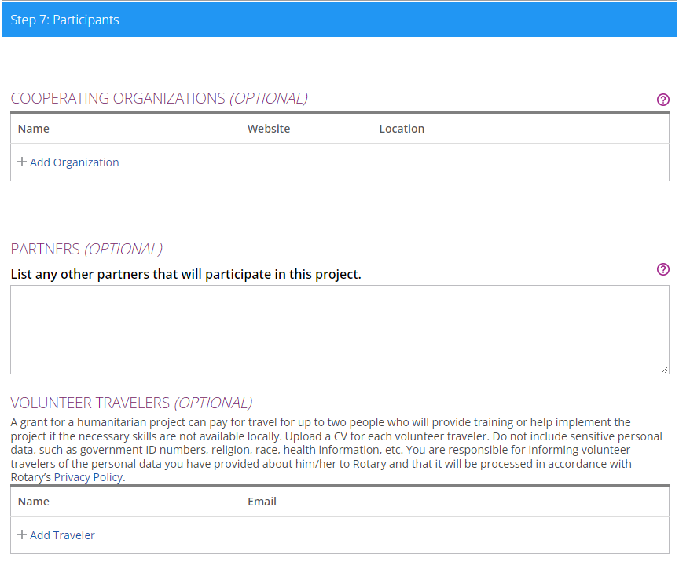
ขั้นตอนที่ 7 ผู้ร่วมโครงการ
Notes:
Step 7 is where you identify any cooperating organizations you may be working with. Sometimes this is also the benefitting organization. When you enter the name of the organization, the system will prompt you to upload the Memorandum of Understanding. Please always be certain to use the Foundation’s template for your MOU.
The Partners section is where you can list other clubs or individuals who are helping with your project. So for example, if it is a club sponsored grant and someone from another club will be helping with the project, you could list them here.
The Terms and Conditions allow for up to 2 Volunteer Travelers on a humanitarian project. But there are some important things to remember:
It is only necessary to fill out this section if the grant is paying for someone’s international travel.
These volunteer travelers should be providing training or directly helping with implementing the projectand only if the host sponsor confirms their skills are not readily available locally. This is not intended for folks to just come and see the project or attend the handover ceremony,

Slide 17
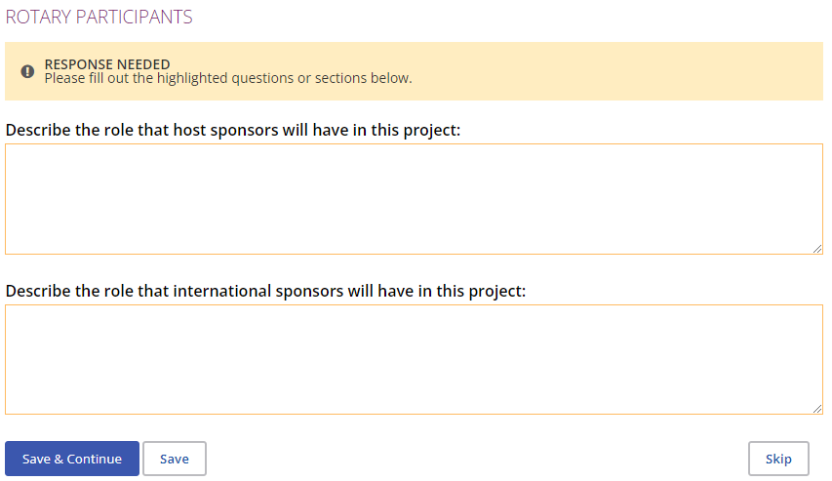
ขั้นตอนที่ 7 ผู้ร่วมโครงการ
Notes:
This is of course were you tell us about what each of the partners will be doing to support the project.
For the most part there does not seem to be any trouble in describing what the host partner will be doing.
But sometimes people struggle with how the international partner will support the project beyond providing funding. At a minimum, an international partner should be taking an active interest in the implementation of the project. A great way to do this is for the 2 grant committees to have monthly or quarterly Zoom meetings to discuss progress on the project. International Rotarians may have valuable suggestions for how to overcome project difficulties and can always provide moral support. The other thing the international partner should be doing is promoting the project in their local Rotary network. This is the minimum, the sky is the limit. ☺

Slide 18
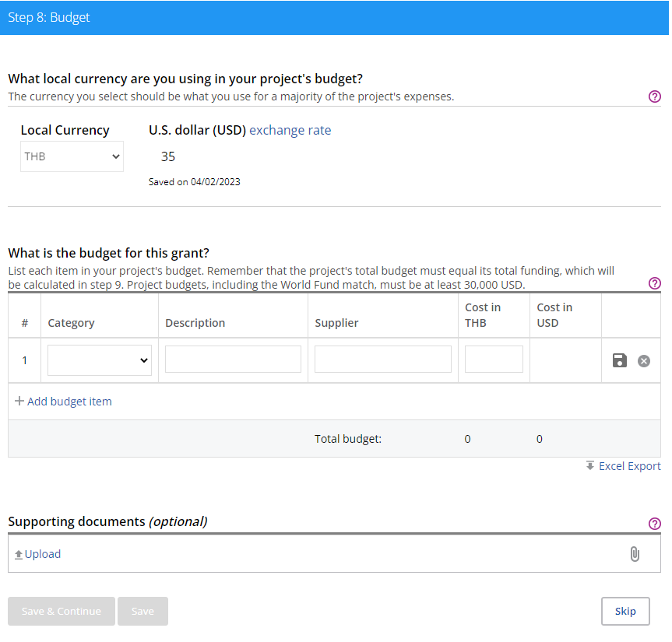
ขั้นตอนที่ 8 งบประมาณ
Notes:
Step 8: the budget.
The Currency in your budget should reflect the currency in which grant expenses are made. If you click on the “exchange rate” in blue you will see the official R.I. Exchange rate for that month. For some currencies, we do not have an official R.I. rate so just do your best to estimate what it will be for the majority of your project.
Please keep in mind that all Global grant projects are approved in USD and paid out at the current “official RI” exchange rate at the time of payment. To protect against issues with currency fluctuations, Rotarians may include up to 10% of the total project budget for contingencies such as currency fluctuations and unexpected price changes. If the contingency is not needed for this then you can use it on other items, but those must be preapproved by The Foundation. This is true for any deviation from the approved budget.
Some things to keep in mind with the budget:
Please try to itemize the budget as much as possible.
Please make sure that your budget matches your vendor quotes.
Please note that there is a USD 1,000 cap on Rotary signage.
Finally be aware that the only eligible publicity costs are for publicity required to support project implementation. Publicity costs to let the public know that Rotary has done a project are not eligible for global grant funding. This includes inauguration or handover ceremony costs. These costs should be paid for outside of grant funds.

Slide 19
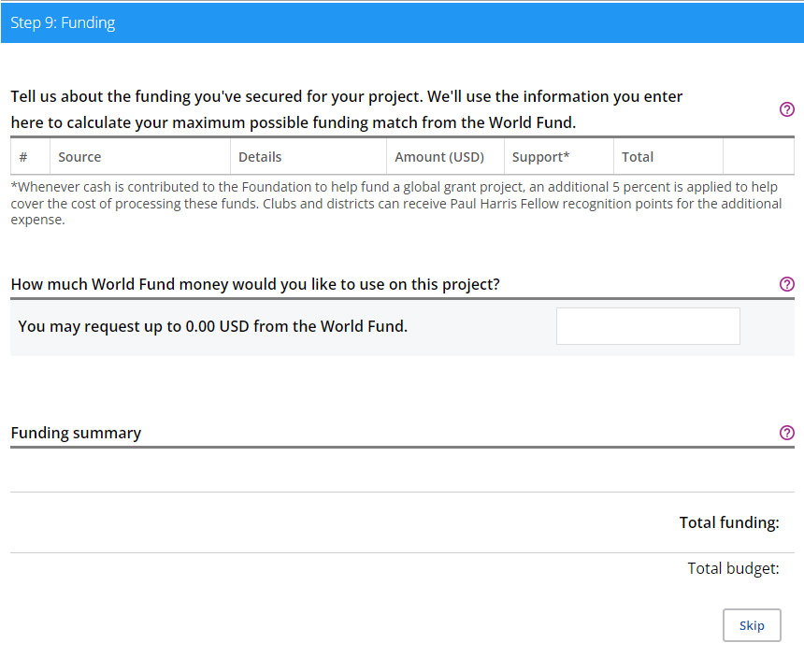
ขั้นตอนที่ 9 การให้ทุน
Notes:
This is where you add cash and DDF contributions to combine with world fund to fund your project.
A couple of important things to remember for this step:
You can include cash contributions from Non-Rotarians. However, please remember that the cooperating or beneficiary org cannot contribute cash to the grant’s funding.
At least 15% of the total cash and DDF contributions must come from outside the host country. It can come from your international partner or any other Rotary club or district outside of the host country. There is no minimum contribution for the host.

Slide 20
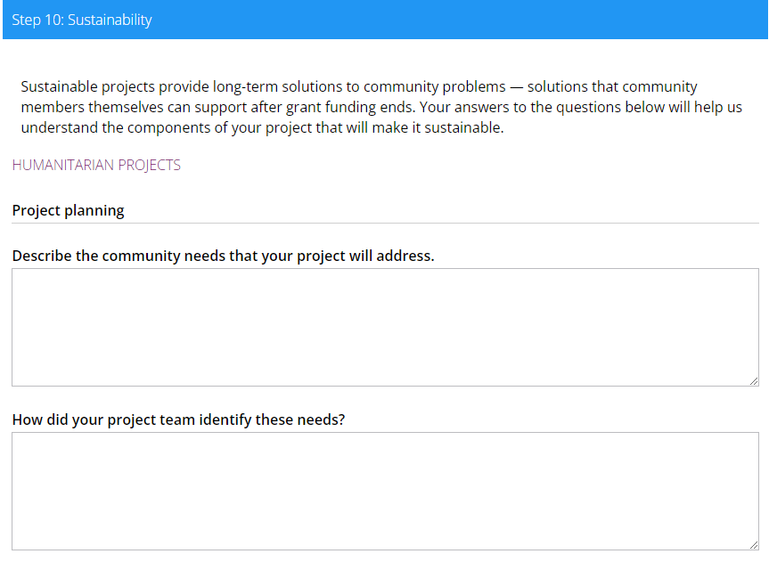
ขั้นตอนที่ 10 ความยั่งยืน
Notes:
Step 10: Sustainability is the longest and most important part of your application.
Project planning. This is where you tell us what you are going to do and how you are going to do it. It is sometimes helpful to start out by describing what the project will be purchasing or paying for and how those purchases will be used to achieve project goals. Keep in mind when you are filling out this section, we are evaluating how well you analyzed the needs of the beneficiaries, how well you involved the beneficiaries in choosing solutions and how strongly you designed your project to make a real long term impact for the beneficiaries and in the area of focus.
This means describing in some detail the current situation of the beneficiary group you are working with.
This is where you tell the story of how you interacted with and involved the beneficiaries and other stakeholders in identifying the goals of the project and involved them in the planning process for how best to achieve those goals. What stakeholders did you identify and how did you involve them in the planning of your project? What data did you collect to inform your strategy? How do all the aspects of your project work together to ensure long-term success?

Slide 21
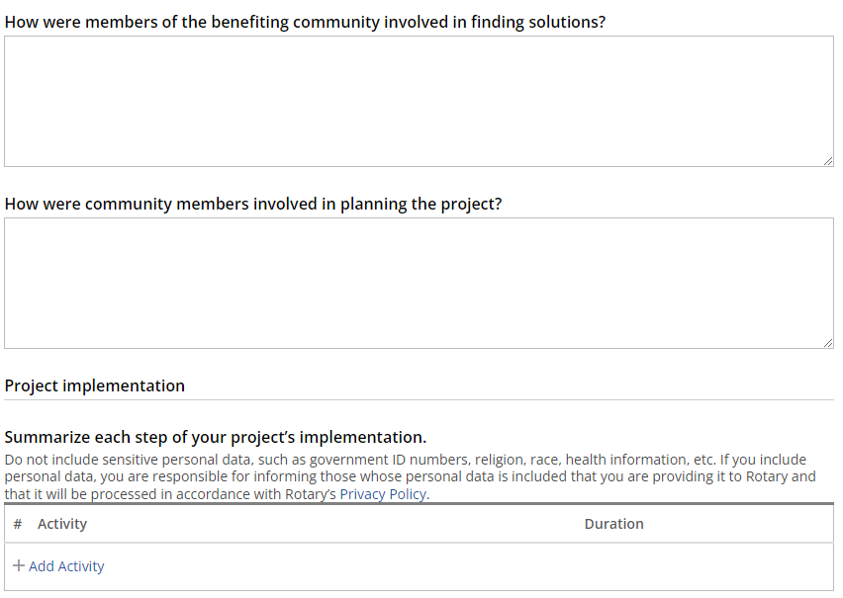
ขั้นตอนที่ 10 ความยั่งยืน
Notes:
The questions continue to focus on how you involved the beneficiaries and other stakeholders in the project planning process because this is so important for the success of your project. Involving the beneficiaries and other stakeholders in the planning process helps give them a sense of ownership over project outcomes.
Project implementation. In this section the idea is to map out the steps that will need to happen in your project. Make sure to include training and any other activities that will happen as result of your project. It’s helpful to understand that these will be loaded into your report and used as bench marks of project completion.

Slide 22
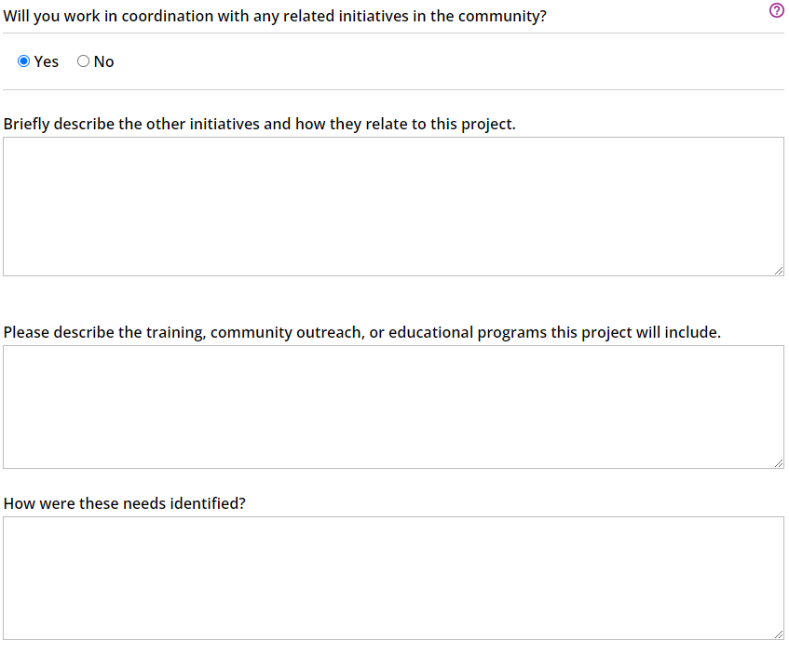
ขั้นตอนที่ 10 ความยั่งยืน
Notes:
Will you work in coordination with any related initiatives in the community? This usually refers to initiatives of the local government or other NGOs.
As you probably already know training is a required component for most project types. We also want to see that the training was designed and selected with input from the beneficiaries.

Slide 23
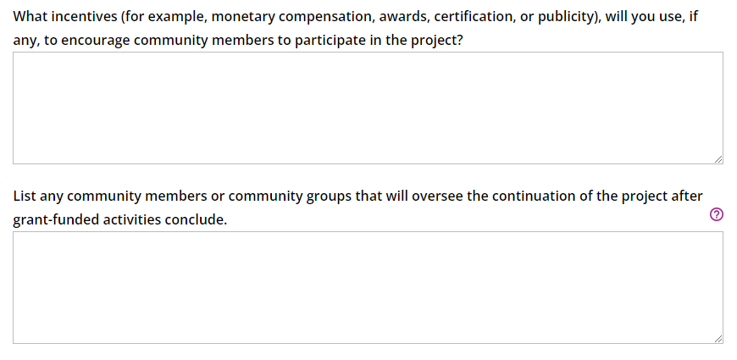
ขั้นตอนที่ 10 ความยั่งยืน
Notes:
What incentives (for example, monetary compensation, awards, certification, or publicity), will you use, if any, to encourage community members to participate in the project? This could be a lot of different things. The question is really trying to get you to think about strategies to insure the active and enthusiastic participation of the beneficiaries in your project’s activities.
List any community members or community groups that will oversee the continuation of the project after grant-funded activities conclude. We are not talking about Rotarians here. What other community groups or members will be champions for the project going forward?

Slide 24
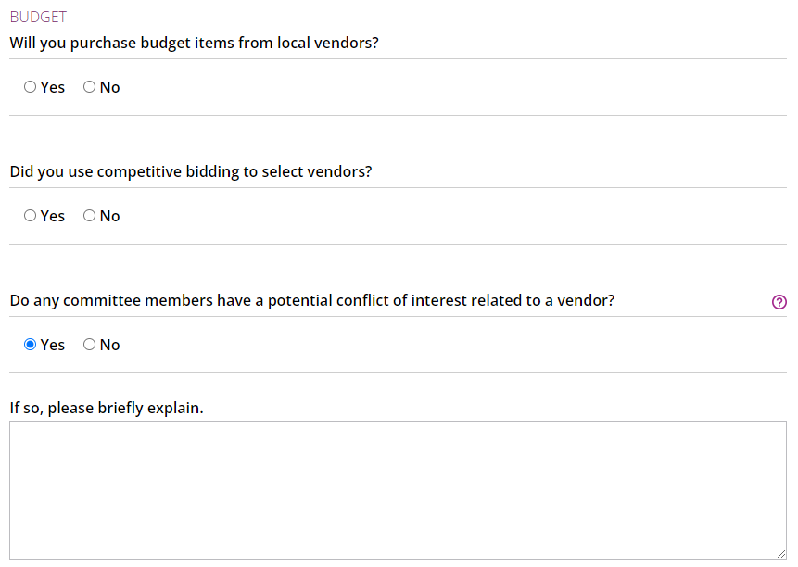
ขั้นตอนที่ 10 ความยั่งยืน
Notes:
For the most part we are going to want to see that you are purchasing from local vendors and using a competitive bidding process. But there are some special circumstances where you might not do either of these things. But in those circumstances, we will want to see there is a good reason.
Are there any Rotarian Vendors? Rotarians can be vendors, but a couple of things to keep in mind.
You must clearly identify Rotarian vendors in your application….you would do that here.
You must establish that they are provided a reasonable price by obtaining 2 comparable quotes. You will want to keep copies of those quotes in your grant records.

Slide 25
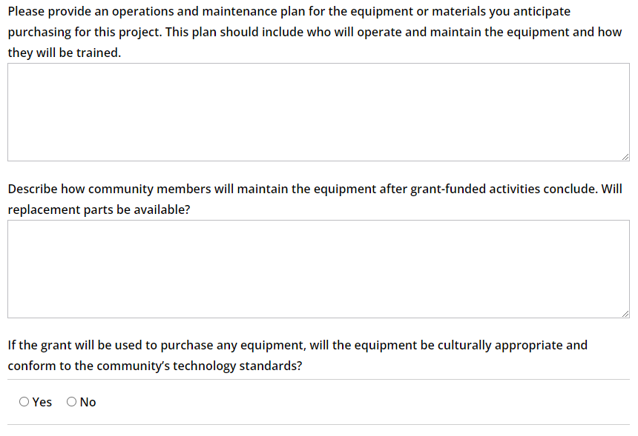
ขั้นตอนที่ 10 ความยั่งยืน
Notes:
Most grants purchase some type of equipment
For all equipment, a well thought out operation and maintenance plan is a must for sustainability. You will also want to make certain that the beneficiaries will be able to easily make repairs and get spare parts.
What do we mean by culturally appropriate and conforming to the community’s technology standards? Are you buying a water filter that is not available for purchase locally? Are you buying a piece of medical equipment from a brand or supplier the hospital has never worked with before?

Slide 26
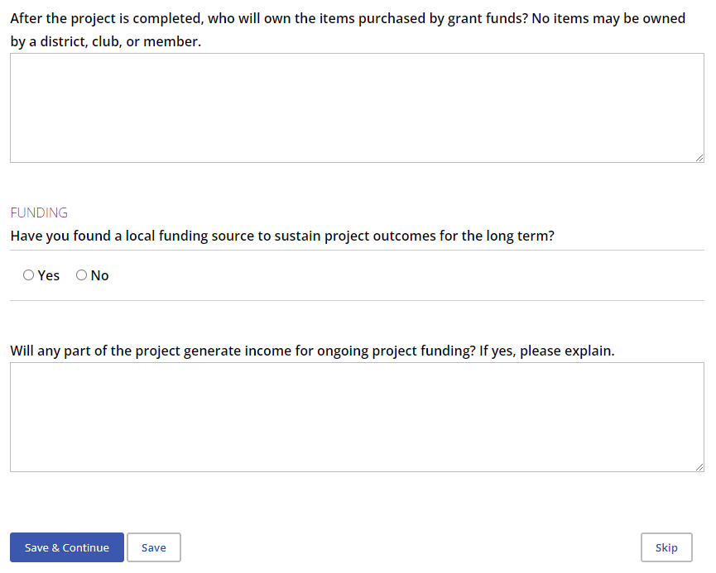
ขั้นตอนที่ 10 ความยั่งยืน
Notes:
Clear ownership of all items purchased with grant funds is essential to sustainability. If it is not clear who owns a piece of equipment, it is not clear who is responsible for maintaining that equipment.

Slide 27
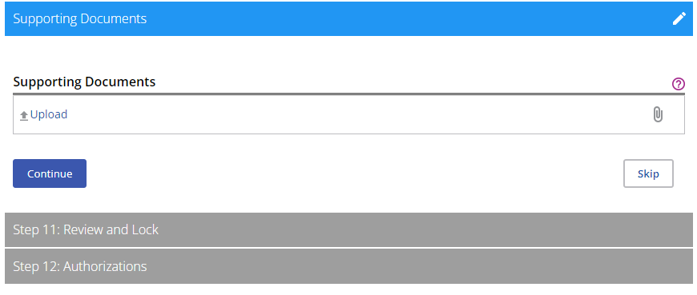
เอกสารประกอบ
Notes:
There are a few different places to upload documents to the application.
When you enter the name of the cooperating organization the application will ask you to upload an MOU there.
In the budget section you should upload all your vendor quotes.
This location is for everything else.

Slide 28
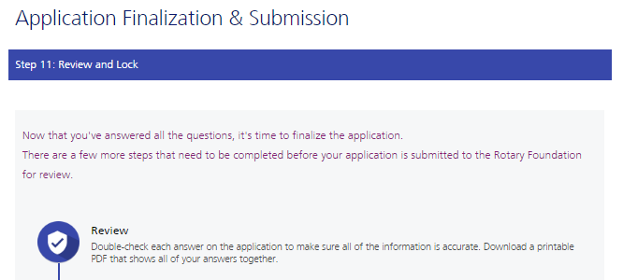
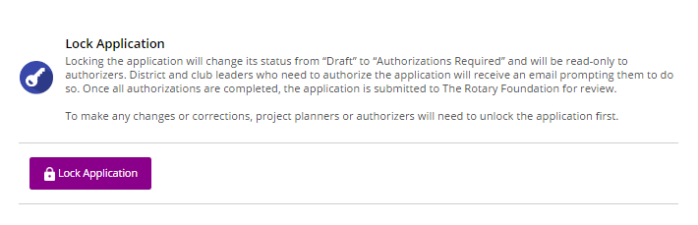
ขั้นตอนที่ 11 ทบทวนและปิดล็อค
เมื่อทำขั้นตอน 1-10 เสร็จสมบูรณ์แล้ว ท่านพร้อมที่จะสรุปครั้งสุดท้ายและส่งใบสมัคร ในขั้นตอนที่ 11 ท่านจะตรวจสอบและปิดล็อคการสมัคร ตรวจสอบคำตอบแต่ละข้อที่ท่านให้ไว้เพื่อให้แน่ใจว่าข้อมูลถูกต้องและสมบูรณ์ทุกประการ การพิมพ์ใบสมัครทั้งชุดออกมาอาจจะเป็นประโยชน์
หลังจากที่ท่านได้ทบทวนใบสมัครทุนสนับสนุนและปิดล็อคแล้ว นั่นคือการเปลี่ยนแปลงสถานภาพใบสมัครจาก “Draft” (ร่าง) เป็น “Authorizations Required” (ต้องมีการอนุมัติ) และทำให้ใบสมัครเป็นแบบอ่านได้เท่านั้น คือ ท่านจะไม่สามารถทำการเปลี่ยนแปลงได้อีก มีเพียงผู้ติดต่อหลักที่สามารถปิดล็อคใบสมัคร
Notes:
When you’ve completed steps 1-10, you’re ready to finalize and submit your application. In step 11 you Review and Lock your application. During this step, Go through your application and make sure it is complete and accurate. You may find it helpful to print up the application.
After you review the grant application, lock it. This will change its status from “Draft” to “Authorizations Required” and make it read-only — you won’t be able to make changes. Only the primary contact can lock the application.

Slide 29
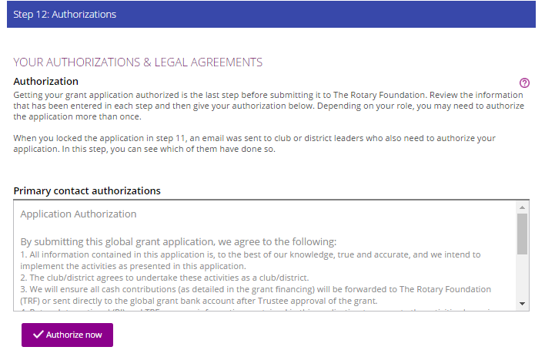
ขั้นตอนที่ 12 การอนุมัติ
ในขั้นตอนที่ 12 การอนุมัติผู้ติดต่อหลักและผู้นำสโมสรและภาคจะอนุมัติ ใบสมัคร
ทบทวนข้อมูลแล้วจึงคลิ้กที่ Authorize Now ทันทีที่ทุกคนซึ่งจำเป็นต้องลงนามอนุมัติการสมัครได้คลิ้กแล้ว ใบสมัครจะถูกส่งไปยังมูลนิธิโรตารีเพื่อการตรวจสอบหลังจากที่ส่งใบสมัครแล้ว ท่านจะไม่สามารถเปลี่ยนแปลงได้ยกเว้น ติดต่อกลับเจ้าหน้าที่ของโรตารี
Notes:
Once the primary contact locks and authorizes the application the Grant Center will send out automated emails to everyone who still needs to provide an authorization. However, I still recommend that you reach out to those people yourself, because sometimes the automated emails wind up in people's junk or spam folders.
Once the last authorization is received, the application should auto submit…but it is always good to keep an eye on it. Remember, I don’t know about your application until it is in submitted status.
At that point I will review your application and send out an application checklist should I have any additional questions. Once the application is complete I forward it to my colleague for a peer review. If she agrees with me that the grant is ready to be approved, then I can move forward with the approval.

Slide 30
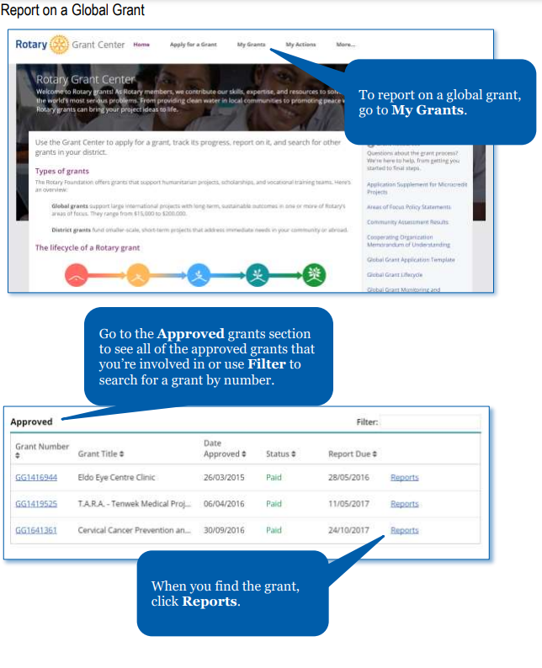
การรายงานทุนสนับสนุนระดับโลก : ประเด็นที่พบมากที่สุด
ในการรายงานทุนสนับสนุนต้องไปที่ My Grants
ไปที่ส่วนของทุนสนับสนุนที่ Approved เพื่อดูทุนทั้งหมดที่ได้รับอนุมัติ ซึ่งท่านมีส่วนเกี่ยวข้องหรือใช้ Filter เพื่อค้นหาทุนตามหมายเลข
เมื่อท่านหาทุนพบแล้ว ให้คลิ้กที่ Reports
Notes:
Lets briefly go over some of the most common issues I see with submitted reports. But the first question is how do I access the report for my grant?
To report on a global grant, Go to the Grant Center, click on My Grants. Scroll down to the Approved grants section to see all of the approved grants that
you’re involved in.
When you find the grant, click Reports.

Slide 31
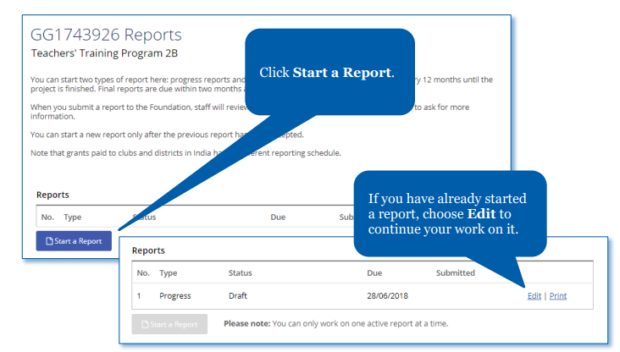
เพจเพื่อการทำรายงาน
คลิ้กที่ start a Report
หากท่านได้เริ่มต้นการทำรายงานไปแล้ว เลือก Edit เพื่อทำงานต่อไป
Notes:
Now you are on the Report landing page
Click Start a Report.
If you have already started a report, choose Edit to continue your work on it.

Slide 32
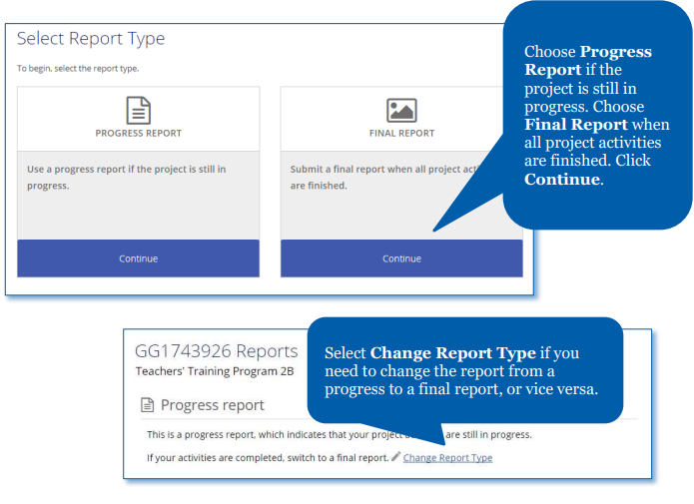
รายงานความก้าวหน้าหรือรายงานฉบับสุดท้าย
เลือก progress Report หากโครงการยังมีความก้าวหน้า เลือก Final Report เมื่อกิจกรรมทั้งหมดของโครงการเสร็จสิ้นแล้ว คลิ้กที่ Continue
เลือก Change Report Type หากท่านต้องการเปลี่ยนแปลงจากรายงานความก้าวหน้าเป็นรายงานฉบับสุดท้ายหรือในทางกลับกัน
Notes:
When you click on start a report it will take you to this screen.
Choose Progress Report if the project is still in progress. Choose Final Report when all project activities are finished and all grant funds are spent. Click Continue.
Select Change Report Type if you need to change the report from a progress to a final report, or vice versa.

Slide 33
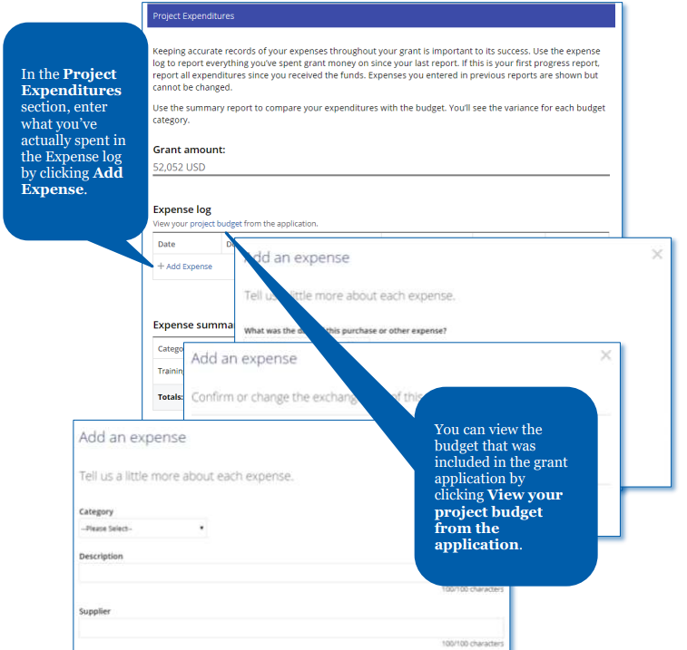
เพิ่มเติมค่าใช้จ่ายเข้าไว้ในรายงานอยู่เสมอ
ในส่วนของ Project Expenditures ใส่ค่าใช้จ่ายที่ท่านได้ใช้จ่ายจริง ที่ Expense log โดยการคลิ้กที่ Add Expense
ท่านสามารถดูงบประมาณที่รวมอยู่ในใบสมัครทุนสนับสนุนโดยคลิกที่ View Your Project budget from the application
Notes:
As soon as the grant is paid, you have access to the report. You can actually start adding in your expenses as you make them. Please remember, your expenses should be easy to match up to the debits listed in your submitted bank states. If that is not possible you may need to submit a project ledger to make the connection clear. Make certain to hold on to your paid receipts as well.

Slide 34
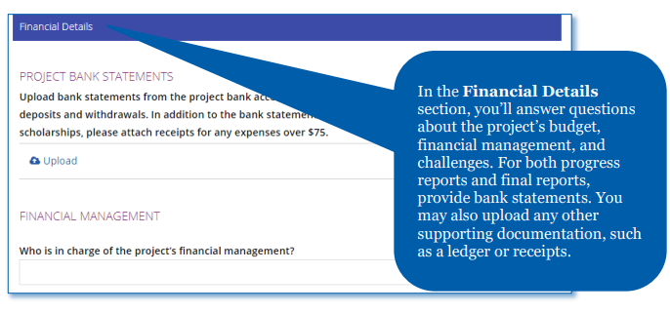
รายงานการเงินของธนาคารสำหรับโครงการ
ในส่วนของ Financial Details ท่านจะตอบคำถามเกี่ยวกับงบประมาณของโครงการ การจัดการการเงินและความท้าทายต่างๆ สำหรับทั้งรายงานความก้าวหน้าและรายงานสุดท้ายต้องรายงานการเงินของธนาคาร ท่านอาจจะอัพโหลดเอกสารประกอบอื่นๆ เช่น บัญชีแยกประเภทหรือใบเสร็จรับเงินด้วยก็ได้
Notes:
Finally, let’s talk about Project Bank accounts and Bank Statements.
You should open a separate bank account for each grant project.
This is the bank account information you should enter in the application and the funds must remain in this one account until they are directly paid to the vendor.
Please don’t ever receive grants funds in an account that you do not intend to keep them in for the life of the project.
Please do not transfer funds in and out of the account. And Please do not transfer grant funds to another account for any reason.
Finally, Please do not use the project bank account for transactions not directly related to the grant
Following these rules makes grant reporting so much easier and more transparent.
When I look at your bank statements, I will look to see that the full grant award has been deposited into the account within a reasonable time frame. If there is a six month lag between the time The Foundation paid the grant and the funds are deposited, this could indicate a problem.
Complete bank statements are required to be submitted with every report. This means showing all debits and credits from the time the grant funds were received until all grant expenses have been made. The easier it is for me to match up the expenses in your grant report with the debits in your bank statements, the quicker I can accept or close your report.

Slide 35
มีคำถามหรือไม่?

