Slide 1
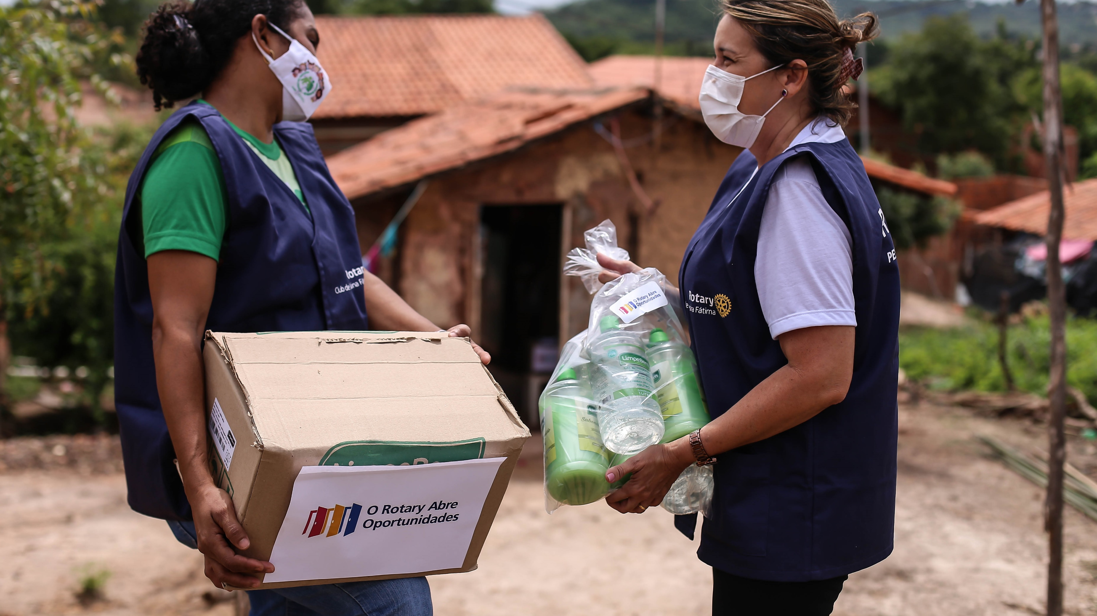
ROTARY GRANTS

Slide 2
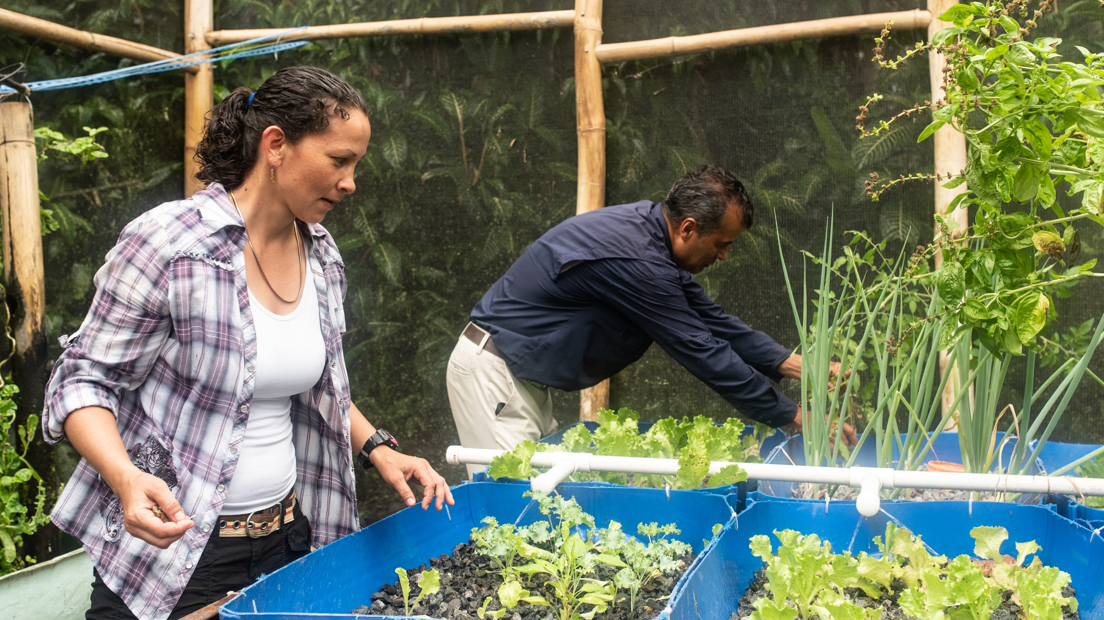
subhead
Foundation Offerings
District grants
Global grants
Disaster response grants
Peace Centers
Programs of Scale
Notes:
The Rotary Foundation offers grants that support a wide variety of humanitarian projects, scholarships, and training that Rotarians are doing around the world. Our two main types of grants are District Grants and Global Grants. We have 3 additional grant offerings, which are Disaster response grants, Rotary Peace Fellows and Programs of Scale. I’ll tell you more about each of them.

Slide 3

GRANT STATISTICS
Notes:
But first let’s get an idea of the scope of District and Global grants world wide.

Slide 4

2021-22 GRANT STATISTICS
District grants
478 grants
$27 million
Global grants
1,199 grants
$73 million
Notes:
Here are some statistics from the 2021-22 Rotary year. We awarded:
478 district grants with program awards of $27 million
1,199 global grants with program awards of $73 million

Slide 5
2021-22 GRANT STATISTICS – worldwide
(UNAUDITED)
Grant type | Number of grants approved | Total funding
District grants | 478 | $28,763,662
Global grants | 1,197 | $76,915,977
Global grant areas of focus and activity types
Area of focus | Number of grants |  | Activity type | Number of grants
Environment | 33 |  | Humanitarian | 1028
Basic education and literacy | 104 |  | VTT | 24
Community economic development | 148 |  | Scholar | 145
Disease prevention and treatment | 569
Maternal and child health | 90
Peacebuilding and conflict prevention | 67
Water, sanitation, and hygiene | 186
Notes:
Shows the worldwide stats breakdown by Area of Focus and Activity Type.

Slide 6
2021-22 GRANT STATISTICS – THAILAND
Grant type | Number of grants approved | Total funding
Global grants | 54 | $2,605,986
Global grant areas of focus and activity types
Area of focus | Number of grants |  | Activity type | Number of grants
Basic education and literacy | 0 |  | Humanitarian | 53
Community economic development | 3 |  | Scholar | 1
Disease prevention and treatment | 41
Environment | 1
Maternal and child health | 5
Peacebuilding and conflict prevention | 1
Water, sanitation, and hygiene | 3
Notes:
Let’s take a look at the statistics for Thailand

Slide 7
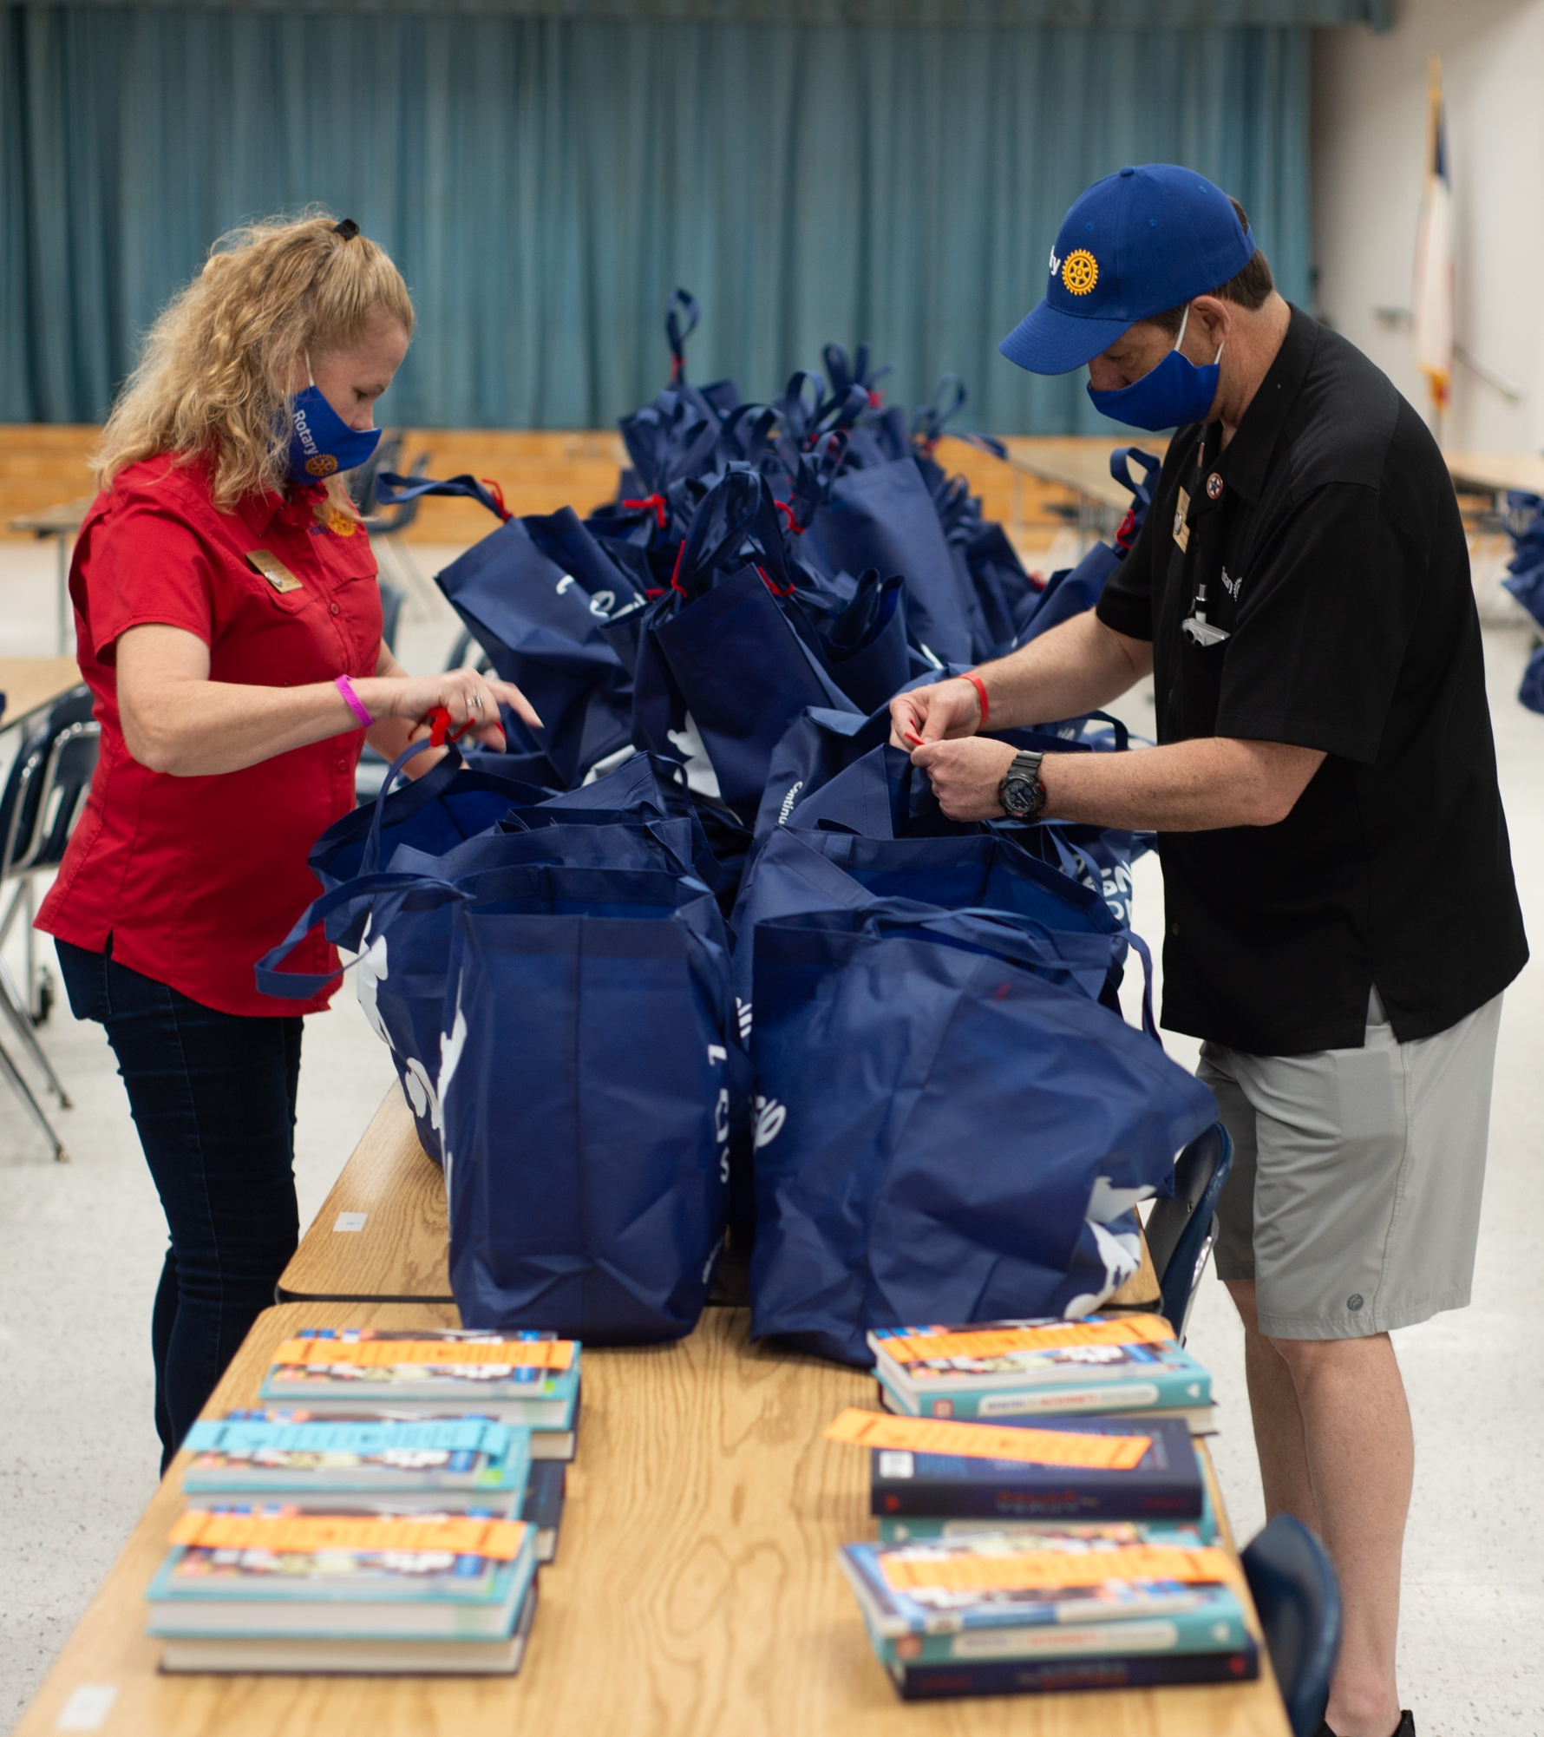
subhead
DISTRICT GRANTS
Small-scale, short-term
Local or international activities
Aligned with the Foundation’s mission
Single grant awarded annually
Notes:
So let’s talk about the grant types themselves. District grants fund small-scale, short-term activities that address needs in your community. Each district chooses which activities it will fund with these grants. You can use district grants to fund a variety of district and club projects and activities.
There aren’t very many restrictions on district grants, as long as your district grant supports the mission of The Rotary Foundation, which is to help Rotarians to advance world understanding, goodwill, and peace by improving health, providing quality education, improving the environment, and alleviating poverty.
Districts may use up to 50 percent of their District Designated Fund to receive one district grant annually. This percentage is calculated based on the amount of DDF generated from a district’s Annual Fund giving three years prior, Endowment Fund earnings are also included. Your district isn’t required to request the full amount available. Districts receive this funding as a lump sum and then distribute it to their clubs.
District grant funding can support local service projects, international humanitarian projects, scholarships and vocational exchanges. District grants can support scholarships at any level of study and for any study area. Similarly, vocational exchanges funded by district grants have great flexibility and don’t need to align with any specific topic area or provide formal training.
Districts must be qualified before they can administer district grants. We will talk more about qualification later.

Slide 8
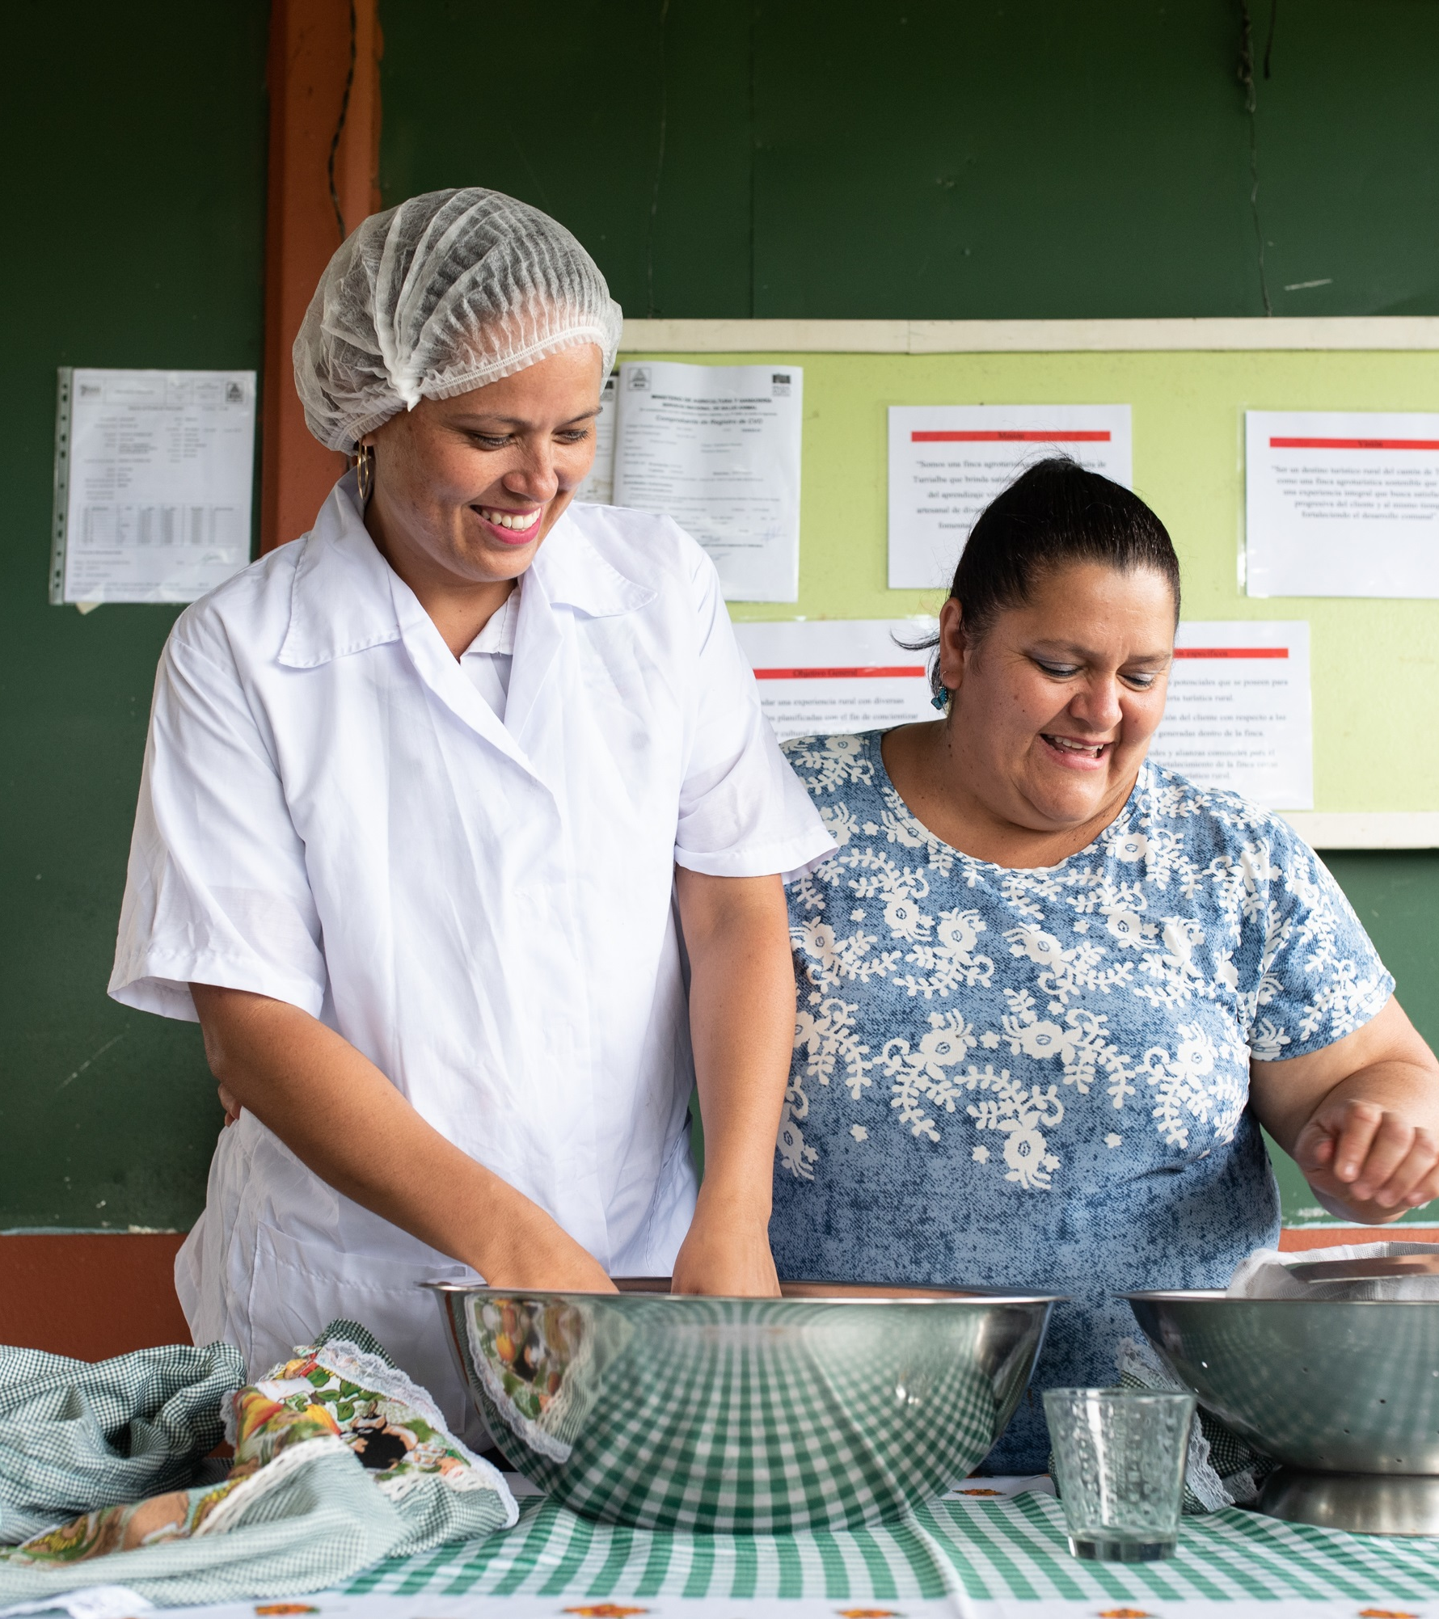
subhead
GLOBAL GRANTS
Large, long-term projects
Sustainable, measurable outcomes
Alignment with areas of focus
International partnership
$30,000 minimum budget
World Fund match for DDF
Notes:
Now let’s move on to the next grant type: global grants. Global grants support large international activities with sustainable, measurable outcomes in Rotary’s areas of focus. A key feature of global grants is partnership, between the club or district where the activity is taking place and a club or district in another country. Both sponsors must be qualified before they can submit an application.
Global grants have a minimum budget of $30,000 and a maximum World Fund award of $400,000. There is no minimum World Fund award amount. Grant sponsors can use a combination of District Designated Funds (DDF), cash, and/or directed gifts and endowment earnings to fund a global grant. The Foundation will provide an 80 percent World Fund match for all DDF contributions.
Global grants can support humanitarian projects, scholarships, and vocational training teams. Global grant scholarships support international graduate and post-graduate study for a period of 1-4 years. Global grant vocational training teams support groups of professionals to travel abroad to provide or receive training.

Slide 9
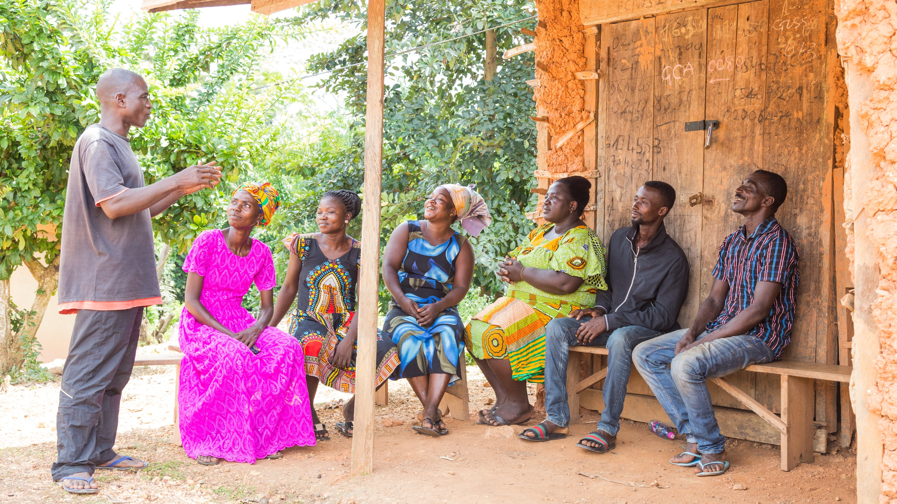
COMMUNITY ASSESSMENTS
Notes:
Now, let’s talk a little bit more about some of the key features of Global Grants.
As many of you know, all global grant applications require a community assessment. This is one of the first things a club or district should do to start developing a project. This assessment explores the community’s strengths, weaknesses, needs, and assets. Understanding and analyzing these factors is essential to planning an effective project. By making the effort to learn about the community and specific beneficiary group you wish to work with, you can identify the most relevant opportunities for projects and maximize your ability to make a meaningful impact.

Slide 10

AREAS OF FOCUS
Peacebuilding and conflict prevention
Disease prevention and treatment
Water, sanitation, and hygiene
Maternal and child health
Basic education and literacy
Community economic development
*NEW* Environment
Notes:
Another key feature of Global Grants is that they must produce measurable impact in one of the Areas of Focus.
We have identified specific causes to target to maximize our local and global impact. We call these our areas of focus. Through global grants we help clubs focus their service efforts in the following areas:
Peacebuilding and conflict prevention
Disease prevention and treatment
Water, sanitation, and hygiene
Maternal and child health
Basic education and literacy
Community economic development
Environment - This is our newest area of focus.

Slide 11
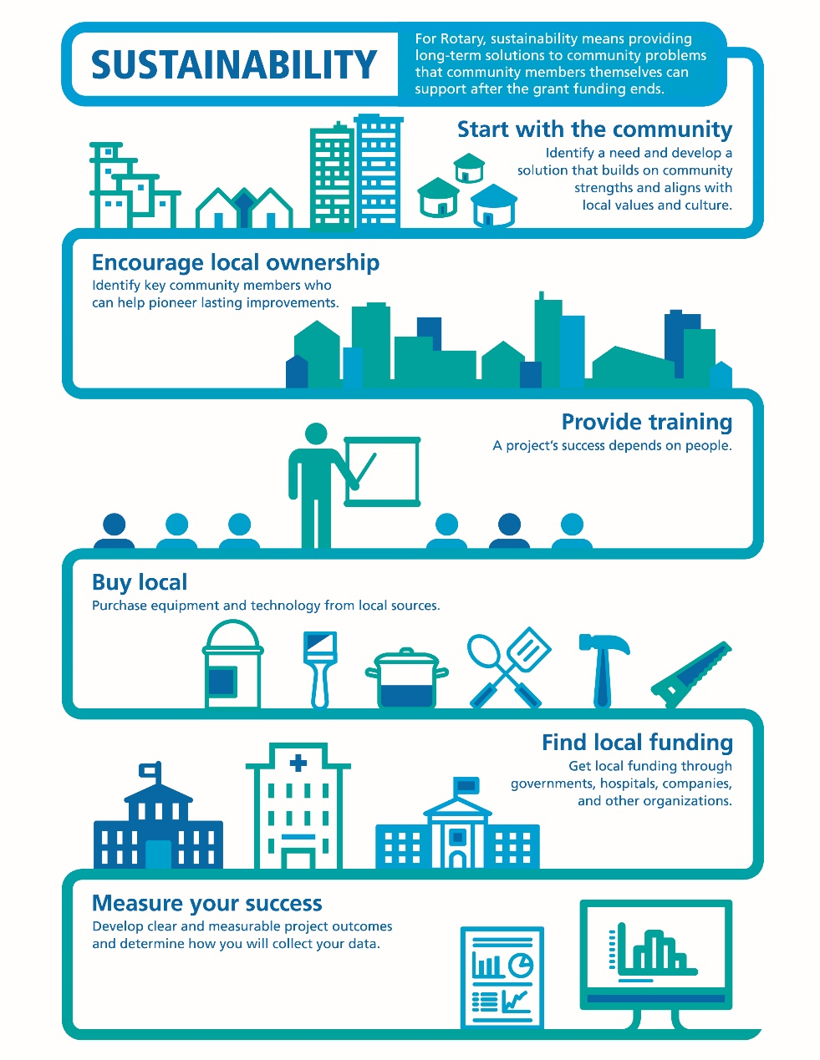
SUSTAINABILITY
Sustainability means different things to different organizations.
For Rotary, sustainability means providing long-term solutions to community needs that the beneficiaries can maintain after grant funding ends.
Notes:
I mentioned earlier, global grants must support projects that are sustainable. Sustainability means different things to different organizations. For Rotary, sustainability means providing long-term solutions to community needs that the beneficiaries can maintain after grant funding ends.
To help Rotary members understand what we mean by sustainability, we’ve identified six steps that can help to ensure the long-term sustainability of a project.
Step 1 Start with the community
Step 2 Encourage Local Ownership
Step 3 Provide Training
Step 4 Buy Local
Step 5 Find Local Funding
Step 6 Measure Your Success

Slide 12
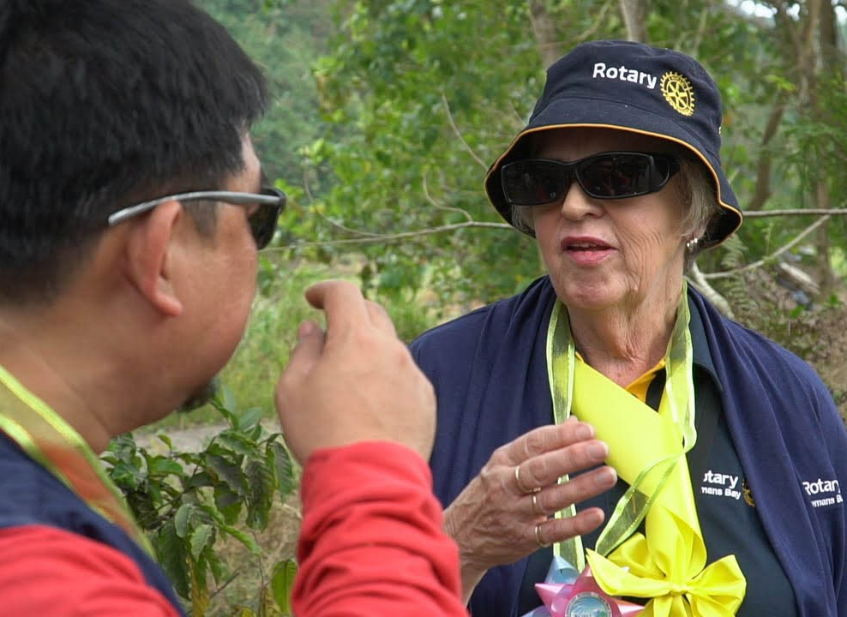
HOW To find partners
Discussion Groups on
My Rotary
Rotary Action Groups
Intercountry committees
Project fairs
Rotary Fellowships
Rotary Showcase
Notes:
International collaboration is also a key feature of global grants.
The Rotary network allows you to work toward a common goal with members from other countries, which also offers the chance to build goodwill and understanding. Networking is one of the things Rotary does best and we have many resources and ways to connect. So take full advantage of your Rotary!
You have many ways to find partners in Rotary:
Discussion Groups on My Rotary. In these forums, clubs exchange project ideas and request assistance.
Rotary Action Groups. They bring together members and others who are experts in a particular field to help clubs and districts with projects.
Intercountry committees. These networks of Rotary clubs or districts in two or more countries work together on service projects, sponsoring new clubs, or other activities.
Project fairs. Districts host these regional events to encourage international friendship and collaboration.
Rotary Fellowships. These independent social groups focus on a hobby, recreational activity, or profession.
Rotary Showcase. This is where clubs can seek partners or financial support, share project budgets, and build relationships with other clubs.

Slide 13
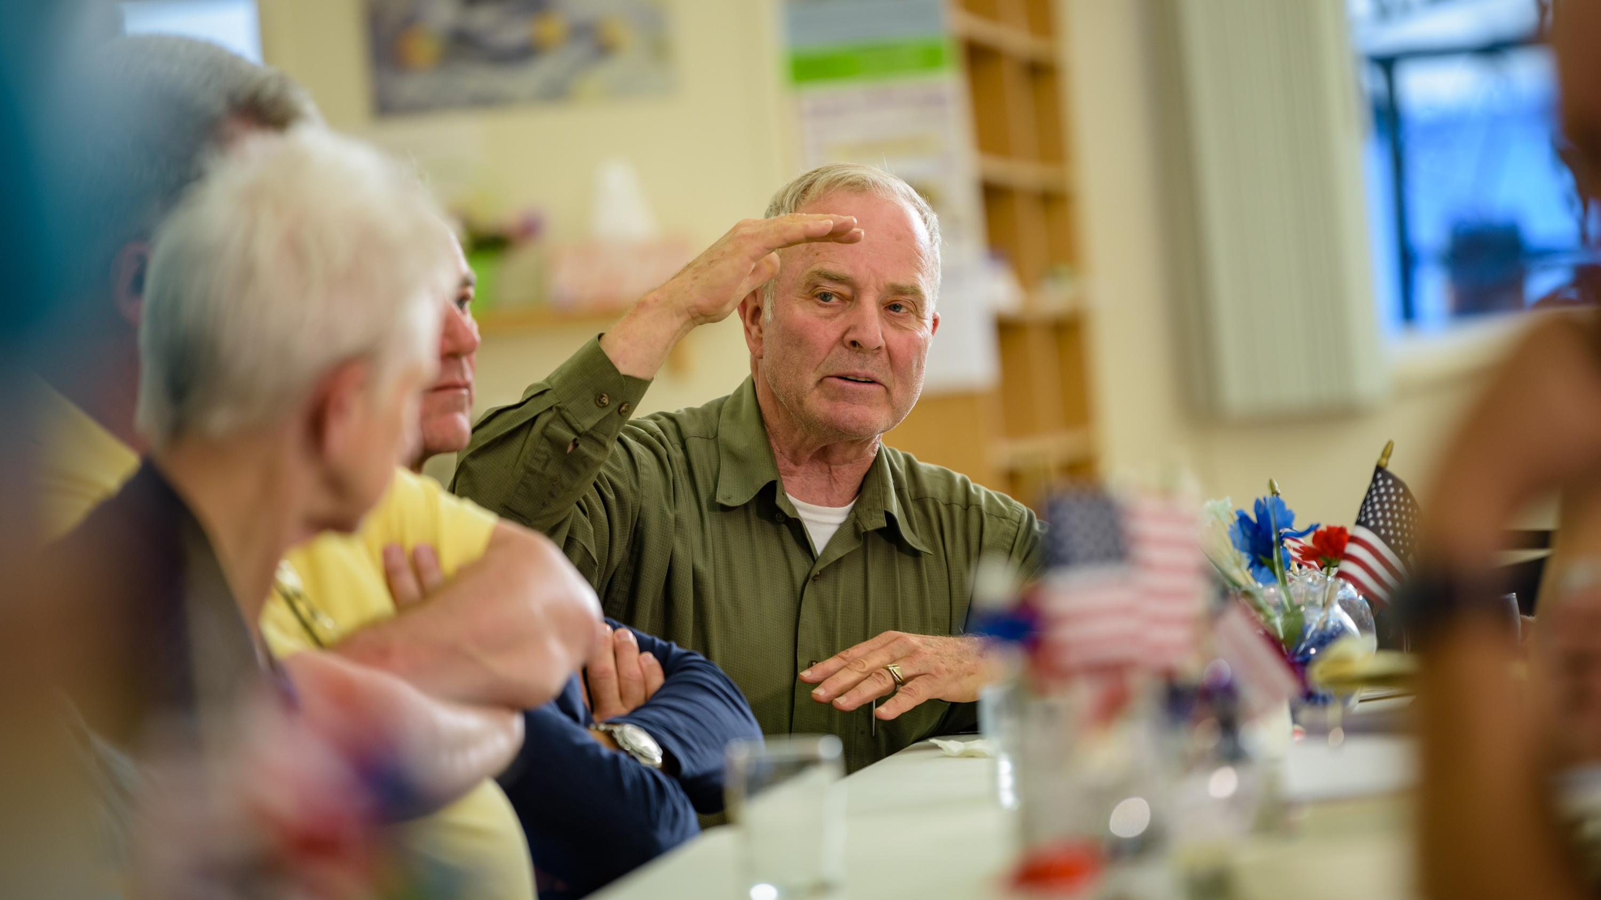
QUALIFICATION
Notes:
So let’s briefly talk about Qualification

Slide 14
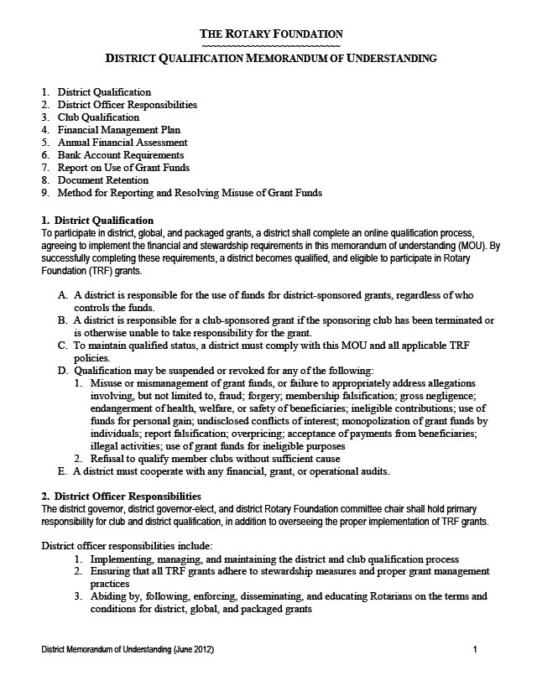
DISTRICT QUALIFICATION
District leaders complete qualification process online annually
Agree to implement MOU
Conduct grant management seminars for clubs
Notes:
As I mentioned earlier in the presentation, districts must become qualified in order to receive grant funding from The Rotary Foundation. The online qualification process helps ensure that your district understands your financial responsibilities, including stewardship, and is prepared to take them on. Qualification must be completed each year.
Becoming qualified is simple. Your district governor, governor-elect, and Rotary Foundation chair should:
Read through the district qualification memorandum of understanding (MOU), answer a series of questions, and agree to the MOU
Conduct grant management seminars for clubs

Slide 15
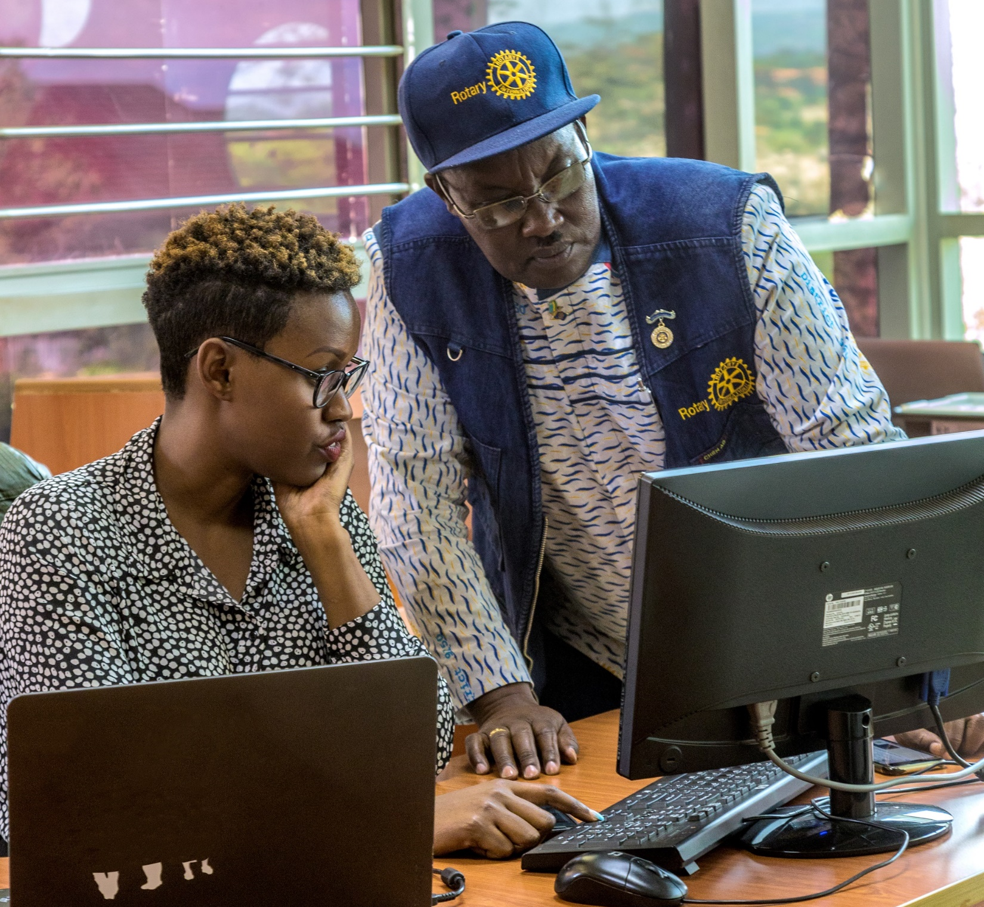
CLUB QUALIFICATION
Agree to implement the club MOU
Send club member to grant management seminar sponsored by the district or complete online seminar in Rotary’s Learning Center
Complete any other district requirements
Notes:
Clubs that want to apply for global grants must also be qualified. Districts are responsible for qualifying their clubs each year. To become qualified, your president and president-elect must:
Agree to implement the club qualification MOU
Send at least one club member to a grant management seminar held by your district or complete the online grant management seminar in Rotary’s Learning Center.
Complete any additional steps that your district requires
Your club must qualify each year if you plan to apply for global grants.

Slide 16
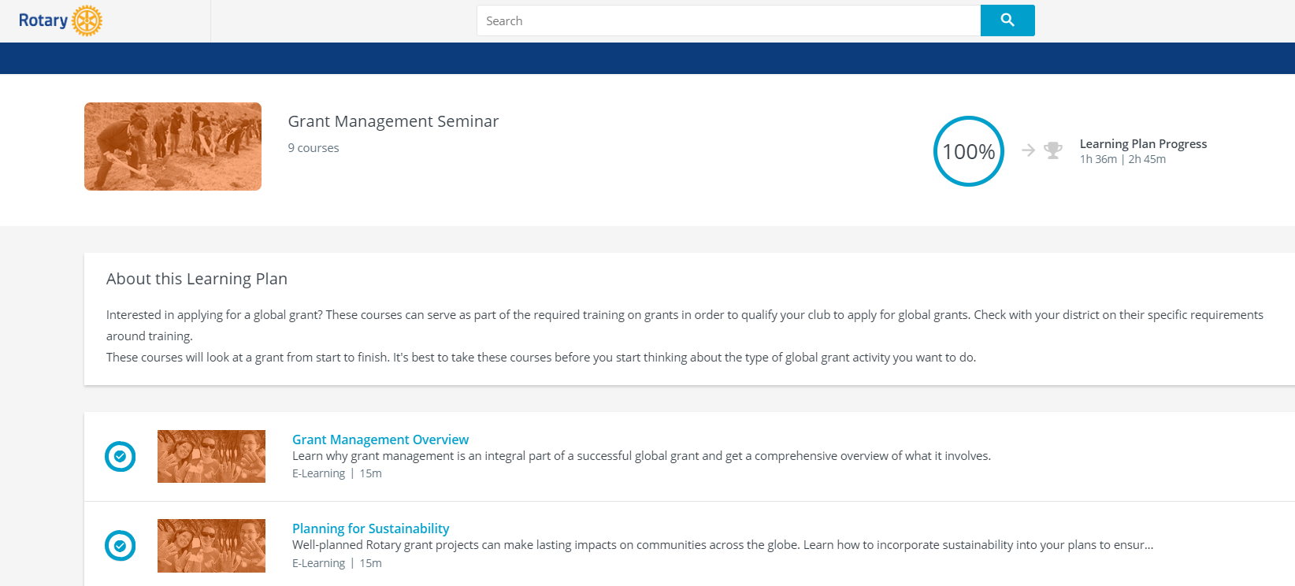
ONLINE GRANT MANAGEMENT SEMINAR
Notes:
To further support clubs, we have a series of grant management courses available online in Rotary’s Learning Center. These courses are grouped together into a Grant Management Seminar Learning Plan. These courses can help clubs get qualified for Rotary Foundation grants and offer them strategies for developing successful projects.
Topics include:
Making your project sustainable
Conducting community assessments
Planning effective projects
Managing grant finances
Reporting on grants, and much more
Districts can choose to offer the online courses as a way to get qualified, or they can choose a mixed approach, having attendees take the online courses first and then attend a shorter in-person training to discuss district requirements, questions, etc.

Slide 17
GLOBAL GRANT VS. DISTRICT GRANT
 | Global grant | District grant
Cost | $30,000 minimum budget | No minimum budget
Funding | World Fund, DDF, cash | DDF
Application | Online in the Grant Center | Managed by district
Area of focus | Project aligns with area of focus | No area of focus requirement
Partnership | Host and international partnership | No partnership required
Sustainability | Required | Not required
Measurability | Required | Not required
Scholarships | Graduate and post-graduate | No study level requirement
Notes:
We have this summary chart that highlights the differences between District and Global Grants.

Slide 18
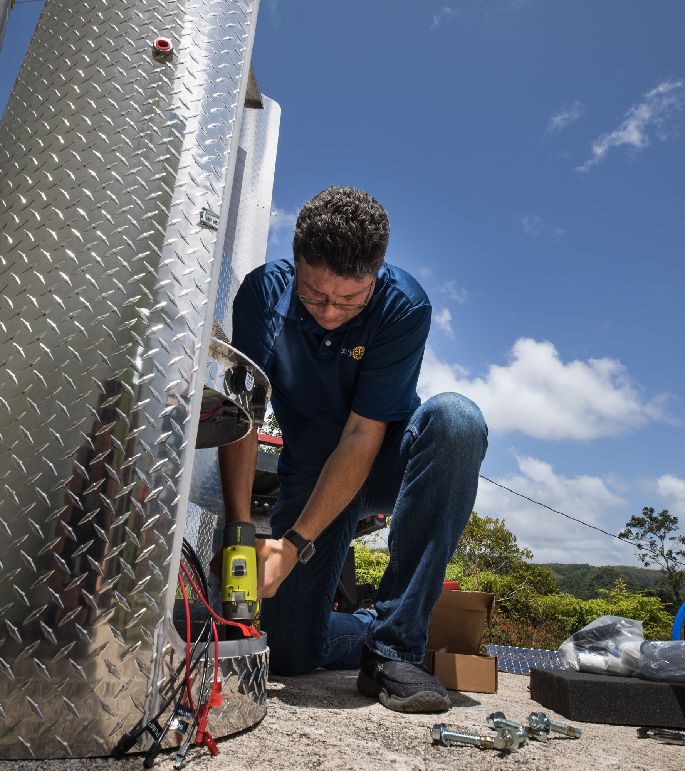
subhead
Disaster response GRANTS
Support relief and recovery efforts in areas affected by natural disaster
Funded by contributions to the Rotary Disaster Response Fund
Rotary Year 21-22
207 grants $8 million
Notes:
Now I’d like to share some information about one of our newer grant types: disaster response grants. These grants support relief and recovery efforts in areas affected by natural disaster. Qualified districts in affected areas may apply for grants of up to $25,000, based on the availability of funds. Grant funds can be used to provide basic items such as water, food, medicine, and clothing.
Districts that request help are responsible for determining the needs in communities affected by disaster. They should work closely with local officials and community groups to ensure that the funding meets the most pressing needs.
These grants are funded by contributions to the Rotary Disaster Response Fund. The fund can accept cash contributions and District Designated Funds (DDF). It is a general disaster-related reserve, and contributions cannot be designated for specific events.

Slide 19
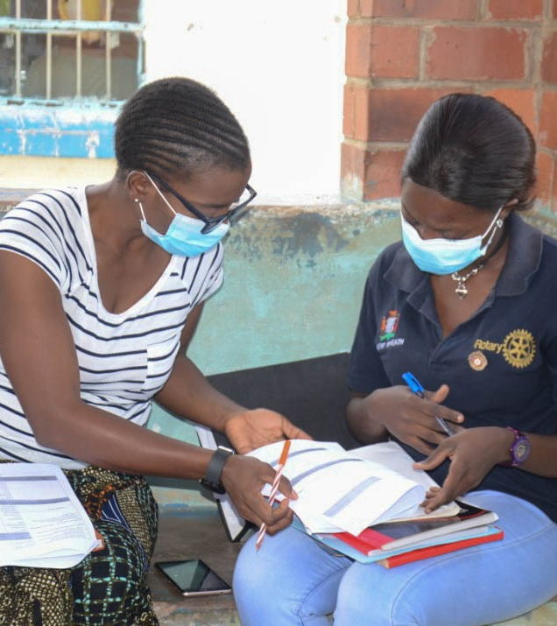
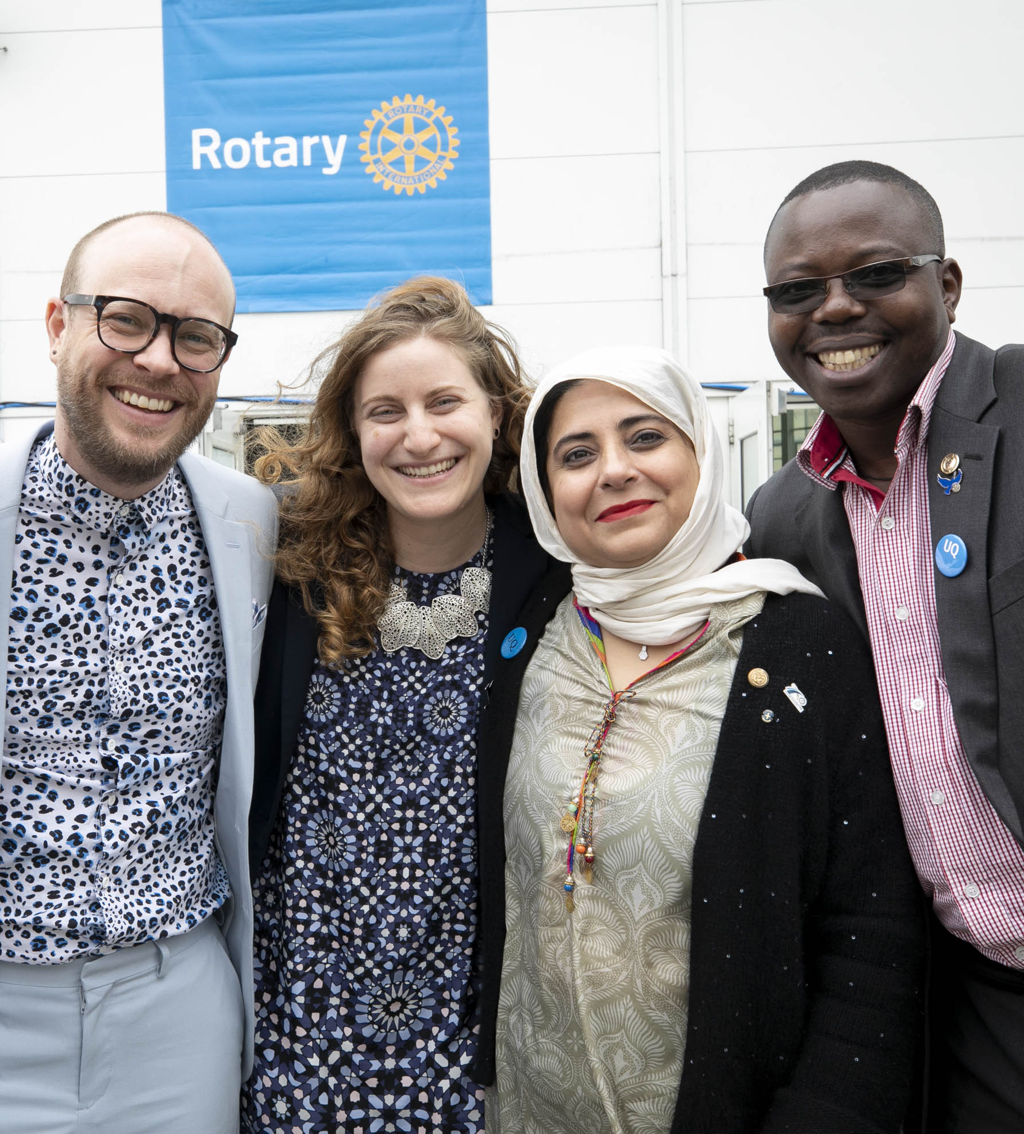
subhead
Rotary Peace Centers
130 fellowships awarded annually to global peace and development leaders
8 university partners offer Master’s and Certificate programs
1400+ alumni working in over 115 countries
New center in Africa established in 2020
$15.5M donation to establish new center in the Middle East or Northern Africa
Notes:
The Rotary Peace Centers program has a vision of creating sustainable peace ― encompassing a network of peacebuilders and community leaders dedicated to preventing and resolving conflicts around the globe.
Rotary has developed partnerships with 8 renowned universities that host the Rotary Peace Centers. The centers empower, educate, and increase the capacity of peacebuilders through rigorous academic training, practice, and global networking opportunities.
Up to 130 Rotary Peace Fellows are selected each year to earn a master’s degree or a professional development certificate.
Since the Rotary Peace Centers began in 2002, more than 1,400 people have graduated from our programs and are working on peace and development initiatives in more than 115 countries.
Program alumni serve as leaders in government and nongovernment agencies, education and research, United Nations agencies, law enforcement and the military, humanitarian groups, and international organizations.
The Rotary Peace Centers is growing it’s program and has already added the first Rotary Peace Center in Africa, in Uganda, in 2020. And The Otto and Fran Walter Foundation has pledged $15.5 million to The Rotary Foundation to start a Rotary Peace Center in the Middle East or North Africa in the coming years.
More information is available at: https://www.rotary.org/en/our-programs/peace-fellowships

Slide 20
subhead
Programs of scale
Long-term activities that benefit large number of people
Alignment with areas of focus
World Fund award of $2 million; no additional Rotarian funding required
Implemented with partner organization(s)
Competitive two-step application process
Notes:
Programs of Scale is a way the Rotary community can increase global impact and measure how we do that.
Programs of Scale is a new grant that enhances the scope, impact, and sustainability of successful Rotary member-led service projects in our areas of focus, by providing longer-term resources. It empowers Rotary members to implement large-scale, high-impact programs with experienced partners that benefit a large number of people in need across a significant geographic area.
The Rotary Foundation will award one $2 million grant each year to a program sponsored by a Rotary club or district working in strong collaboration with partners. It is a competitive process that requires a concept note and full proposal. Applicants should be prepared to include a fully developed program design that is based on clear evidence and involves all of the key stakeholders for successful implementation and sustainability. Monitoring, evaluation, and learning should be fully integrated into the program as well. Each grant will help these programs scale up over a three- to five-year period.
We have awarded two of these grants so far.
20-21 Partners for a Malaria-Free Zambia, a malaria elimination program that aims to reduce cases of malaria – especially severe malaria and death, particularly for pregnant women and children under 5 – in ten target districts in two provinces in Zambia.
21-22 The Together for Healthy Families in Nigeria, fostering the health of mothers and newborns, program is working to reduce maternal and neo-natal mortality rate by improving health seeking behavior and quality care for pregnant women, mothers, and newborns in Nigeria.
More information is available at rotary.org/programsofscale.

Slide 21
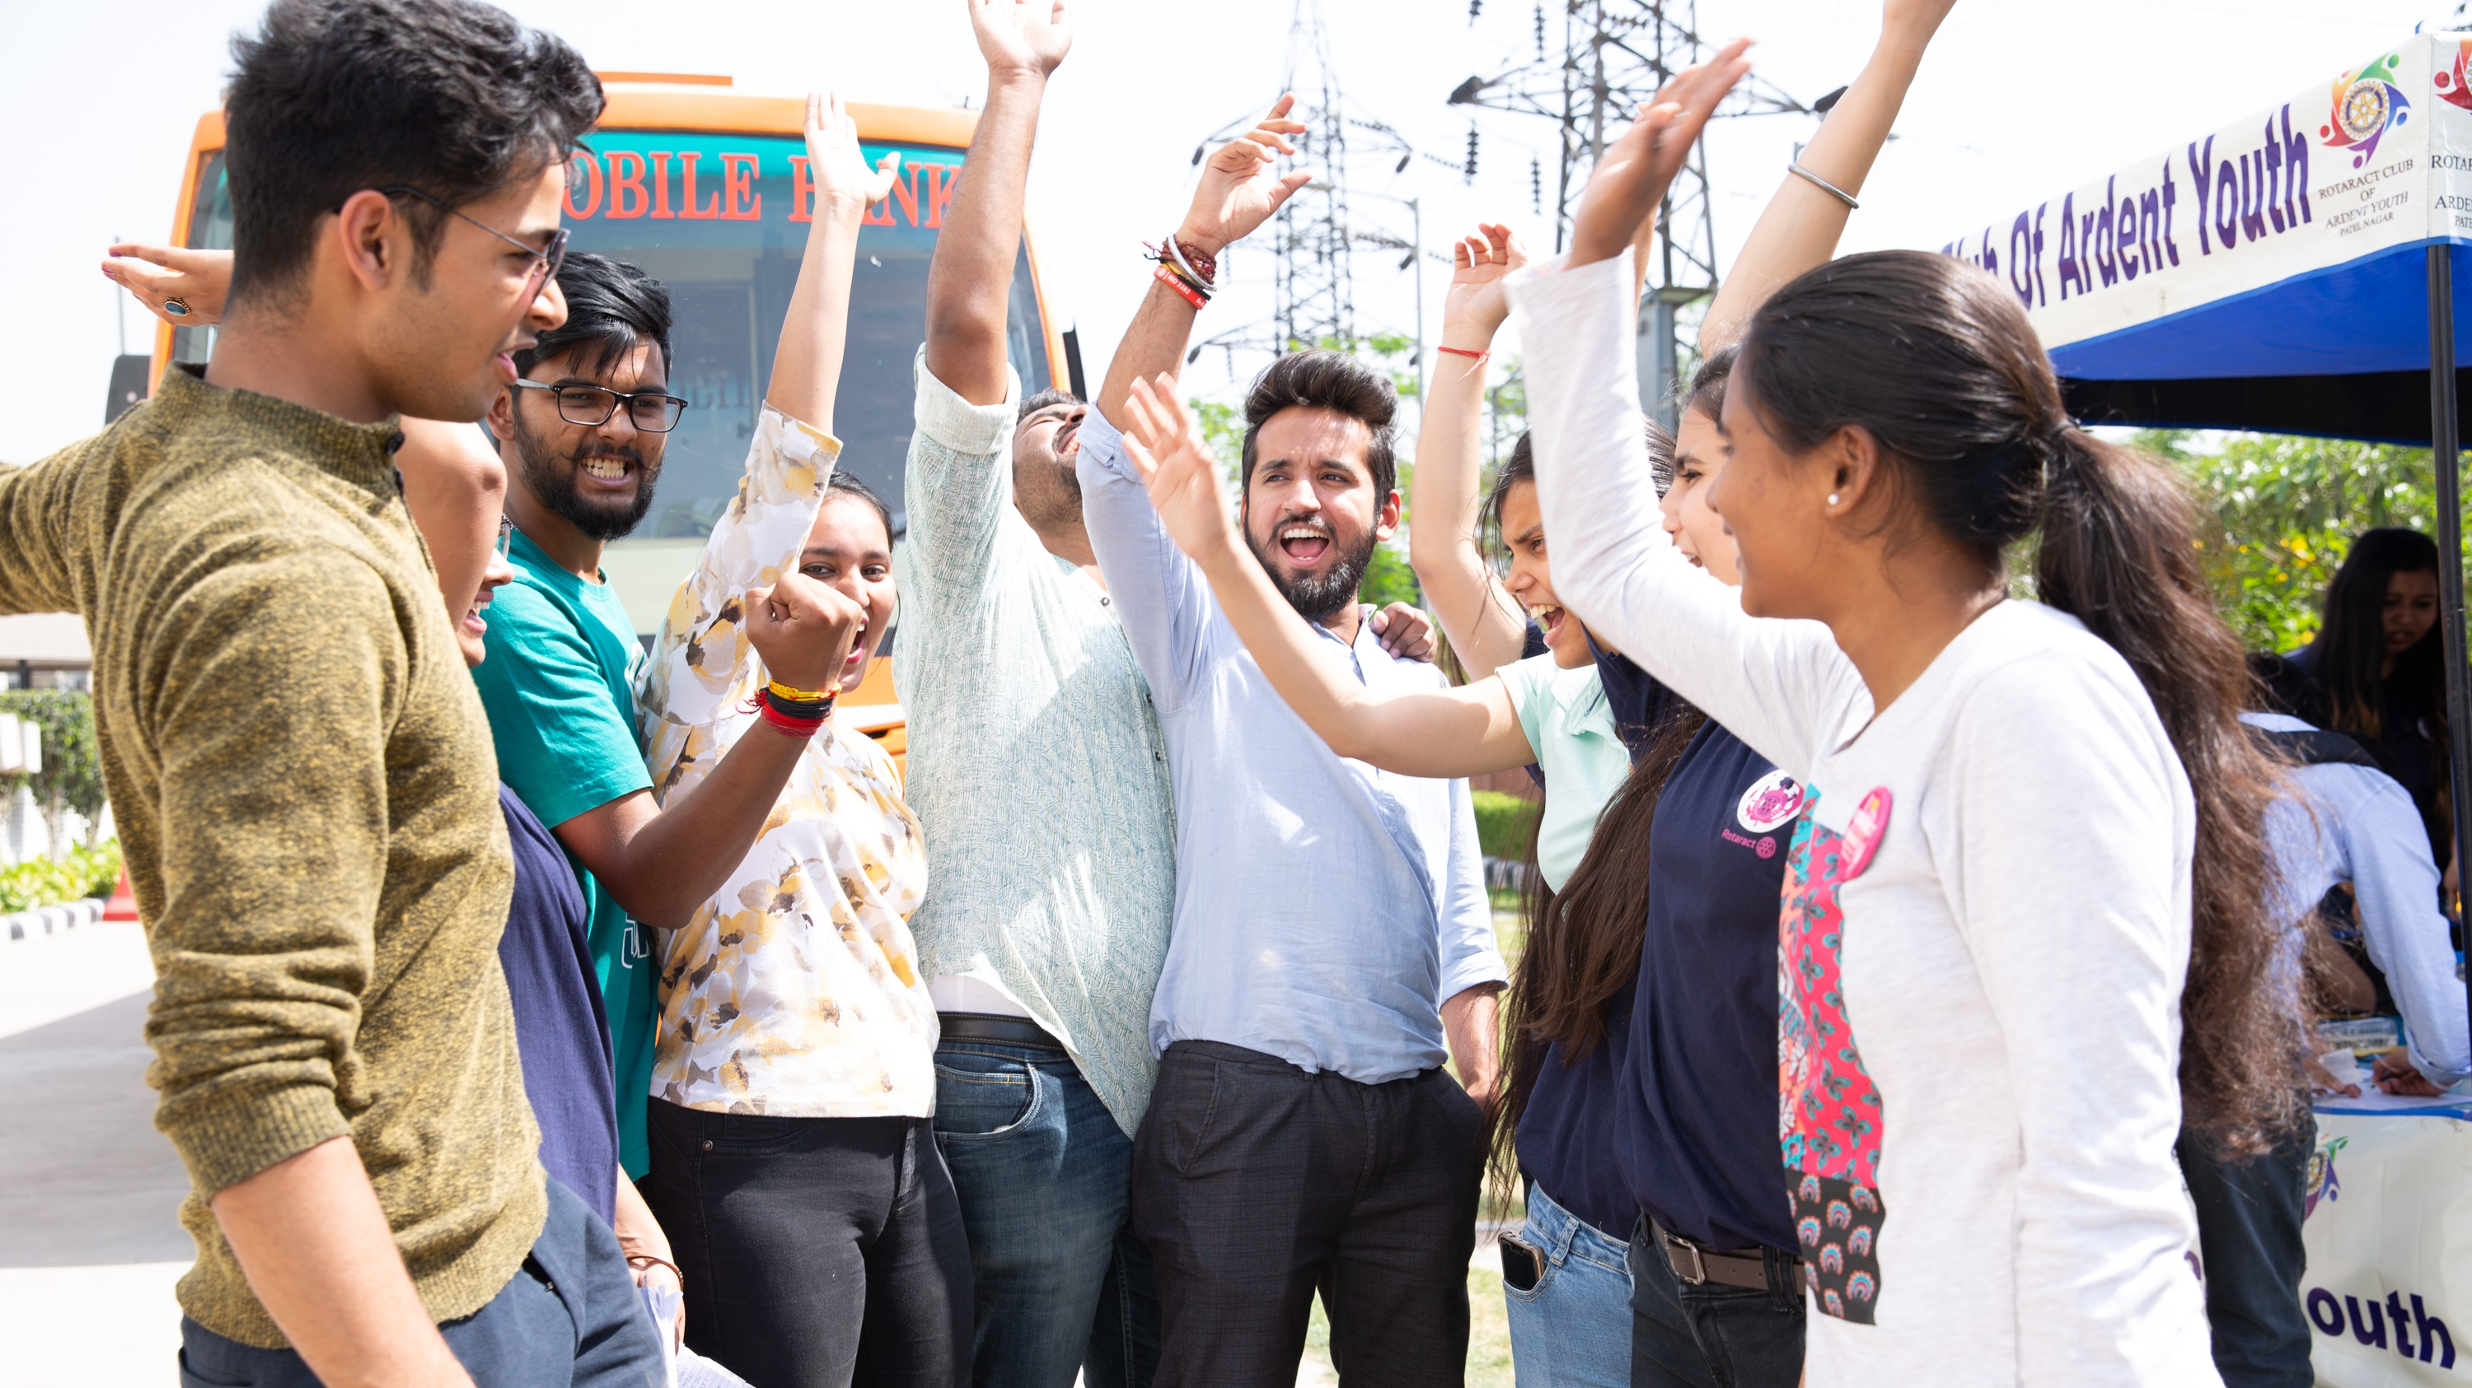
UPDATES
Notes:
Now let’s take a look at some recent developments

Slide 22

ENVIRONMENT
Unanimous decision to add area of focus: environment
Officially launched July 2021
Global grant applications now accepted
Notes:
As mentioned earlier, Rotary has a new area of focus: environment. In June 2020, both the Trustees and Board unanimously approved the motion to add a new area of focus: environment. The cause officially launched on 1 July 2021. Clubs and districts are now able to apply for global grants to support environment-focused activities.

Slide 23
ENVIRONMENT STATS
2021-22 Environment stats
Area of Focus / Activity Type | Number of Grants | World Fund | Total Funding
Environment | 33 | $623,218 | $1,928,012
Humanitarian projects | 22 | $453,023 | $1,441,150
Scholar | 11 | $170,195 | $486,862
Notes:
A total of 33 grants addressing the environment have been awarded last year.

Slide 24
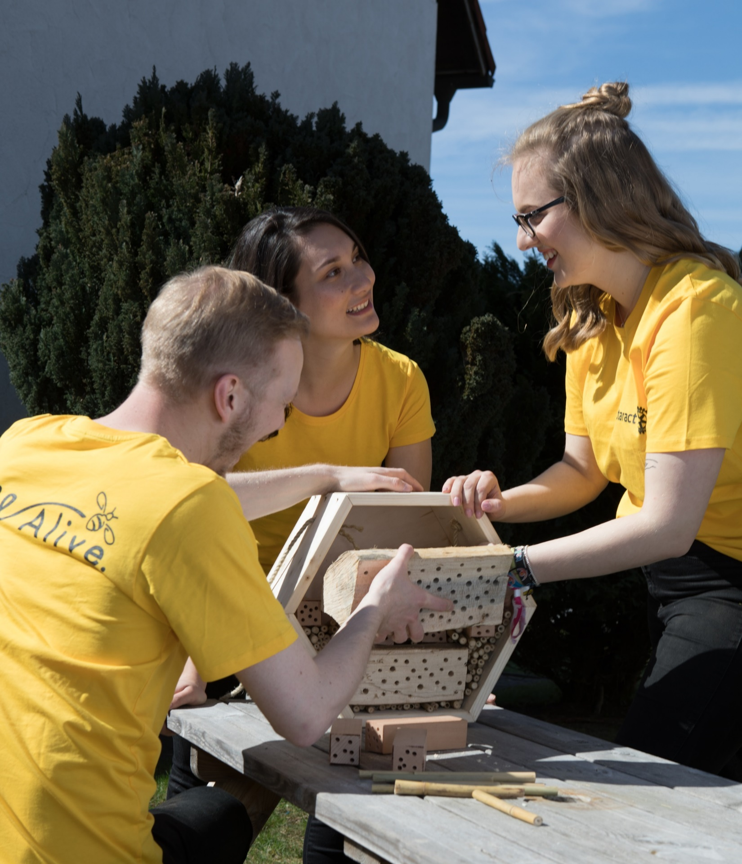
ROTARACT PARTICIPATION IN GRANTS
January 2022: Rotaract clubs may be included in district grant spending plans
July 2022: Rotaract clubs can apply for global grants
  Prior experience with global grants
  Partner with Rotary club
Suggestion: Start with district grants then move to global grants.
Notes:
We have an exciting update regarding Rotaract clubs and Rotary grants. Over the years, Rotaract clubs have often partnered with Rotary clubs to participate in Rotary grant-funded projects. Starting this year, Rotaract clubs will have direct access to Rotary grants.
Beginning in January 2022, districts have the option to include Rotaract clubs directly into their district grant spending plans.
And, since July 2022, Rotaract clubs can apply for global grants to support their service efforts in their own communities or abroad. To be eligible to sponsor a global grant, a Rotaract club must have partnered previously with a Rotary club or district on a global grant-funded project and must be qualified. Also, Rotaract clubs wishing to apply for a global grant must have a Rotary club as their co-sponsor on the grant application.
In general, Rotaract clubs are encouraged to begin their involvement in grants through districts grants. Once they build their club’s capacity to carry out grant funded projects, they can consider moving on to global grants.

Slide 25
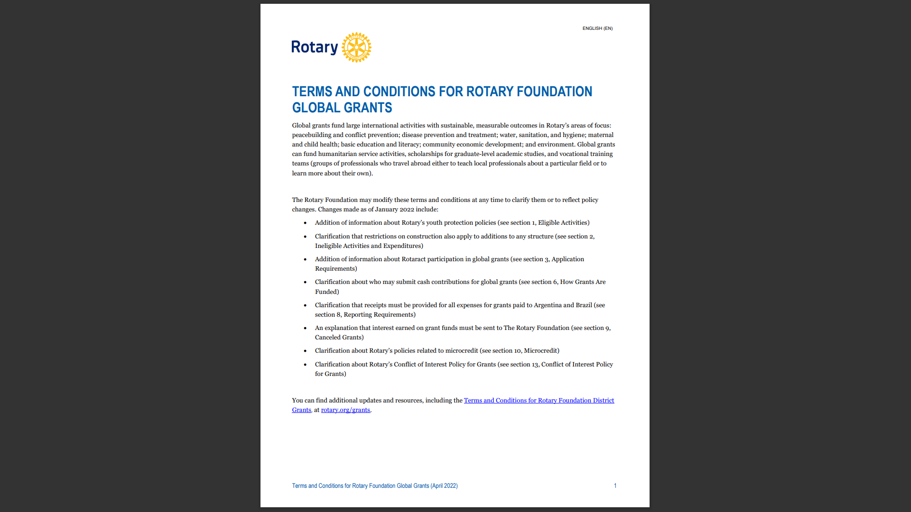
Terms and conditions
Terms and Conditions are now available in separate versions. One for Global Grants and one for District Grants.
Notes:
Terms and Conditions – one for Global Grants, one for District Grants

Slide 26
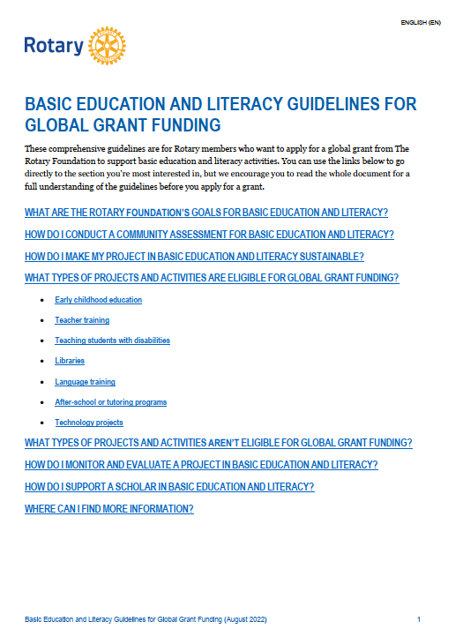
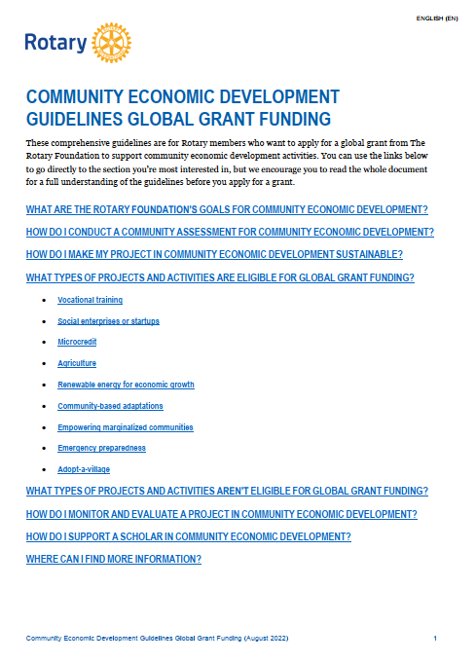
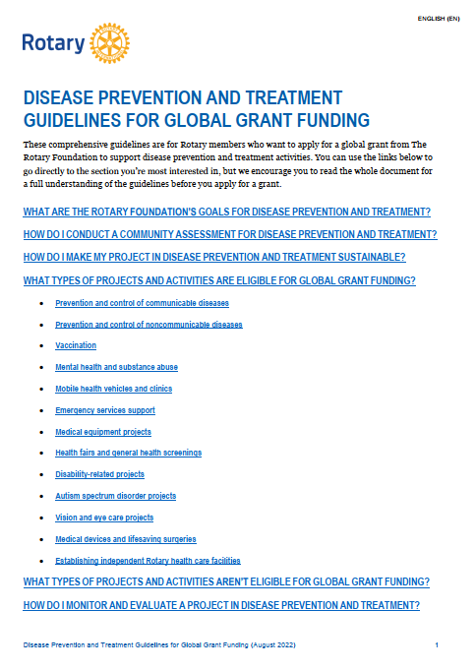
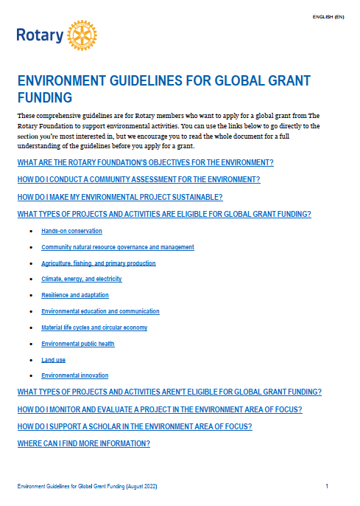
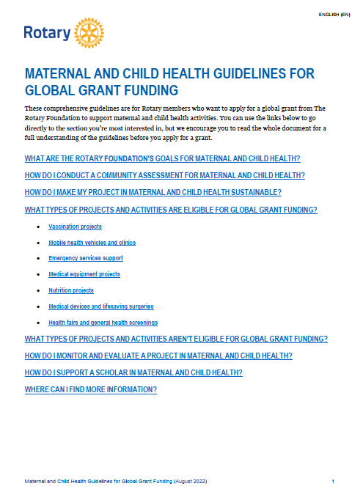
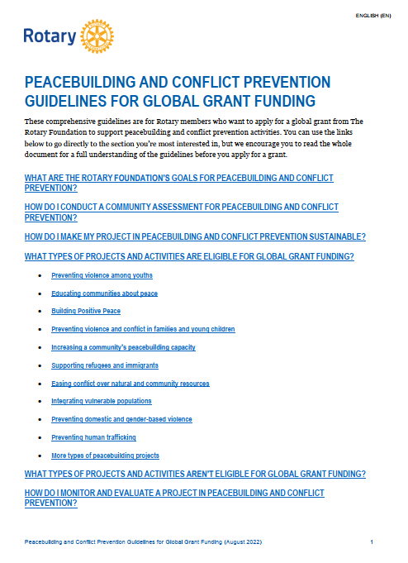
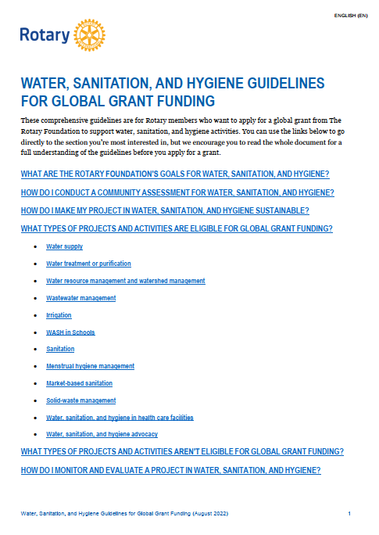
AREA OF FOCUS GUIDELINES
Notes:
Another set of resources that will be helpful to you if you decide to apply for a global grant are the area of focus guidelines. We’ve recently updated these documents—one for each area of focus—and they can be found on My Rotary.
Each document includes information specific to that area of focus about the Foundation’s goals, community assessments, sustainability, what kinds of projects are eligible for funding and which ones aren’t, monitoring and evaluation, scholarships, and other resources.

Slide 27

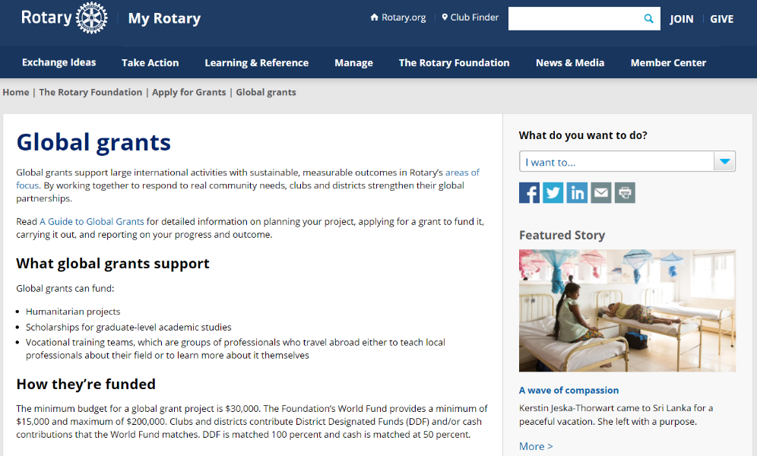
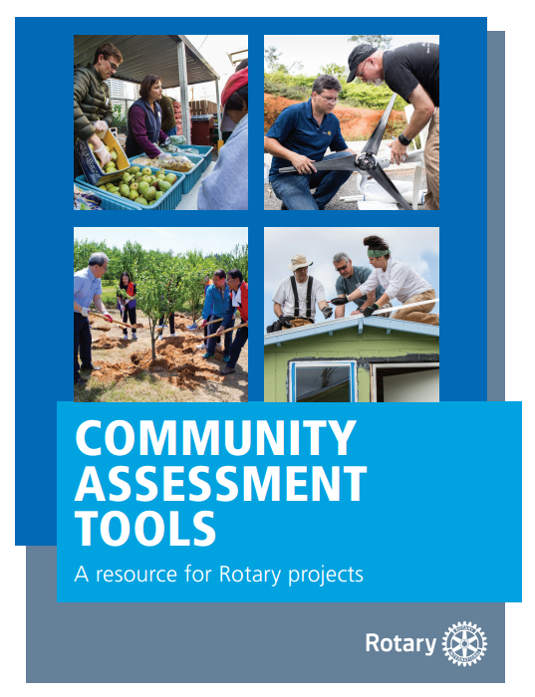
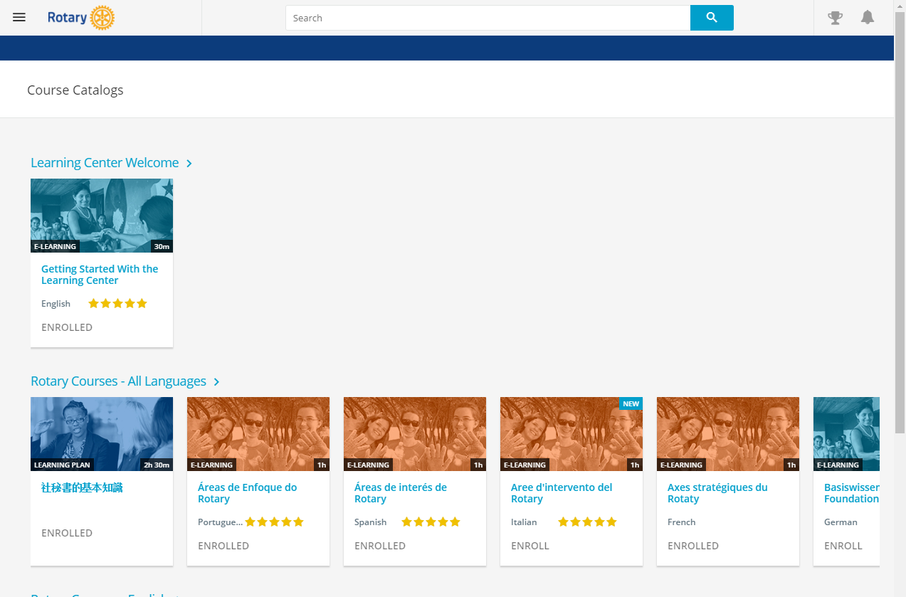
RESOURCES
Notes:
We have a number of resources available to help you take full advantage of grant opportunities.
I encourage you to read A Guide to Global Grants. This helpful manual includes everything you need to know to get started with global grants.
Rotary’s website has a wealth of general and detailed information about each of our grant types.
The recently refreshed learning center offers training resources on a wide variety of topics, including, as I mentioned earlier, information to help you apply for Foundation grants. I would encourage anyone interested in applying for grants to take the grant management seminar courses in the Learning Center.
Community Assessment Tools, is an invaluable resource for clubs and districts who are conducting a community assessment.

Slide 28
QUESTIONS

