Slide 1
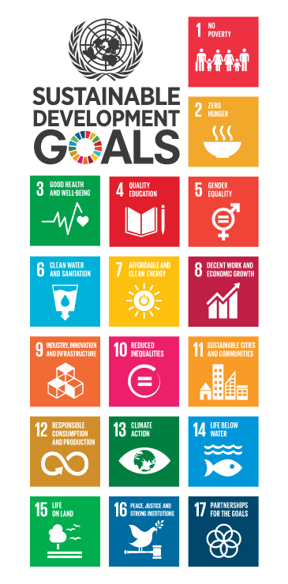

Notes:
Rotary’s has 7 AOFs which are informed by the UN’s Sustainable Development Goals. They also represent areas that Rotarians accel working in.

Slide 2







GLOBAL GRANT FUNDING BY AREA OF FOCUS (RY14-22)
Notes:
Here is a chart that shows the funding levels in all the areas of focus since the launch of global grants. As you can Disease Prevention and Treatment is the most popular area of focus by far. But it is followed by Water, Sanitation and Hygiene and Community Economic Development. In this session we are going to look at each AOF and learn more about the goals under each Area of Focus and talk about some of the common project types.

Slide 3
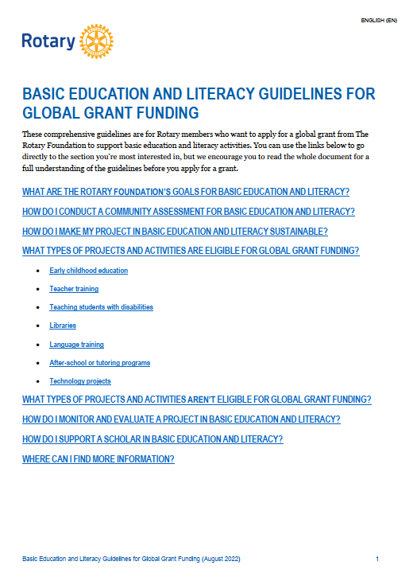
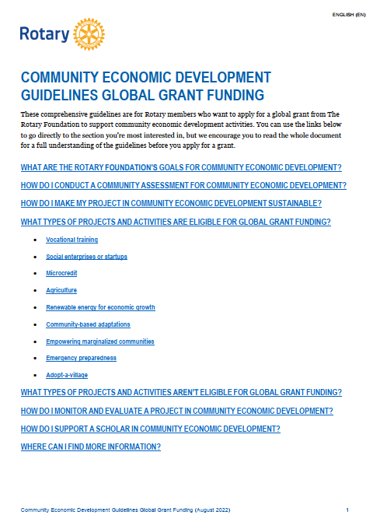
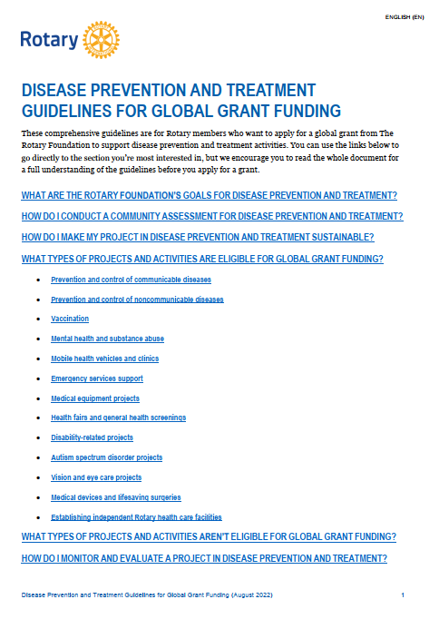
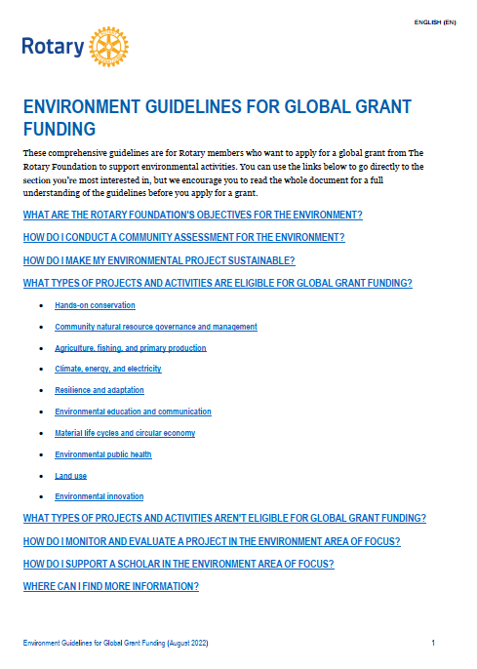
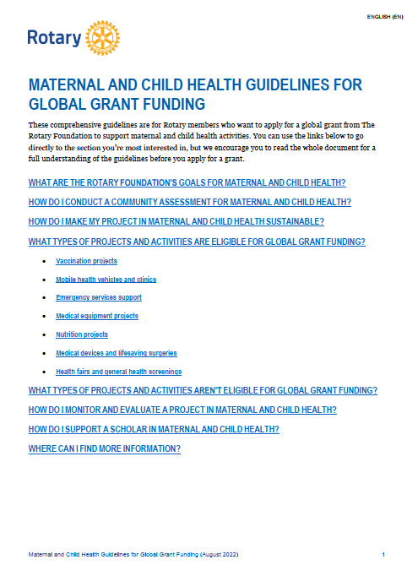
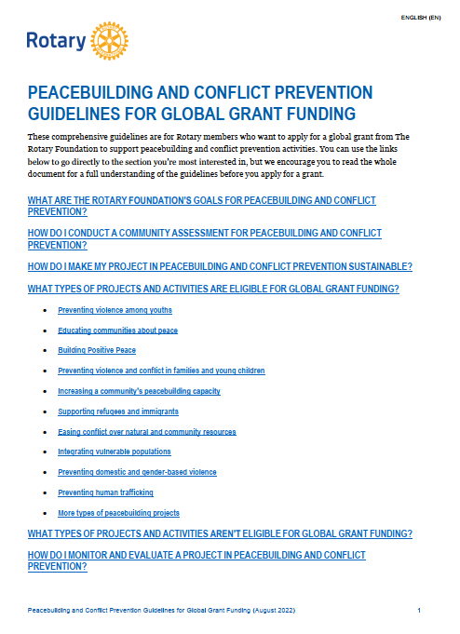
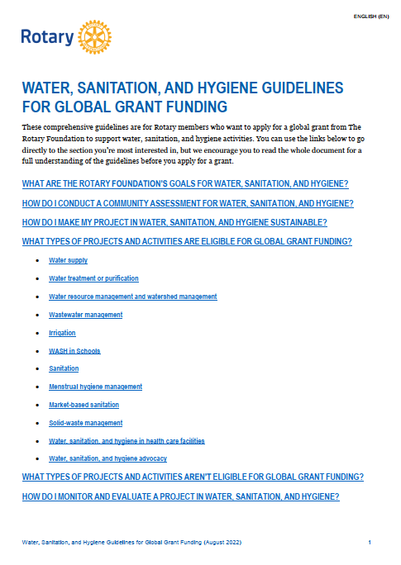
AREA OF FOCUS GUIDELINES
Notes:
Everything we are going to talk about, and so much more, can be found in the Area of Focus specific Guidelines for Global Grant funding. This is what I reference when reviewing a global grant application to determine if it is a fit in the Area of Focus.
We’ve recently updated these documents and they can be found on My Rotary.
Each document includes information specific to that area of focus. They provide detailed guidance on the Area of Focus goals, information on what kinds of community assessment information we are looking for and key components of sustainability in that area of focus. They also describe what kinds of projects are eligible for funding and which ones aren’t. And they provide important coaching on best practices for successful projects, all tailored to the project type. I really cannot overstate how important it is to look through the Area of Focus Funding Guidelines when considering doing a project.

Slide 4

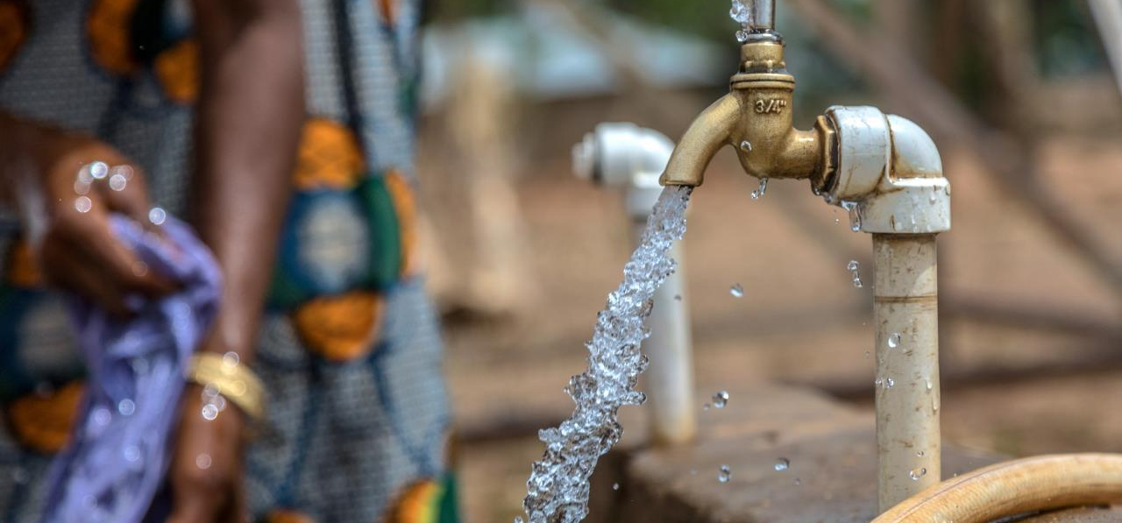
ENVIRONMENT (Since July 2021)
Notes:
The Environment is our newest area of focus. In June 2020, both the Trustees and Board unanimously approved the motion to add a new Area of Focus: Protecting the Environment. The cause officially launched on 1 July 2021. Clubs and districts are now able to apply for global grants to support environment-focused activities.

Slide 5



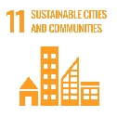



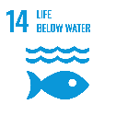
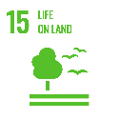
Global Grants (RY21-22)
$1.9 M total funding
33 grants
Rotary’s AOF
Protecting, preserving and conserving the environment
Conserve nature and biodiversity, from species to landscape-scale protection
Mitigate climate change by reducing or avoiding greenhouse gas emissions or ensuring that they are absorbed or stored in natural carbon sinks
Facilitate sustainable and adaptable livelihoods with smaller ecological footprints that maintain people’s social well-being in compatibility with flourishing natural systems
Strengthen environmental equity by addressing socio-environmental issues that disproportionally affect marginalized communities
Notes:
The primary objectives under the Environment area of focus are:
I. Conserve nature and biodiversity, from species to landscape-scale protection
II. Mitigate climate change by reducing or avoiding greenhouse gas emissions or ensuring that they are absorbed or stored in natural carbon sinks
III. Facilitate sustainable and adaptable livelihoods with smaller ecological footprints that maintain people’s social well-being in compatibility with flourishing natural systems
IV. Strengthen environmental equity by addressing socio-environmental issues that disproportionally affect marginalized communities
Since this is a new area of focus for us…we haven’t yet started to see a pattern in the types of projects Rotarians like to do most, but the guidelines clear action goals. So let’s take a look at those goals.

Slide 6
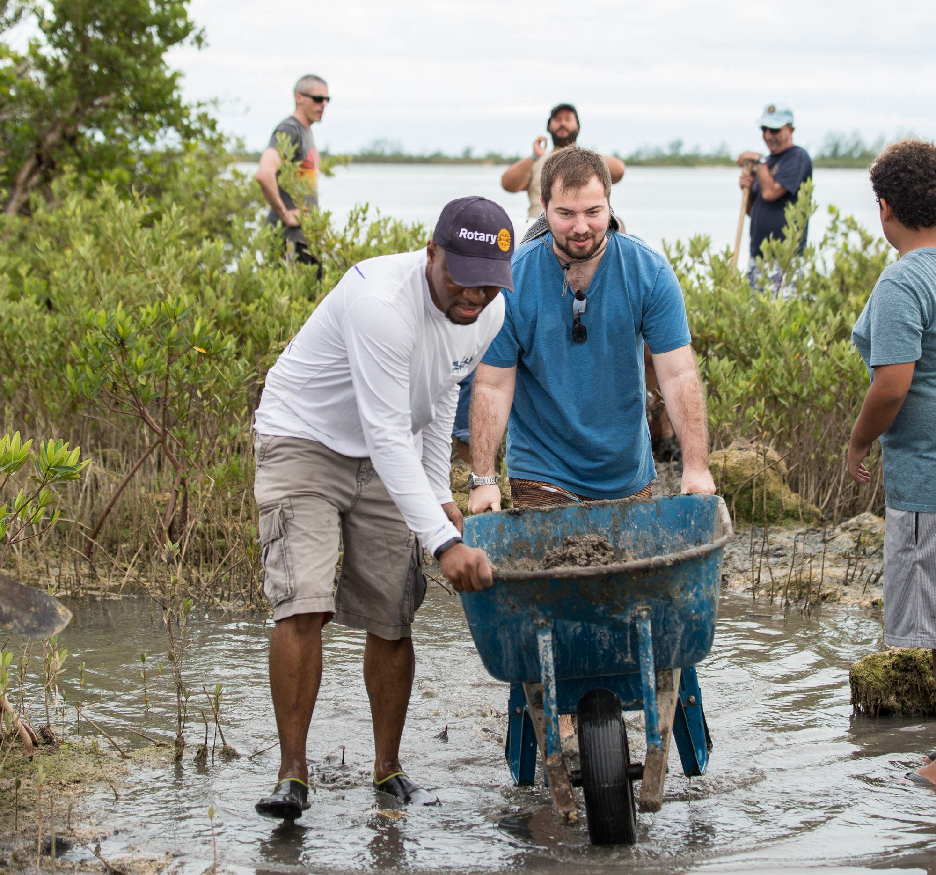
GLOBAL GRANT ELIGIBILITY: GOAL #1
Protecting and restoring land, coastal, marine, and freshwater resources
Notes:
There are eight main goals within the new area of focus and within each goal are specific parameters for eligibility. To be eligible to receive global grant funding, grant activities or a scholar candidate's academic program must be strongly aligned with one or more of these goals You can find more information about these goals and parameters for eligibility in the Areas of Focus Policy Statements, which are available on My Rotary. Now, we will briefly cover each of the eight goals.
Goal #1 is protecting and restoring land, coastal, marine, and freshwater resources
Eligible activities for this goal include:
Protecting and restoring terrestrial ecosystems and improving their resiliency through initiatives such as promoting reforestation, preventing deforestation, planting native vegetation, restoring habitats, and removing invasive plant and animal species
Preserving biodiversity by protecting and restoring habitats, conserving native species, removing invasive plant and animal species, conserving and protecting endangered species, and preventing poaching and the illegal wildlife trade
Supporting strategies and targeted initiatives to improve aquifer and groundwater recharging, water conservation, water quality, sanitation, and watershed management (adhering to the policy statements and guidelines for the water, sanitation, and hygiene area of focus)
Protecting and restoring coastal, marine, and freshwater ecosystems through initiatives such as habitat restoration, protecting and propagating native plant and animal species, removing invasive plant and animal species, addressing overfishing, pollution, coastal erosion and ocean acidification

Slide 7
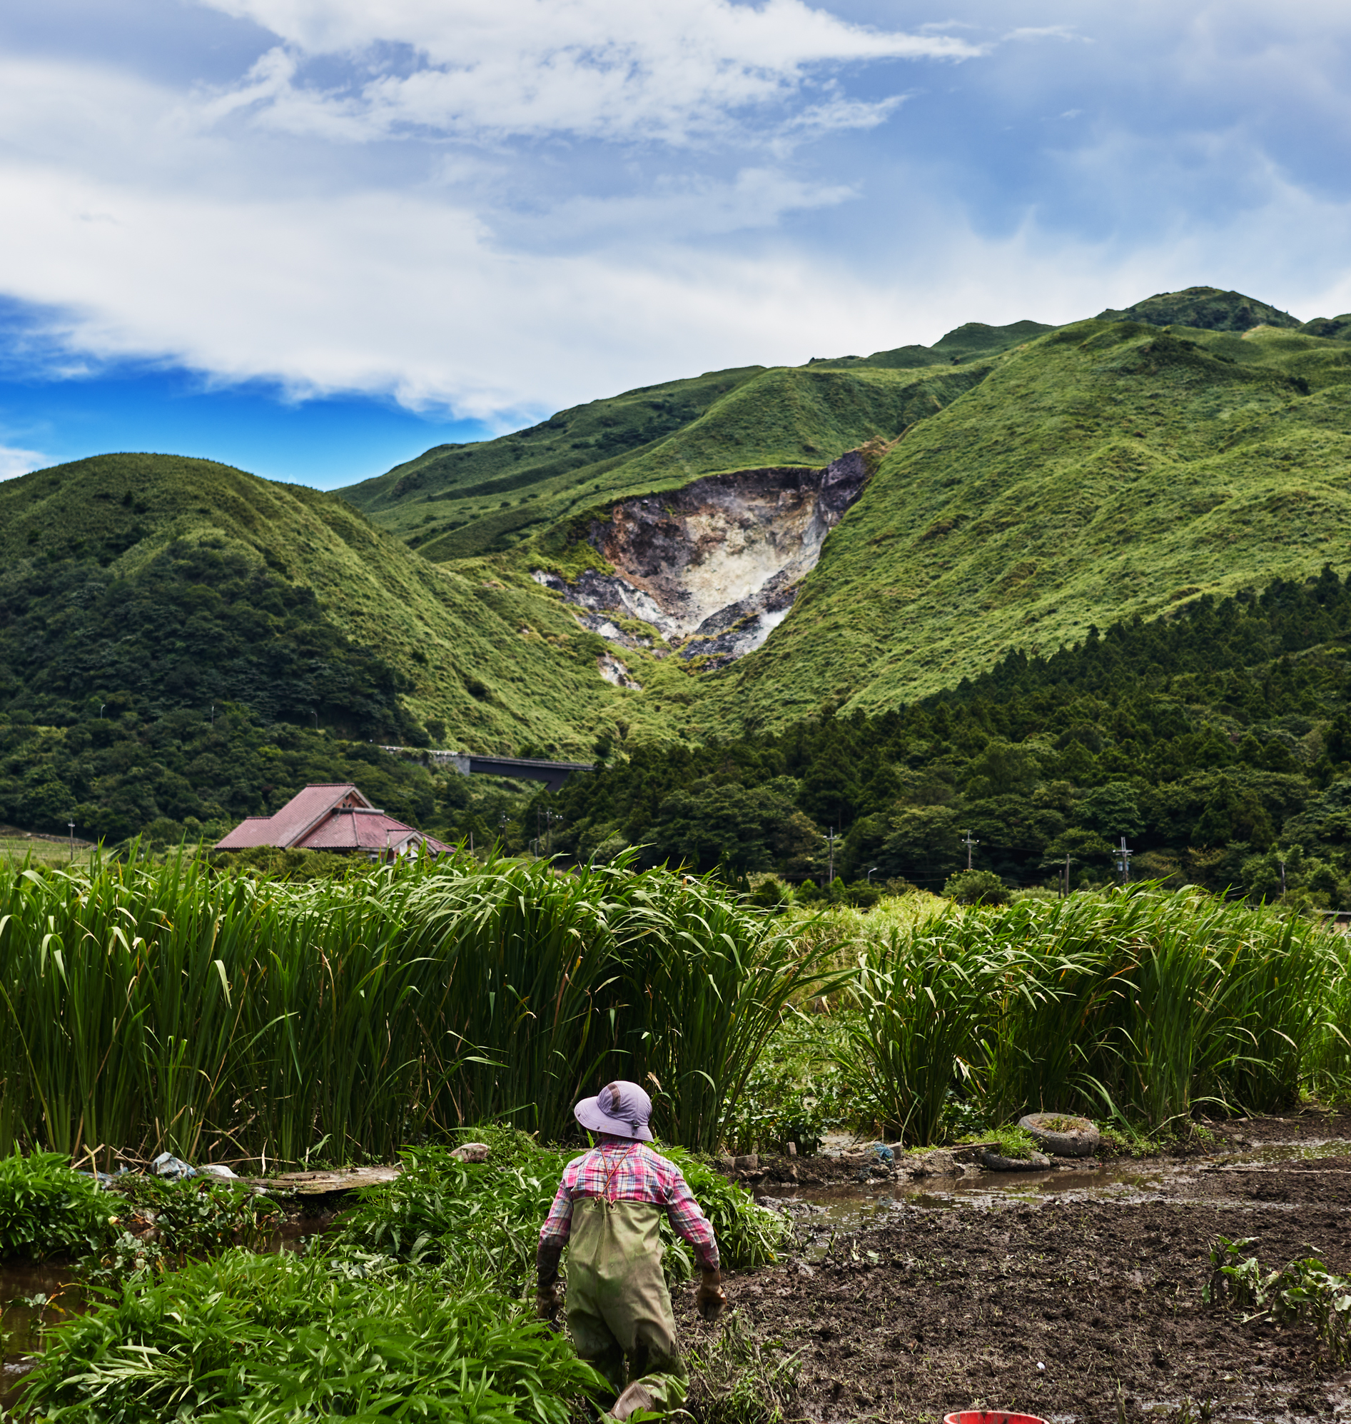
GLOBAL GRANT ELIGIBILITY: GOAL #2
Enhancing the capacity of communities and local governments to support natural resource management and conservation
Notes:
Goal #2 is enhancing the capacity of communities and local governments to support natural resource management and conservation.
Eligible activities for this goal include:
Developing peacebuilding and conflict prevention initiatives related to the management and use of natural resources (adhering to the policy statements and guidelines for the peacebuilding and conflict prevention area of focus)
Mitigating human-wildlife conflict through ecologically sound and peaceful resolutions
Training and educating communities in conservation and resource management to preserve, protect, and sustainably use natural resources

Slide 8
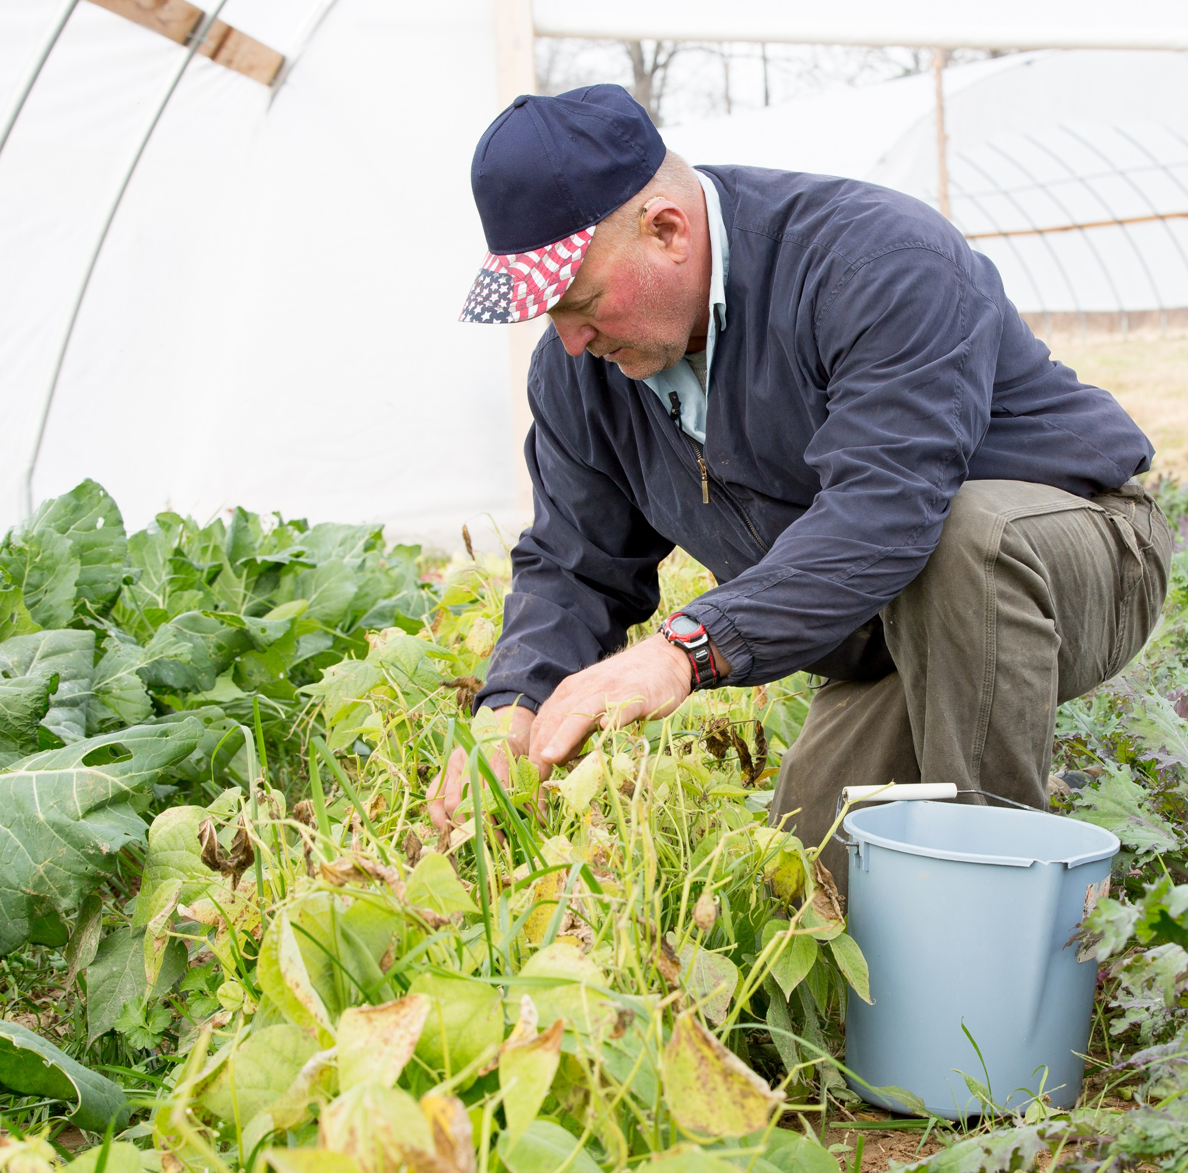
GLOBAL GRANT ELIGIBILITY: GOAL #3
Supporting agroecology and sustainable agriculture, fishing, and aquaculture practices to improve ecological health
Notes:
Goal #3 is supporting agroecology and sustainable agriculture, fishing, and aquaculture practices to improve ecological health.
Eligible activities for this goal include:
Creating awareness of and supporting ecologically viable agriculture through activities such as regenerative agriculture, conservation agriculture, managed grazing, silvopasture, and tree intercropping
Supporting sustainable fisheries and ecologically sound aquaculture (adhering to the policy statements and guidelines for the community economic development area of focus)
Promoting the use of traditional and Indigenous knowledge in agricultural, land, ocean, and natural resource management practices
Improving food security through sustainable agricultural, aquacultural, and fishing methods, enhanced local food production and consumption, reduction of food waste, and equitable access to high-quality food

Slide 9
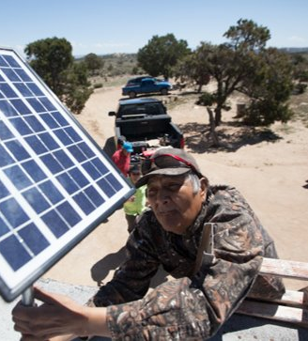
GLOBAL GRANT ELIGIBILITY: GOAL #4
Addressing the causes of climate change and climate disruption and supporting solutions to reduce the emission of greenhouse gases
Notes:
Goal #4 is addressing the causes of climate change and climate disruption and supporting solutions to reduce the emission of greenhouse gases.
Eligible activities for this goal include:
Providing access to locally sourced, renewable energy, including solar, methane-capture, and small-scale wind and hydropower systems, as part of holistic interventions to mitigate climate change and disruption
Providing clean-cooking technologies as part of a holistic approach to reduce or eliminate the burning of biomass and fossil fuels that results in deforestation, degraded land, or increased air pollution
Supporting the transition to sustainable, energy-efficient transportation modes through holistic urban and regional planning, education, or infrastructure changes

Slide 10
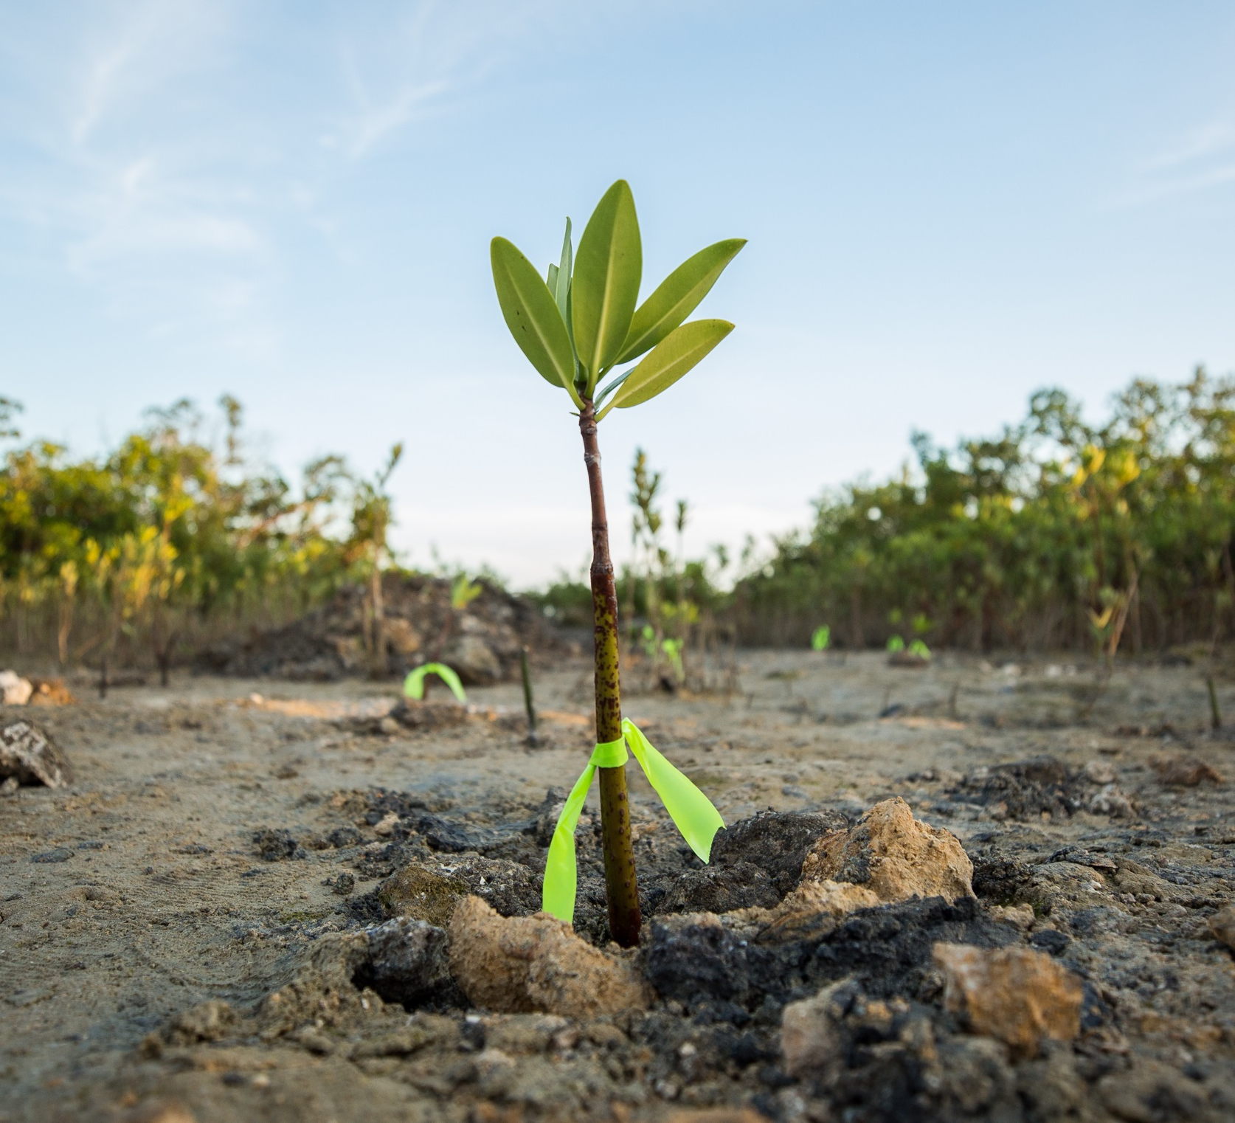
GLOBAL GRANT ELIGIBILITY: GOAL #5
Strengthening the resilience of ecosystems and communities affected by climate change and climate disruption
Notes:
Goal #5 is strengthening the resilience of ecosystems and communities affected by climate change and climate disruption .
Eligible activities for this goal include:
Supporting adaptation and resiliency strategies for ecosystems and communities affected by climate-related events, with an emphasis on vulnerable segments of the population

Slide 11
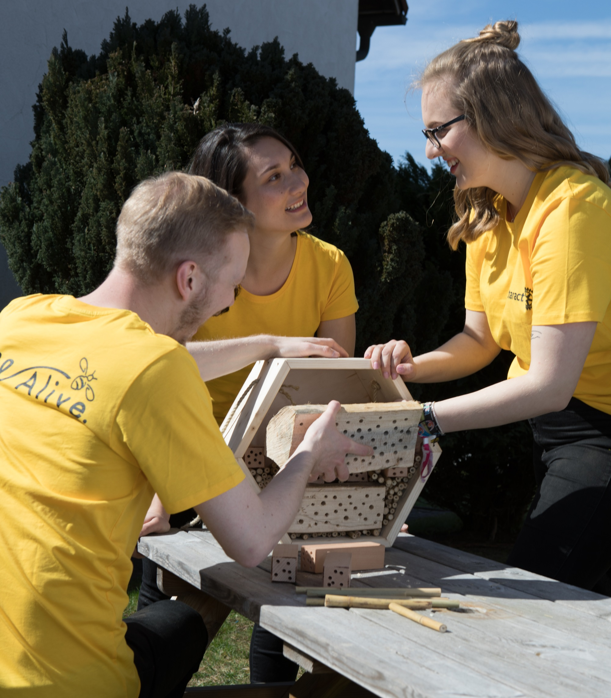
GLOBAL GRANT ELIGIBILITY: GOAL #6
Supporting education to promote behaviors that protect the environment
Notes:
Goal #6 is supporting education to promote behaviors that protect the environment.
Eligible activities for this goal include:
Supporting environmental education programming in schools that aligns with local government curriculum (adhering to the policy statements and guidelines for the basic education and literacy area of focus)
Promoting community-based environmental education, environmental awareness and advocacy initiatives, and strategies to facilitate engagement and behavior change to support environmentally sustainable living, environmental protection, and sustainable development

Slide 12

GLOBAL GRANT ELIGIBILITY: GOAL #7
Advocating for the sustainable consumption of products and the environmentally sound management of byproducts to build a more resource-efficient economy
Notes:
Goal #7 is advocating for the sustainable consumption of products and the environmentally sound management of byproducts to build a more resource-efficient economy.
Eligible activities for this goal include:
Supporting community planning efforts to strengthen circular economies through composting, recycling, upcycling, and repurposing programs (for solid waste management projects, adhering to the policy statements and guidelines for the water, sanitation, and hygiene area of focus)
Promoting efficient food consumption by reducing food waste by local businesses and households

Slide 13

GLOBAL GRANT ELIGIBILITY: GOAL #8
Addressing environmental justice issues and environmental public health concerns
Notes:
Goal #8 is addressing environmental justice issues and environmental public health concerns.
Eligible activities for this goal include:
Addressing adverse environmental public health impacts in communities through education, outreach, and advocacy
Eliminating and reducing exposure to environmental toxins in homes, schools, and communities within vulnerable and marginalized populations
Increasing equitable access to organic, healthy, and nutritious food for vulnerable and marginalized populations

Slide 14
Environment Community Assessments
What are currently the greatest environmental threats to local land, air, water resources, and the ecosystem?
List any cultural practices that are relevant to the project (such as agricultural techniques or traditions)
What positive and negative environmental changes do you anticipate as a result of the project?
Notes:
Community assessments in every area of focus has their own special considerations and the Environment is no exception. When completing a community assessment for an Environment project be certain to address these questions.
What are currently the greatest environmental threats to local land, air, water resources, and the ecosystem?
List any cultural practices that are relevant to the project (such as agricultural techniques or traditions)
What positive and negative environmental changes do you anticipate as a result of the project?

Slide 15
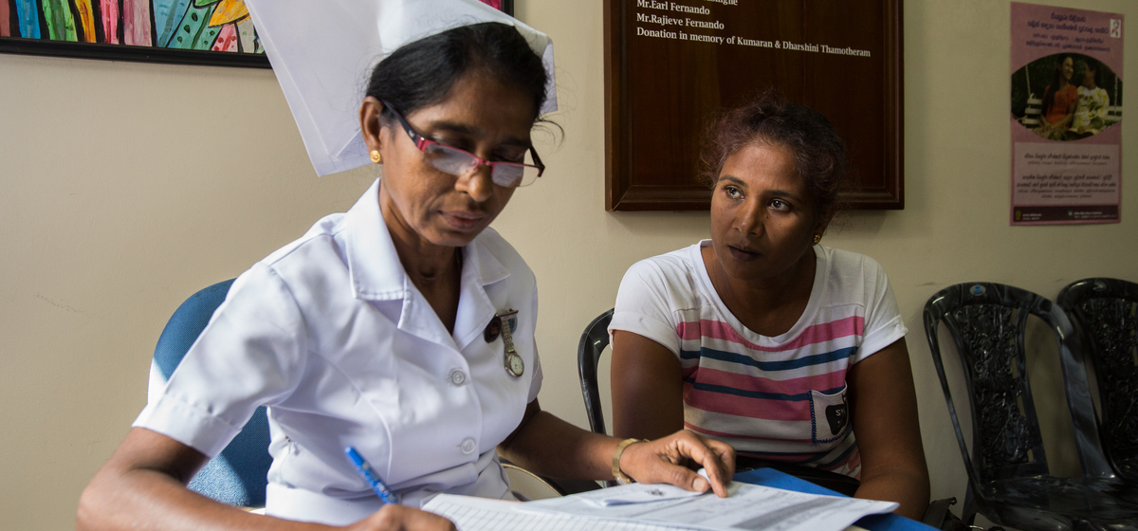
DISEASE Prevention & TREATMENT
Notes:
Now let's discuss the most popular area of focus for Rotarians, Disease Prevention and Treatment.

Slide 16


Global Grants (RY14-22)
$338.9 M total funding
4,754 grants
Rotary’s AOF
Reducing the causes and effects of disease and strengthening the health care system
Improving the capacity of local health care professionals
Promoting disease prevention and treatment programs that limit the spread of communicable diseases and reduce the incidence and effect of noncommunicable diseases
Strengthening health care systems
Providing clinical treatment and rehabilitation for physical disabilities
Funding graduate scholarships for career-minded professionals related to disease prevention and treatment
Notes:
Reducing the causes and effects of disease and strengthening the health care system
Improving the capacity of local health care professionals
Promoting disease prevention and treatment programs that limit the spread of communicable diseases and reduce the incidence and effect of noncommunicable diseases
Strengthening health care systems
Providing clinical treatment and rehabilitation for physical disabilities
Funding graduate scholarships for career-minded professionals related to disease prevention and treatment

Slide 17
Popular DPT Project Types
Medical Equipment / Ambulances
Targeted awareness campaigns on disease prevention and early detection
Cataract Surgeries, Heart Surgeries
Notes:
Medical Equipment
Use local, state, and national data to gather information about the health conditions in the community that the medical equipment will address
Is the equipment appropriate for the level of service currently offered in the health care facilities?
Does the Hospital or Clinic have staff capable of using and maintaining the equipment?
Is the space ready to receive the equipment?
Surgeries
Use local, state, and national data to gather information about the health conditions the surgeries will address.
Does the hospital already have a waiting list? Should be an identified pool of beneficiaries at the time of application
Should cover the whole cost of the surgery and provide follow up care
Vaccines
Consult with local health authorities to provide the existing vaccination schedule and assess the gaps in vaccination coverage.
Hospital or clinic must receive and administer and take responsibility.

Slide 18
WATER, SANITATION & HYGIENE

Slide 19
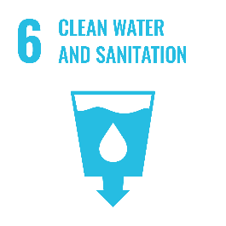

Global Grants (RY14-22)
$167.8 M total funding
2,355 grants
Rotary’s AOF
Increasing sustainable access to water, sanitation and hygiene
Facilitating universal and equitable access to safe and affordable drinking water and improving water quality by protecting and maintaining surface- and groundwater resources, and promoting wastewater reuse
Facilitating universal and equitable access to improved sanitation and waste management services
Improving community hygiene knowledge, behaviors, and practices
Strengthening the capacity of governments, institutions, and communities to develop, finance, manage, and maintain sustainable water and sanitation services
Funding graduate scholarships for career-minded professionals related to water, sanitation, and hygiene
Notes:
Increasing sustainable access to water, sanitation and hygiene
Facilitating universal and equitable access to safe and affordable drinking water and improving water quality by protecting and maintaining surface- and groundwater resources, and promoting wastewater reuse
Facilitating universal and equitable access to improved sanitation and waste management services
Improving community hygiene knowledge, behaviors, and practices
Strengthening the capacity of governments, institutions, and communities to develop, finance, manage, and maintain sustainable water and sanitation services
Funding graduate scholarships for career-minded professionals related to water, sanitation, and hygiene

Slide 20
Popular WASH Project Types
WASH in Schools
Water Supply, Treatment, and Purification
Sanitation - Toilets
Notes:
Operations and Maintenance plan & Financial sustainability plan
WASH in schools
WASH is a system – holistic approach – current situation infrastructure/hygiene behaviors - behavior change – Student to Toilet Ratio
Water Supply
Does the supply meet the current and future demands? Is the technology choice appropriate to the location and water test results? If you are accessing groundwater, you will need a hydrological survey,
Sanitation
We see a lot of projects aimed at constructing toilets for individual houses in the village setting.
Don’t do shared toilets, not equitable nor very sustainable
Behavior change / open defecation
Include handwashing stations

Slide 21
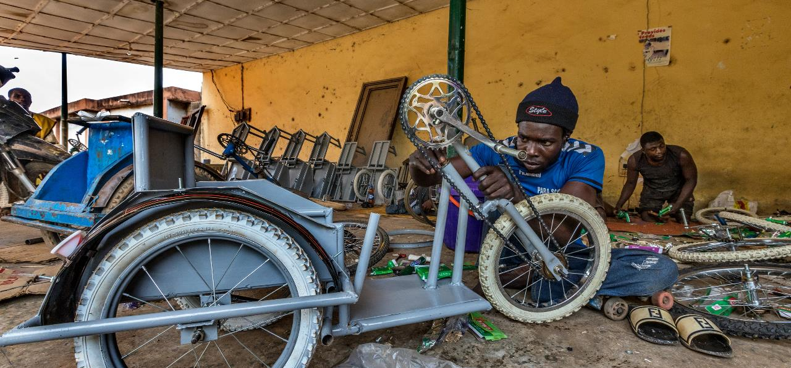
Community economic development

Slide 22
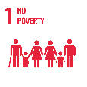



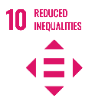
Global Grants (RY14-22)
$100.2 M total funding
1,637 grants
Rotary’s AOF
Alleviating poverty and creating measurable and enduring economic improvements in marginalized communities
Building the capacity of local leaders, organizations, and networks to support economic development in poor communities
Developing opportunities for productive work and improving access to sustainable livelihoods
Building the capacity of entrepreneurs, social businesses, and locally supported business innovators
Funding graduate scholarships for career-minded professionals related to Community Economic Development
Notes:
Alleviating poverty and creating measurable and enduring economic improvements in marginalized communities
Building the capacity of local leaders, organizations, and networks to support economic development in poor communities
Developing opportunities for productive work and improving access to sustainable livelihoods
Building the capacity of entrepreneurs, social businesses, and locally supported business innovators
Funding graduate scholarships for career-minded professionals related to Community Economic Development

Slide 23
Popular CED Project Types
Vocational Training
Agriculture
Social Enterprises
Notes:
Vocational Training 2 types, directly funding training for individuals or supporting an existing vocational training organization with program enhancement, more students or better quality training. Market survey to show the demand for these skills. Interest in the training from beneficiaries. Start their own business or job placement
Wide range of Agriculture projects
Capacity-building training is required. The goal should be to increase farmers’ income in the long term. Explain the gaps in skills, knowledge, and resources, and explain why the project improves the existing system. Supporting or creating farmers’ cooperatives and market access.
Social Enterprises
Business plan – what is the ownership structure going to be? Training to build capacity in business management

Slide 24
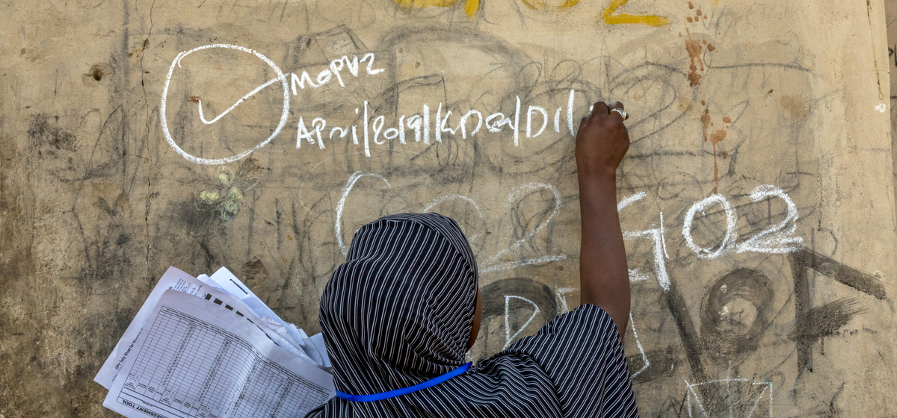
BASIC EDUCATION & LITERACY

Slide 25


Global Grants (RY14-22)
$86.3 M total funding
1,350 grants
Rotary’s Area of Focus
Improving sustainable access to basic education & literacy for all people
Strengthening the abilities of communities to provide basic education & literacy to all
Increasing adult literacy
Reducing gender disparity in education
Funding graduate scholarships for career-minded professionals related to basic education and literacy
Notes:
Improving sustainable access to basic education & literacy for all people
Strengthening the abilities of communities to provide basic education & literacy to all
Increasing adult literacy
Reducing gender disparity in education
Funding graduate scholarships for career-minded professionals related to basic education and literacy

Slide 26
Popular BEL Project Types
Technology and Infrastructure Improvements for Schools
Language training
After School Tutoring Programs
Notes:
BEL projects should focus on specific educational outcomes in Basic education, reading, writing, math and science.
Global grants can fund computer labs and infrastructure improvements, but the ultimate goal of the project must be improving educational outcomes. This means talking to teachers about where they would like to see improvement for their students academically and what type of professional development training, they feel will help them achieve those goals.
Some things to keep in mind:
Assessment: baseline understanding of teachers’ computer knowledge and how to use technology to support instruction
Teacher training that specifies how teachers will use the technology and integrate it into the curriculum, lesson planning, instruction, or their evaluations.
Training: methodology, IT professionals not qualified trainers (unless have ed qualifications)
Technology maintenance plan required
Language training
Language projects can be implemented at schools if the school requires those language courses as part of a curriculum mandated by the national department of education.
A plan to train teachers in how to teach the language
After School Tutoring Programs
Tutoring programs can have a significant impact on students’ learning achievements, especially when the programs are staffed with qualified tutors. The primary goal of a grant-funded program needs to be improving academic performance. We will also be looking for professional development training for the tutors.

Slide 27
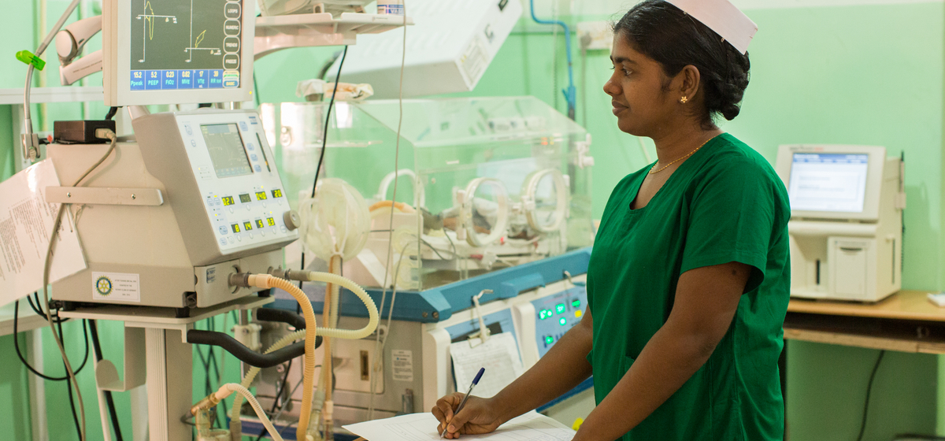
MATERNAL & CHILD HEALTH

Slide 28

Global Grants (RY14-22)
$64.2 M total funding
864 grants
Rotary’s AOF
Improving maternal health and reducing mortality for children under five.
Reducing the neonatal and newborn mortality rate
Reducing the mortality and morbidity rate of children under five
Reducing the maternal mortality and morbidity rate
Improving access to essential medical services, trained community health workers, and health care providers
Funding graduate scholarships for career-minded professionals related to maternal and child health
Notes:
Improving maternal health and reducing mortality for children under five.
Reducing the neonatal and newborn mortality rate
Reducing the mortality and morbidity rate of children under five
Reducing the maternal mortality and morbidity rate
Improving access to essential medical services, trained community health workers, and health care providers
Funding graduate scholarships for career-minded professionals related to maternal and child health

Slide 29
Popular MCH Project Types
Medical Equipment /Ambulances
Neonatal Intensive Care Units (NICU)
Hospital or Clinic supported Milk Banks
Notes:
Medical Equipment
Use local, state, and national data to gather information about the health conditions in the community that the medical equipment will address
Is the equipment appropriate for the level of service currently offered in the health care facilities?
Does the Hospital or Clinic have staff capable of using and maintaining the equipment?
Is the space ready to receive the equipment?
All Maternal and child health medical equipment projects must include educational activities at the hospital for women related to a healthy pregnancy, delivery, or neonatal care. This model of care is standard in most hospitals and is likely already part of the services that the hospital provides. Please describe the current educational programs the hospital provides for mothers.

Slide 30
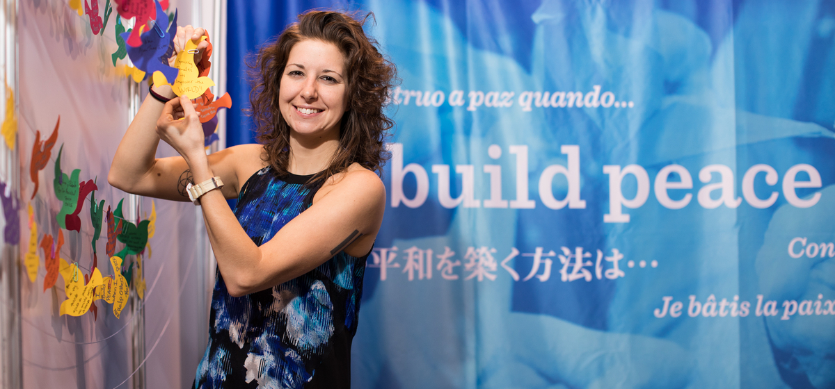
PEACEbuilding & conflict prevention

Slide 31


Global Grants (RY14-22)
$33.2 M total funding
708 grants
Rotary’s AOF
Advancing peacebuilding and preventing conflict
Enhancing the capacity of individuals and communities to transform conflict and build peace
Training community members in peace education, peace leadership, and conflict prevention and resolution
Providing services that help integrate vulnerable populations into society
Improving dialogue and community relations to determine how best to manage natural resources
Funding graduate scholarships for career-minded professionals related to peacebuilding and conflict prevention
Notes:
Advancing peacebuilding and preventing conflict
Enhancing the capacity of individuals and communities to transform conflict and build peace
Training community members in peace education, peace leadership, and conflict prevention and resolution
Providing services that help integrate vulnerable populations into society
Improving dialogue and community relations to determine how best to manage natural resources
Funding graduate scholarships for career-minded professionals related to peacebuilding and conflict prevention

Slide 32
Popular PCP Project Types
Integrating Vulnerable Populations
Conferences and Workshops
Preventing Violence Among Youths
Notes:
Integrating Vulnerable Populations
Rotary considers vulnerable populations to be people who have experienced violence or who are at risk of perpetrating violence. This could include at-risk young people, refugees, people who have been trafficked, communities that have been persecuted or marginalized, or other groups affected by conflict or violence. Projects to help these groups of people further integrate into society can include legal, psychological, social, and rehabilitation services. These projects have traditionally been implemented through partner organizations that provide training, support, and other direct services.
Conferences and Workshops
We support members organizing conferences or workshops that train non-Rotary members in the community about peacebuilding and conflict prevention.
Collaborate with respected local organizations and experts
Preventing violence among youths
Youth projects can include after-school programs, youth camps, and other programs that incorporate a curriculum of nonviolence or peacebuilding.

Slide 33
AREA OF FOCUS GUIDELINES
Notes:
Just to remind you, all this information about community assessments, sustainability and eligibility is available in the Area of Focus Guidelines for Global Grant Funding resources located on My Rotary.

Slide 34
QUESTIONS

